Slide 1
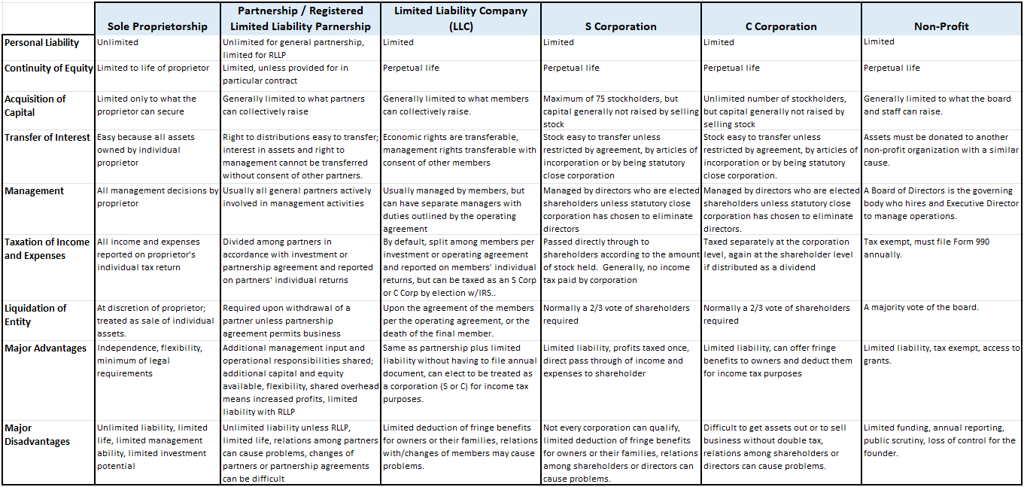
Legal/Business Structures Comparison

Slide 2
Understanding When to Use LLC in Your Business Name
https://www.incfile.com/blog/post/when-to-use-llc-with-business-name
The right business name can make a big difference to your success. A great name can support your business mission, grab attention and tell people what you do. If you’re starting a Limited Liability Company, then you have even more of an advantage. Those three letters — “LLC” — can do a lot of heavy lifting when it comes to building trust and showing you’re serious about business.
LLCs are popular, too. According to Berkman Solutions, forming LLCs has increased from 2.3 million a year in 1985 to over 8 million a year now. Over a five-year period, the IRS saw a 20 percent growth in the formation of LLCs.
Before we get into when you can and should use LLC in the name of your business, let’s explore some of the basics.

Slide 3
Understanding When to Use LLC in Your Business Name
https://www.incfile.com/blog/post/when-to-use-llc-with-business-name
What It Means to Have an LLC
An LLC at the end of your company name means you’re telling the world that you’re a Limited Liability Company, but what does that mean in practice?
Liability protection: Assets and liabilities of the LLC are distinct from those of the owner
Easy to run: Minimal administration and overhead compared to a corporation
Separate finances: LLCs have their own profit, loss, bank account and balance sheet
Simple taxation: Profits “pass-through” to the owner’s tax return and are taxed there
Increase credibility: An LLC helps clients and business partners take you more seriously
There are two main reasons to include LLC in your business name:
It tells everyone that the business is separate from you. This is important to maintaining your LLC as a “separate legal entity,” which is what protects your personal assets from your business liabilities.
It builds credibility in your company. It tells customers, partners, suppliers and others that you have gone through the time and effort of registering your business as an LLC. This helps to build trust that you’ll apply the same kind of oversight to your business dealings.

Slide 4
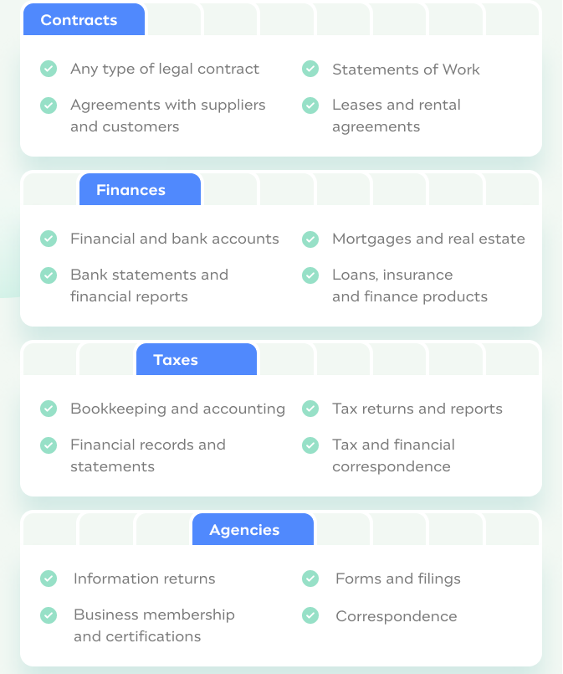
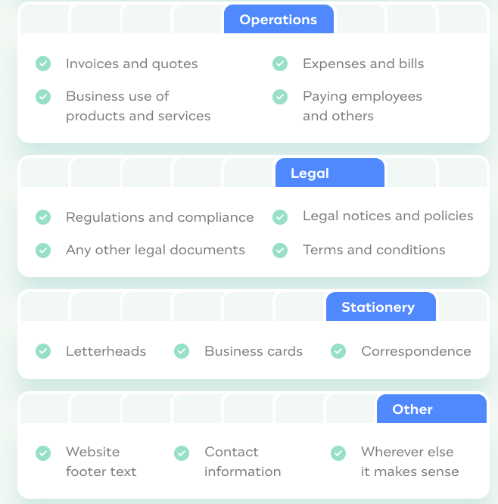
Always Use LLC at End of Your Business Name With…
https://www.incfile.com/blog/post/when-to-use-llc-with-business-name

Slide 5
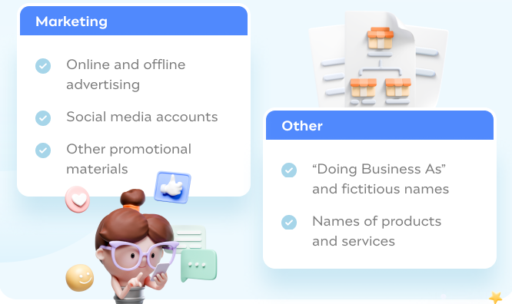
LLC Not Needed at End of Your Business Name With…
Check with your state’s rules, but in most cases, you don’t need to use “LLC” for the following types of content.
https://www.incfile.com/blog/post/when-to-use-llc-with-business-name

Slide 6
Using LLC at End of Your Business Name …
When to Use LLC in Your Business Name for All Types of Legal, Financial and Similar Documents
If you create, share, sign or are otherwise involved with official documentation as a business, you should always use the LLC as part of your business name. This applies to:
Contracts and agreements: Contracts, agreements, leases and other documents that you sign on behalf of your business
Finances and accounts: Financial reports, bank statements, financial account opening and management and other official records
Bookkeeping and taxes: Accountancy, tax correspondence, tax returns, IRS and state tax filings
Communications with official bodies: Information returns, forms, filings and any other official documents or memberships
Quotes, bills, expenses and invoices: Any documents dealing with financial transactions
Business cards, websites and stationery: Anything with your official business name printed on it, online or off
Legal notices, terms of use, privacy policies: On your website, communications with customers and official bodies or elsewhere
Signing up for products and services: Taking on business offerings from other individuals or organizations
This isn’t an exclusive list. Generally, you should use the LLC designator whenever it seems reasonable to do so. It tells everyone that you’re business is a separate legal entity and can avoid issues later on.
Other Common Abbreviations for Limited Liability Company
The exact wording of “LLC” depends on the state you form your business in. While “LLC” is the most common abbreviation, you may find “Limited Liability Co.,” “Limited” or "L.L.C." to be used in some states..
You Generally Don’t Need to Use LLC in Your Business Name for Marketing and Promotion
Whether it’s because “LLC” doesn’t fit in your logo design or adding it to your promotional materials may feel like a little much, we have some good news. You typically don’t need to include the letters “LLC” in your marketing materials. We do recommend checking the official rules with your state’s business formation agency, but in most cases, advertising doesn’t need to declare you’re an LLC.
This means you can avoid including “LLC” in your logo, domain name, social media pages or other marketing collateral.
“Doing Business As” and Fictitious Names
Once you have formed your LLC, you can choose to register a DBA name (doing business as), which is also called a “fictitious" or "assumed” business name. You can file for a DBA and not use “LLC” in the title. For example, your legal LLC name could be "Taylor Brothers LLC" and your DBA is "Taylor Coffee." This is a legal way around including “LLC”; however, since it does vary by state, research the state-by-states rules and requirements for this first.
When Should “LLC” Be Used?
Use LLC at the end of your business name whenever you are signing or completing official documentation. Generally, err on the side of using “LLC” in your business name unless you are creating promotional or marketing materials.
https://www.incfile.com/blog/post/when-to-use-llc-with-business-name

