Slide 1
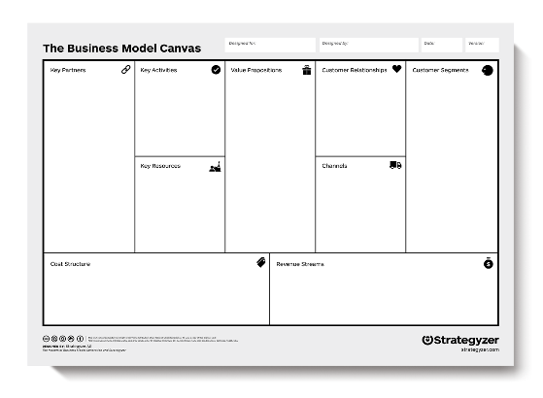
An Easier Way to Prepare Your Business Plan
The Business Model Canvas

Slide 2
Business Model Canvas Workshop Agenda
The importance of business planning
The Business Model Canvas vs. a traditional business plan
The 9 Key Elements of the Business Model Canvas
An example showing how to use the Business Model Canvas
Questions & Answers
Notes:
1. Why use the business model canvas vs. a traditional business plan 2. The 9 key elements that make up the canvas 3. How the Business Model can be used in your planning 4. Tips and strategies for using the business model canvas 5. How to create value and build a new business with the BMC3

Slide 3

Why do I need a business plan… some sobering numbers
Business Start Up Failure Rates¹:
21.5% of startups fail in the first year
30% in the second year
50% in the fifth year
Notes:
https://www.investopedia.com/articles/personal-finance/040915/how-many-startups-fail-and-why.asp

Slide 4
What is a business plan?
Definition¹:
A company's plan for making a profit.
It describes the products or services the business will sell; the intended target market; the value proposition; and the anticipated revenue/expenses.
It details the key drivers that will make the business successful.
It can be a lot of work….but the Business Model Canvas can help.

Slide 5
Business Model Canvas
Finding the path to success
Notes:
Using a business model canvas is all about helping you create your path to success for your business start up or current business

Slide 6
Business Model Canvas – A Preliminary Business Plan
Test and validate your business idea and value proposition
Helps identify issues and barriers
Helps answer important questions before risking time and money
One page plan: easy to understand, easy to communicate
Work can go into a traditional business plan
Notes:
Really helps with early-stage businesses modeling.
Maybe have an idea, but haven’t talked to anyone or know the market and think there could be a need, but not sure.
It is a process to help you determine if you might be successful, no it isn’t a guarantee, but used by thousands of companies around the globe and it is much better than shooting at a target in the dark….
“Create and validate the “value proposition”.
Why would customer buy from you, what problems does it solve for customer, what is value, how are you different?
Initial step to help you think through and validate the “moving parts” of your idea.

Slide 7
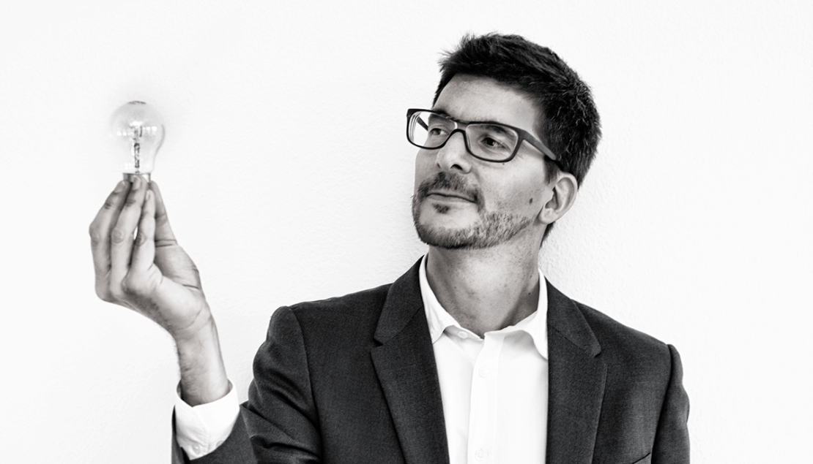
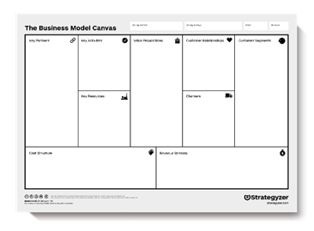

What is the Business Model Canvas?
Created by Alexander Osterwalder Strategizer.com
It’s a visual chart that that answers three questions:
Desirability - Do customers want it?
Feasibility - Can we build it?
Viability – Can we make money?
Notes:
Alexander Osterwalder (born 1974) is a Swiss business theorist,^{[1]} author, speaker, consultant, and entrepreneur, known for his work on business modeling^{[2]} and the development of the Business Model Canvas in mid 2000s.^{[3]}

Slide 8
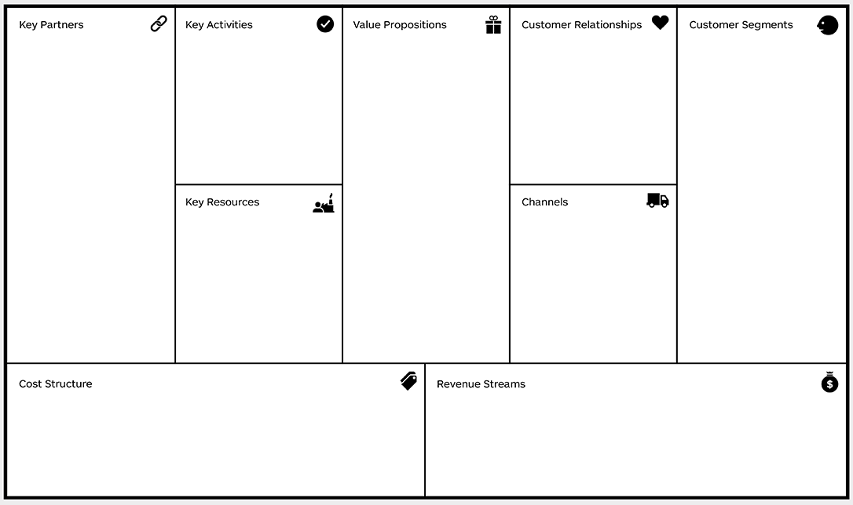
Business Model Canvas Components
Customer Segments
Value Proposition
Channels
Customer Relationships
Revenue Streams
Key Resources
Key Activities
Key Partnerships
Cost Structure

Slide 9
The big picture - question #1:
Desirability
Do they want it?
Notes:
Do your potential customers want what you are selling, and more importantly, what are they willing to pay you for your product/service?

Slide 10
The big picture - question #2:
Feasibility
Can you build it?
Notes:
What big hurdles and roadblocks need to be over come in order to deliver your product and service?
Importantly, which ones will you do yourself and which ones will you outsource?

Slide 11
The big picture - question #3:
Viability
Can you make money?
Notes:
How does your business earn money? Where does the money come from? What you are trying to figure out is what strategy are you going to use to capture the most value from your customers. The means and sources that the business gets income from. These are the different ways that an organization would use to get revenue. Examples could be advertising, asset sale, subscription fees and renting. Give away product for free??

Slide 12
The big picture - question #1:
Desirability
Do they want it?
Notes:
Do your potential customers want what you are selling, and more importantly, what are they willing to pay you for your product/service?

Slide 13
1. Customer Segments
Understand your major customer targets
Determine what they need/want
Guiding questions
Who are your important customers?
What benefits will they accrue from your business?
Notes:
Customer Segments answers the question Who are your customers? Remember, your customers don't exist to serve you, you exist to serve their needs. This refers to the market which the service or product is offered to. A customer segment is that part of the market targeted by the organization. In any business model, customers are at the center of the business. There is a need to classify these customers, identify their needs and satisfy the customers for the business to survive. There are different customer segments which include based on different market characteristics.

Slide 14
1. Customer Segments
Uber Business Model
Understand your major customer targets
Determine what they need/want
Guiding questions
Who are your important customers?
What benefits will they accrue from your business?
Passengers
Do not own car
Travel for business
Convenient service
Drivers
Car owners looking for extra income
Car owners looking for a flexible work environment
Notes:
Customer Segments answers the question Who are your customers? Remember, your customers don't exist to serve you, you exist to serve their needs. This refers to the market which the service or product is offered to. A customer segment is that part of the market targeted by the organization. In any business model, customers are at the center of the business. There is a need to classify these customers, identify their needs and satisfy the customers for the business to survive. There are different customer segments which include based on different market characteristics.

Slide 15
2. Value Proposition
Describe the value you deliver to each customer segment
Explain why they will buy from you
Guiding questions
Why will customers buy from your business?
What makes you unique?
What value do you deliver?
Notes:
Answers question: Why do customers buy from you? What is the gain that you provide or the need you satisfy? What value do you deliver to each segment. These are the different products and services which the business offers and which create value in each of the customer segments. Value proposition enables the customers to go for the product or service that is being offered as compared to the others. It is the one that attracts the customers and which makes the customers return. Some of the characteristics of value proposition include the newness, customization, uniqueness, and quality of the product or service. Price, design, brand, and accessibility are some of the key attributes of a value proposition.

Slide 16
2. Value Proposition
Uber Business Model
Describe the value you deliver to each customer segment
Explain why they buy from you
Guiding questions
Why do customers buy from your business?
What makes you unique?
What value do you deliver?
Passengers
Makes it easy to get a ride when I need it
Drivers
Allows me to be my own boss and work when I want
Notes:
Answers question: Why do customers buy from you? What is the gain that you provide or the need you satisfy? What value do you deliver to each segment. These are the different products and services which the business offers and which create value in each of the customer segments. Value proposition enables the customers to go for the product or service that is being offered as compared to the others. It is the one that attracts the customers and which makes the customers return. Some of the characteristics of value proposition include the newness, customization, uniqueness, and quality of the product or service. Price, design, brand, and accessibility are some of the key attributes of a value proposition.

Slide 17
2. Value Proposition
Uber Business Model
Describe the value you deliver to each customer segment
Explain why they buy from you
Guiding questions
Why do customers buy from your business?
What makes you unique?
What value do you deliver?
Passengers
One tap ordering
Real-time tracking
Accurate ETA
Cashless payment
Drivers
Income
Ease of joining
Flexible schedule
Instant customers
Online payment
Notes:
Answers question: Why do customers buy from you? What is the gain that you provide or the need you satisfy? What value do you deliver to each segment. These are the different products and services which the business offers and which create value in each of the customer segments. Value proposition enables the customers to go for the product or service that is being offered as compared to the others. It is the one that attracts the customers and which makes the customers return. Some of the characteristics of value proposition include the newness, customization, uniqueness, and quality of the product or service. Price, design, brand, and accessibility are some of the key attributes of a value proposition. Ultimately Problem/Solution fit needs to be addressed and then product/market fit

Slide 18
3. Customer Relationships
Describe how you get, keep, and grow your customers
Explain how you motivate and impress customers
Guiding questions
What type of relationship does each customer segment expect you to establish and maintain with them?
What incentives and rewards are available for customers?
Notes:
This involves all the activities that are undertaken to motivate and impress customers. Different market segments have different relations which the business should identify and maintain. To answer this question, you need to walk through the customer journey. Pre-purchase, purchase/use, post purchase.

Slide 19
3. Customer Relationships
Uber Business Model
Describe how you get, keep, and grow your customers
Explain how you motivate and impress customers
Guiding questions
What type of relationship does each customer segment expect you to establish and maintain with them?
What incentives and rewards are available for customers?
?
Self service
On demand
Ease of use
Responsive
Transparent/Ratings
Notes:
This involves all the activities that are undertaken to motivate and impress customers. Different market segments have different relations which the business should identify and maintain. To answer this question, you need to walk through the customer journey. Pre-purchase, purchase/use, post purchase.

Slide 20
4. Channels
Describe how you reach your target customers
Explain how they become aware of your product/service
Guiding questions
What channels are used to reach customers?
What channels perform the best?
What alternatives are available?
Notes:
How are your products or services delivered to the customer? How do people want to be reached or how can your reach them. These are the means by which the goods and services reach customers. Recently modern technologies have been used to easily and effectively reach customers. Distributors or own sales force

Slide 21
4. Channels
Uber Business Model
Describe how you reach your target customers
Explain how they become aware of your product/service
Guiding questions
What channels are used to reach customers?
What channels perform the best?
What alternatives are available?
Mobile app
Social media
Word of mouth
Online advertising
Offline advertising
Notes:
How are your products or services delivered to the customer? How do people want to be reached or how can your reach them. These are the means by which the goods and services reach customers. Recently modern technologies have been used to easily and effectively reach customers. Distributors or own sales force

Slide 22
5. Revenue Streams
Describe where the money will come from
Explain how you capture value from your customers
Guiding questions
What are the main revenue sources?
What are customers willing to pay?
What can be done to increase income?
Notes:
How does your business earn money? Where does the money come from? What you are trying to figure out is what strategy are you going to use to capture the most value from your customers. The means and sources that the business gets income from. These are the different ways that an organization would use to get revenue. Examples could be advertising, asset sale, subscription fees and renting. Give away product for free??

Slide 23
5. Revenue Streams
Uber Business Model
Describe where the money will come from
Explain how you capture value from your customers
Guiding questions
What are the main revenue sources?
What are customers willing to pay?
What can be done to increase income?
Ride transaction fee
Surge pricing
License fees
Alternative streams: Uber eats
Notes:
How does your business earn money? Where does the money come from? What you are trying to figure out is what strategy are you going to use to capture the most value from your customers. The means and sources that the business gets income from. These are the different ways that an organization would use to get revenue. Examples could be advertising, asset sale, subscription fees and renting. Give away product for free??

Slide 24
The big picture - question #1:
Desirability
Do they want it?
Notes:
Do your potential customers want what you are selling, and more importantly, what are they willing to pay you for your product/service?

Slide 25
The big picture - question #2:
Feasibility
Can you build it?
Notes:
What big hurdles and roadblocks need to be over come in order to deliver your product and service?
Importantly, which ones will you do yourself and which ones will you outsource?

Slide 26
6. Key Activities
Describe the most important strategic things you must do to make business model work?
Explain what unique activities are crucial to success
Guiding questions
What are the main activities to deliver the value proposition?
Your channels?
Your customer relationships?
Your revenue streams?
Notes:
What unique strategic activities does your business perform to deliver your value proposition?
These are the major functions of the organization
Most likely do yourself or have a heavy investment in seeing being completed exactly the way you want.
These are key activities that a business engages in, to ensure survival in the market.

Slide 27
6. Key Activities
Uber Business Model
Describe the most important strategic things you must do to make business model work?
Explain what unique activities are crucial to success
Guiding questions
What are the main activities to deliver the value proposition?
Your channels?
Your customer relationships?
Your revenue streams?
Platform development
Hire drivers
Recruit customers
Customer support
Driver payout
Notes:
What unique strategic activities does your business perform to deliver your value proposition?
These are the major functions of the organization
Most likely do yourself or have a heavy investment in seeing being completed exactly the way you want.
These are key activities that a business engages in, to ensure survival in the market.

Slide 28
7. Key Resources
Describe your most important strategic assets
Explain what unique resources you have or need
Guiding questions
What are the main assets and resources needed to deliver the value proposition?
Your channels?
Your customer relationships?
Your revenue streams?
Notes:
What unique strategic resources do you have or need?
Key resources are the main utilities that the business has and uses to achieve customer satisfaction.
They include the equipment, pool of assets and other products that the business uses to ensure that there are production and service delivery.
Typically fall into 4 different categories. Physical, Intellectual, Human. Financial.

Slide 29
7. Key Resources
Uber Business Model
Describe your most important strategic assets
Explain what unique resources you have or need
Guiding questions
What are the main assets and resources needed to deliver the value proposition?
Your channels?
Your customer relationships?
Your revenue streams?
Technology infrastructure
Platform architecture - App
Data analysis and AI
Branding
Notes:
What unique strategic resources do you have or need?
Key resources are the main utilities that the business has and uses to achieve customer satisfaction.
They include the equipment, pool of assets and other products that the business uses to ensure that there are production and service delivery.
Typically fall into 4 different categories. Physical, Intellectual, Human. Financial.

Slide 30
8. Key Partners
Describe the activities that are important but will be outsourced
Explain what unique activities are crucial to success
Guiding questions
Which resources do you need from partners in the market?
Who are key partners?
Who are key suppliers?
What key activities do they perform?
Notes:
What non key activities can you outsource to enable you to focus more on your core activities. Includes all the key stakeholders that the business requires to be able to perform its activities. These may include manufacturers, suppliers and other businesses in the same category of other entities that a business can collaborate with. Optimization and economy, reduction of risk and uncertainty, acquisition of particular resources and activities

Slide 31
8. Key Partners
Uber Business Model
Describe the activities that are important but will be outsourced
Explain what unique activities are crucial to success
Guiding questions
Which resources do you need from partners in the market?
Who are key partners?
Who are key suppliers?
What key activities do they perform?
Investors / VCs
Google Maps
Amazon AWS
Technology partner
Payment processor
API providers
Drivers
Lobbyists
Notes:
What non key activities can you outsource to enable you to focus more on your core activities. Includes all the key stakeholders that the business requires to be able to perform its activities. These may include manufacturers, suppliers and other businesses in the same category of other entities that a business can collaborate with. Optimization and economy, reduction of risk and uncertainty, acquisition of particular resources and activities

Slide 32
9. Cost Structure
Describe the key costs and ensure they are aligned with your value proposition
Explain if your business is cost driven or value driven
Guiding questions
What are the business’ major cost drivers? How are they linked to revenue?
What are the main expenses for the business?
What resources are most expensive?
What activities are most expensive?
Notes:
What are the major costs incurred by your business. Describes all costs incurred to operate a business model. Should be aligned with your value proposition. Such costs include the costs incurred during the creation and delivery of value, enabling customer value and getting income. Fixed costs (salaries, rent, utilities), variable costs, economies of scale, economies of scope

Slide 33
9. Cost Structure
Uber Business Model
Describe the key costs and ensure they are aligned with your value proposition
Explain if your business is cost driven or value driven
Guiding questions
What are the business’ major cost drivers? How are they linked to revenue?
What are the main expenses for the business?
What resources are most expensive?
What activities are most expensive?
Driver payments and insurance
Technology development and maintenance
Sales and marketing
Employee salaries
Notes:
What are the major costs incurred by your business. Describes all costs incurred to operate a business model. Should be aligned with your value proposition. Such costs include the costs incurred during the creation and delivery of value, enabling customer value and getting income. Fixed costs (salaries, rent, utilities), variable costs, economies of scale, economies of scope

Slide 34
The big picture - question #3:
Viability
Can you make money?
Notes:
How does your business earn money? Where does the money come from? What you are trying to figure out is what strategy are you going to use to capture the most value from your customers. The means and sources that the business gets income from. These are the different ways that an organization would use to get revenue. Examples could be advertising, asset sale, subscription fees and renting. Give away product for free??

Slide 35
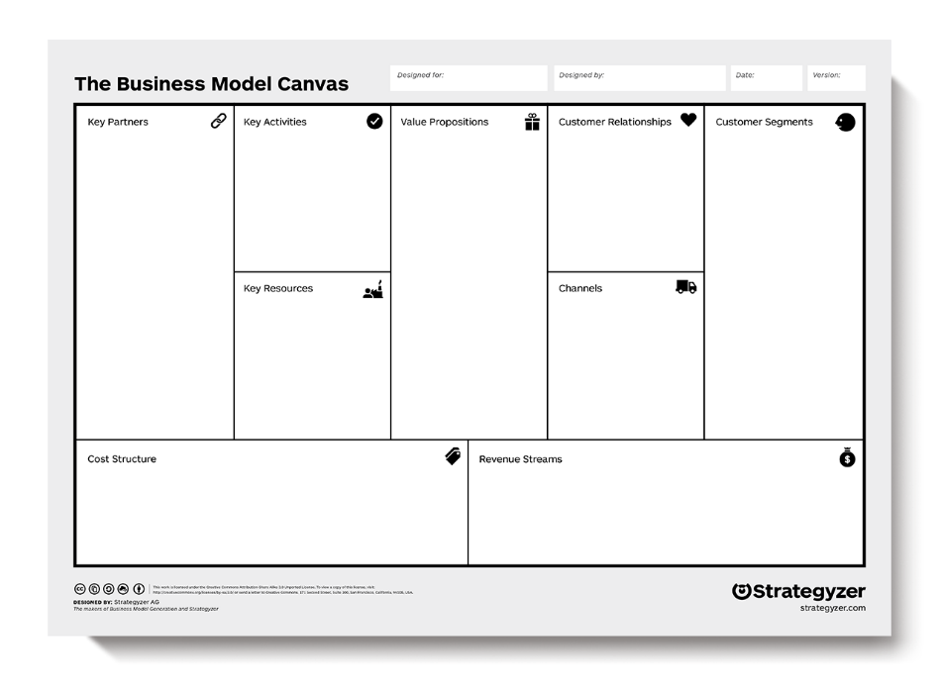
Business Model Canvas Summary
Business Model Canvas is a way to show the key elements of any business model on a single sheet of paper
The canvas has nine building blocks to help answer the three key questions
It will help you identify issues, barriers, and validate your business idea and value proposition
Notes:
It’s a canvas because you can paint what you want, but it gives you a process and common language to use that fits with a traditional business plan to help reduce risk and raise the potential that your business idea or new product/service will be successful.

Slide 36
Are you interested in using the business model canvas?
Online Resources:
Business Model Canvas (blank) - Link
Alexander Osterwilder BMC Training - Link
Strategyzer Training - Link
SCORE Self Paced Learning - Link
Request a SCORE Mentor:
Get free mentoring on your business idea
Go to memphis.score.org and click on “request a mentor”
Notes:
It’s a canvas because you can paint what you want, but it gives you a process and common language to use that fits with a traditional business plan to help reduce risk and raise the potential that your business idea or new product/service will be successful.

Slide 37
Questions & Answers

