Slide 1
SO YOU WANT TO START A BUSINESS
A GUIDE TO FIGURING OUT WHAT YOU DON’T KNOW
By Gary Robinson (Gary.Robinson@scorevolunteer.org)
SCORE MEMPHIS
Notes:
Testing, 1-2-3

Slide 2
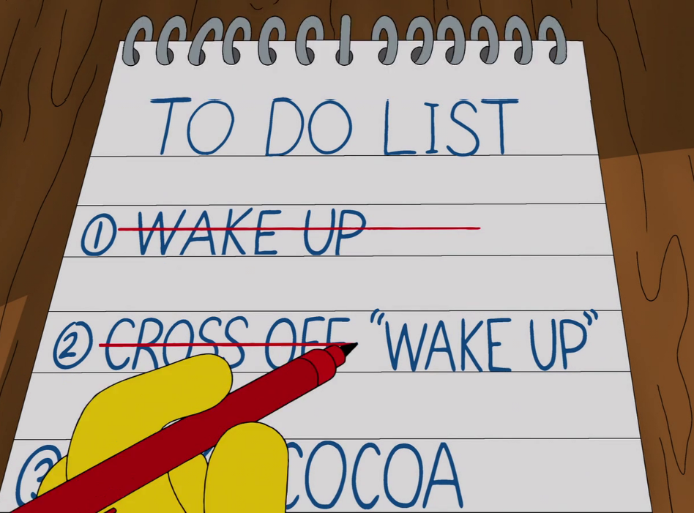
AGENDA
** STEP 1: THE IDEA
** STEP 2: THE PLAN
** STEP 3: BEFORE YOU OPEN
But first, a definition
What is a business owner?
Someone who jumps off a cliff and
invents the airplane on the way down.
This Photo by Unknown Author is licensed under CC BY-SA

Slide 3

WHAT EXACTLY ARE WE DOING HERE
Some basic questions:
What are you selling? Goods? Services? What is the customer’s problem you want to solve?
Who else is doing this?
How are you going to stand out in the market? What is your competitive advantage?
Is the market for your product growing? Shrinking? Is it stable?
How much of your product will a customer want to purchase?
Who is your ideal customer?

Slide 4

MORE QUESTIONS: THE BOTTOM LINE
** How much money will it take to start and run the business?
** How much money do you have now?
** How will you finance the balance?
** Can you support yourself during the early months?
** How will you set up the legal structure of your business?
** How will you advertise your business?

Slide 5
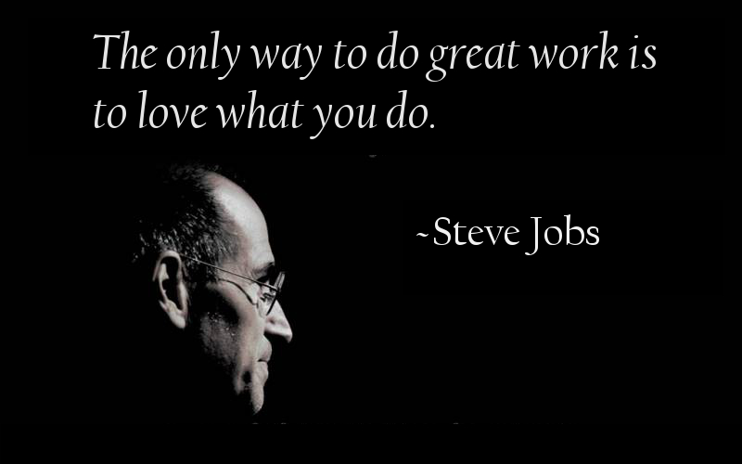
STEP 1: THE IDEA
WHAT IS YOUR MOTIVATION?
** Need a job, benefits, long-term security
** Have an idea or see an opportunity
** Family history/future
** Be my own boss
** Entrepreneurial spirit
EXPLORE MORE: 50 Reasons To Start Your Own Business
This Photo by Unknown Author is licensed under CC BY-SA-NC
Notes:
1. THIS IS GOING TO TAKE AWHILE. Doesn’t happen overnight. 2. Do you have experience? Can your idea be tested? Satisfaction factor is HIGH if you can make it work, but you have to have passion. 3. Do you want to employ family members or friends (TRICKY). A succession plan for future generations is nice, but first, you have to succeed. 4. Sounds great at first but it comes with baggage. You do whatever needs to be done. Discipline and commitment. Never far from work issues. Pay employees and THEN you. 5. High tolerance for risk? Security not a concern? Strong belief in skills?

Slide 6
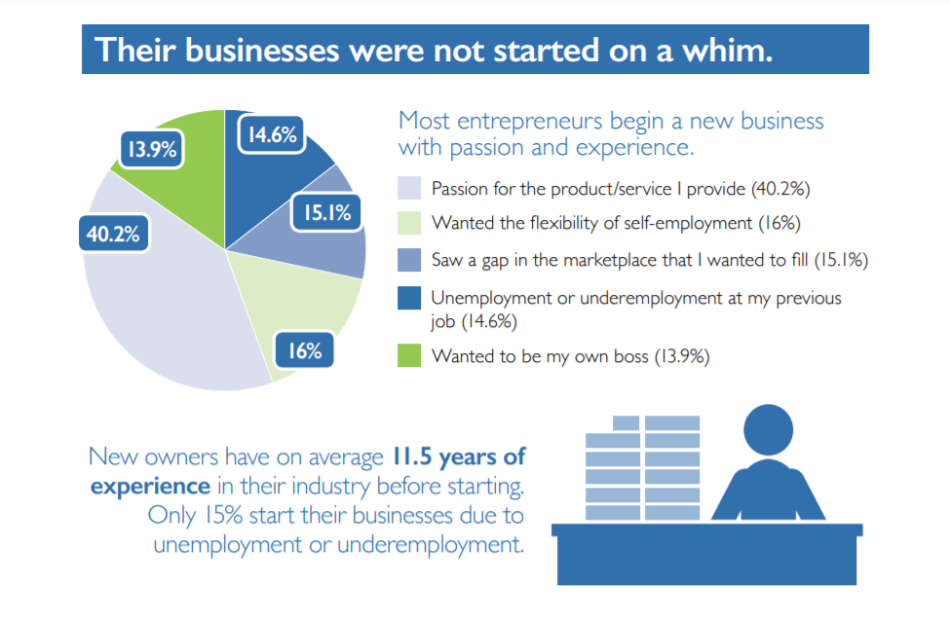
SURVEY SAYS
SCORE surveyed 1,000 new businesses about their experiences as a startup.
Here’s what we found:
Finding No. 1: Passion and experience
EXPLORE MORE: Megaphone of Main Street report

Slide 7
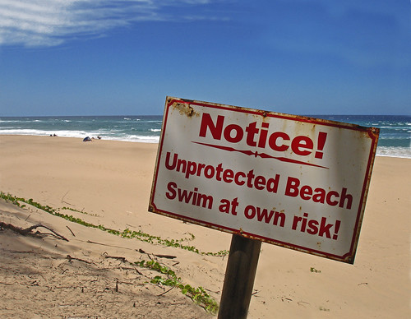
STEP 1: THE IDEA
RISKY BUSINESS
Risk is neither good nor bad. It’s just uncertainty.
Usually, the greater the risk, the greater the reward.
Three components of risk
** How much could I lose?
** How likely is it to happen?
** Can I insure against the loss?
This Photo by Unknown Author is licensed under CC BY-NC-ND

Slide 8
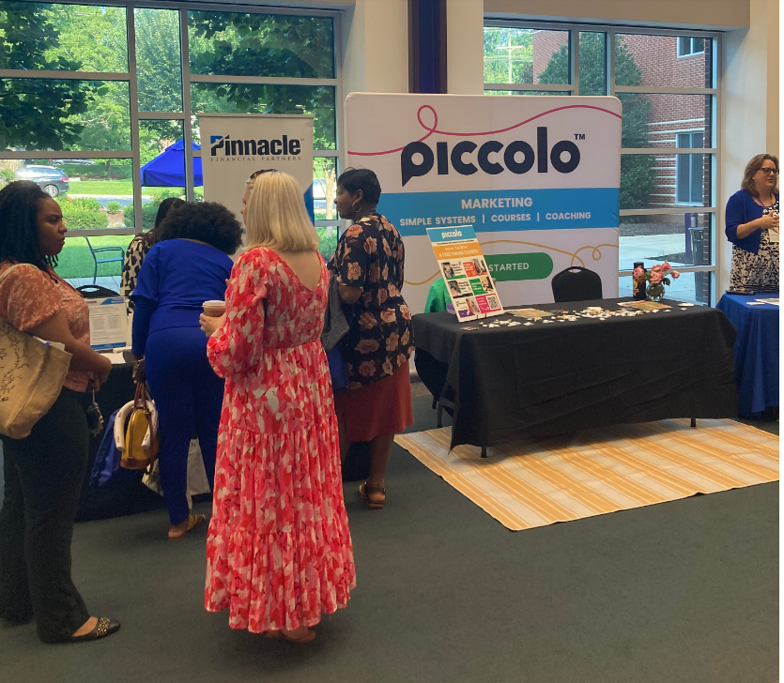
STEP 1: THE IDEA
WHAT SETS YOU APART FROM COMPETITION?
** Price point?
** Selection?
** Customer service?
(NOTE: Nobody starts out saying they’ll give WORSE customer service!)
If you can’t answer
DO NOT PASS GO, DO NOT COLLECT $200!
EXPLORE MORE: Setting Yourself Apart

Slide 9
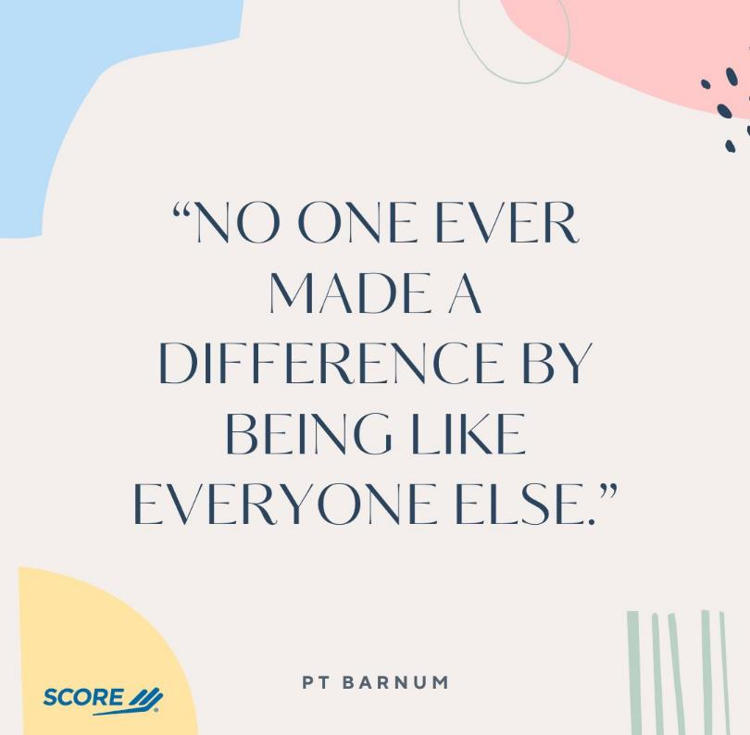
STEP 1: THE IDEA

Slide 10

STEP 1: THE IDEA
THE COMPETITION
** What makes THEM successful?
** What do they charge?
** What is their social media presence?
You’ve got to know them to beat them!
COMPARE YOUR IDEA
TO THEIR REALITY!

Slide 11

STEP 1: THE IDEA
WHO IS YOUR
TARGET AUDIENCE?
** Age factor?
** Gender factor?
** Ethnicity?
** Geography?
** Marital status?
** Parenting status?
** Household income?
IF YOU ANSWER “EVERYBODY,” YOU’LL ATTRACT
NOBODY
EXPLORE MORE: Target Market vs. Target Audience
This Photo by Unknown Author is licensed under CC BY-SA-NC

Slide 12

STEP 1: THE IDEA
WHO IS YOUR IDEAL CUSTOMER?
“As a < type of person >, I want <some goal > so that <some reason>.”
“As a concerned parent, I want my child to have every educational advantage. My child needs extra help tailored to him.”
EXPLORE MORE: Identify your ideal client

Slide 13

STEP 1: THE IDEA
YOUR WORK ETHIC
Are you willing to do the research and learn the how-to’s?
Ahhh, I’ll do that tomorrow. I’m going out with my friends tonight
=
Houston, we have a problem
You can’t have a million-dollar dream without a million-dollar work ethic!

Slide 14

STEP 1: THE IDEA
SHOW ME THE MONEY!
Do you have …
** Money to invest?
** A good credit rating? (680)
** Outside capital resources?
** Collateral to get a loan?
** Current income?
EXPLORE MORE: How to boost your credit score

Slide 15
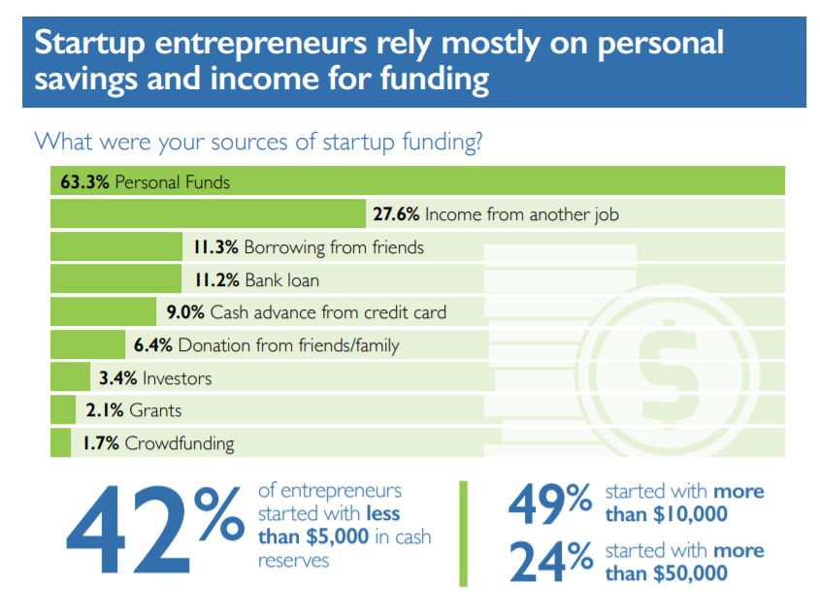
WHERE’S MY PIGGYBANK?
Finding No. 2: Funding usually starts at home
EXPLORE MORE: Megaphone of Main Street financing report

Slide 16

STEP 1: THE IDEA
TRUTH ABOUT GRANTS
Bad news: There aren’t many!
Good news: There are a few!
EXPLORE:
Inc.com: 31 Small-Business Grants for Women
Nerdwallet.com has some ideas
HelloAlice is another good one
Grants.gov should be checked
DISCLAIMER:
Grants are for programs, not for people.

Slide 17
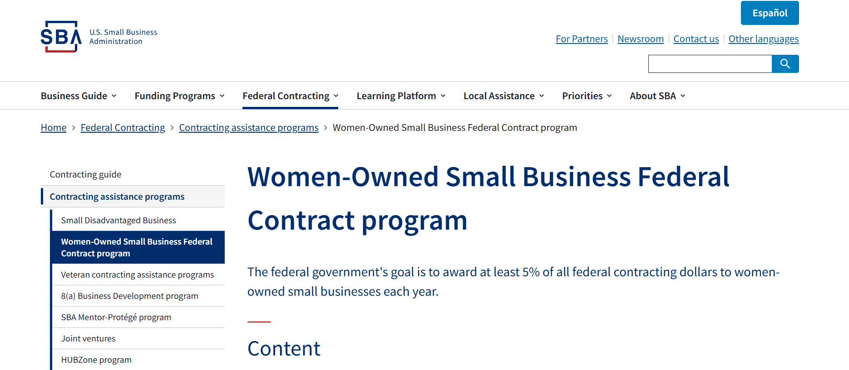
STEP 1: THE IDEA
GETTING SBA CERTIFIED
HUBZone: Helps historically underutilized business zones
8(a): Federal contracting and training program to help small business owners who are socially and economically disadvantaged.
Veteran-Owned Small Business: Allows to compete for government contracts.
Women-Owned Small Business: Allows to compete for government contracts.
Mississippi Certification Info

Slide 18
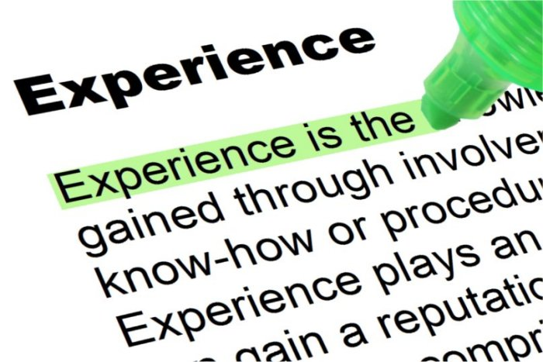
STEP 1: THE IDEA
WHAT DO YOU KNOW ABOUT IT ALREADY?
You want to open a restaurant. You have a great idea for a menu.
If I ask you about your restaurant experience and you say, “I’ve eaten in plenty,” that isn’t experience.
This Photo by Unknown Author is licensed under CC BY-SA-NC

Slide 19
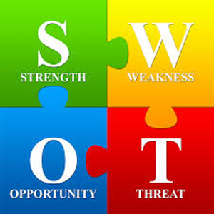
STEP 1: THE IDEA
THE SECRET OF SWOT
** STRENGTHS: What do your competitors do well? Can you copy that?
** WEAKNESSES: What do they do poorly? Can you avoid these?
** OPPORTUNITIES: What SHOULD they do? Can you do it?
** THREATS: What can they do to keep you from succeeding?
EXPLORE MORE: 48 Questions In Your SWOT Analysis
This Photo by Unknown Author is licensed under CC BY-NC-ND

Slide 20
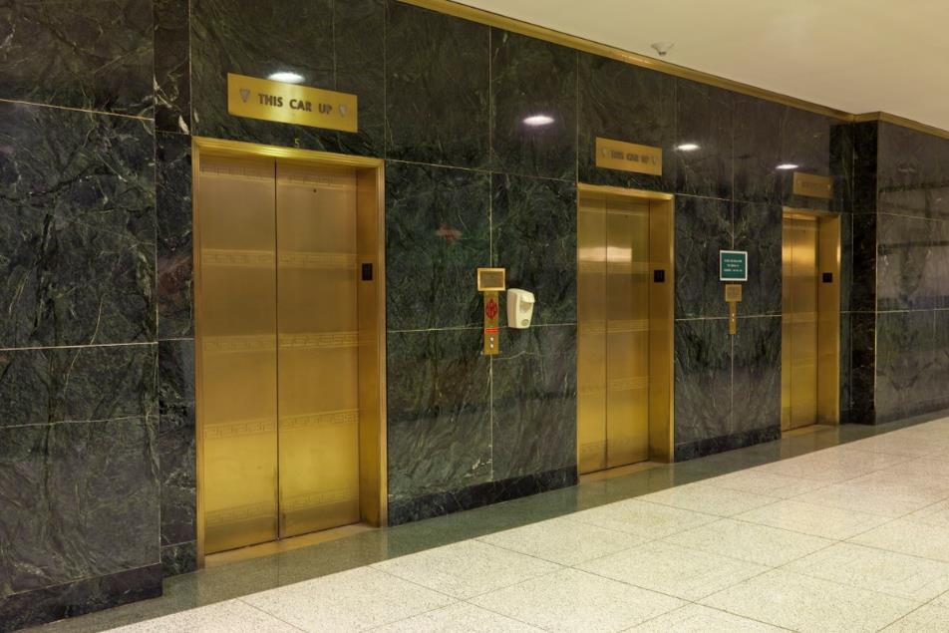
STEP 1: THE IDEA
YOUR ELEVATOR PITCH
(OR: Tell me what you’re doing)
You should be able to tell someone IN 30 SECONDS what your business is about.
If you can’t, you need to refocus.
EXPLORE MORE: Tips to Make an Elevator Pitch Great
This Photo by Unknown Author is licensed under CC BY-SA

Slide 21

STEP 1: THE IDEA
THE FINAL TEST
** Get a group of friends and/or family together.
** Pitch them your ideas.
** Show them your products.
** Ask them for their HONEST opinion. You don’t want them if they aren’t HONEST. Listen!!

Slide 22
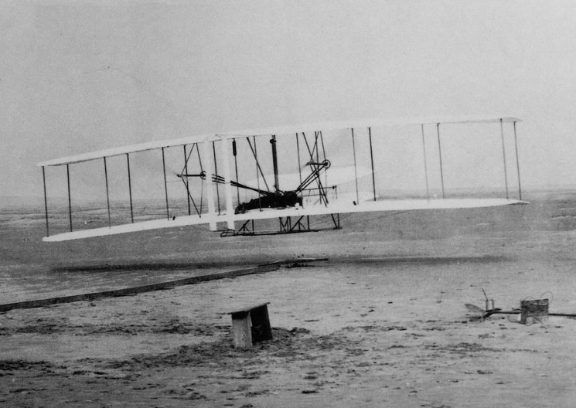
STEP 1: THE IDEA
Wilbur and Orville were two brothers named Wright,
A nicer pair of kids you’ve never seen.
They worked 12 years on a secret project.
They thought it was a washing machine.
I said, “Fellas, what are all those wings for?”
They said, “For hanging clothes out to dry.”
I said, “You fools, take that washing machine out to Kitty Hawk
“And see if the darned thing will fly!”

Slide 23
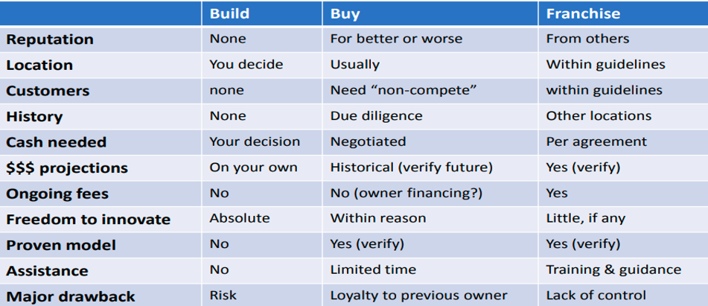
STEP 1: THE IDEA
OTHER CONSIDERATIONS
** Could you buy an existing business?
** Could you buy a franchise?
** Could you create a home-based business?
** Are you the sole owner or do you want/need partners?
EXPLORE MORE: Build or buy your business

Slide 24
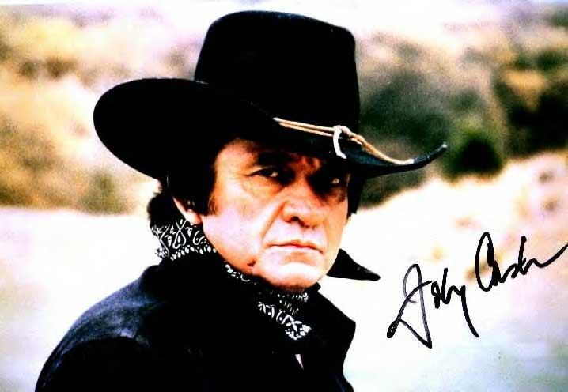
STEP 1: THE IDEA
WHAT’S IN A NAME?
Did these businesses think things through?
Sam and Ella’s Chicken Palace
Passmore Gas
Amigone Funeral Home
Stubbs Prosthetics and Orthotics
STD Contractors
Hindenburger
CONSIDER YOUR BUSINESS NAME FROM ALL ANGLES!
DOES SOMEONE ELSE HAVE YOUR BUSINESS NAME AS A WEBSITE?
EXPLORE MORE: Tips on Naming Your Business
This Photo by Unknown Author is licensed under CC BY-NC-ND

Slide 25
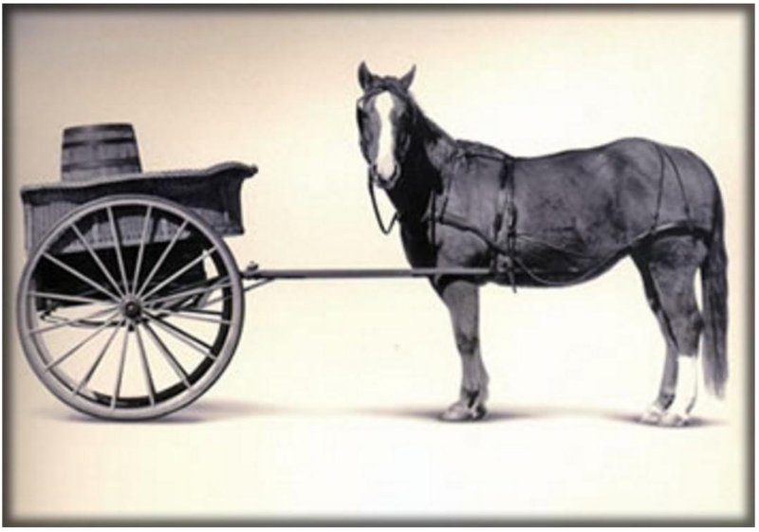
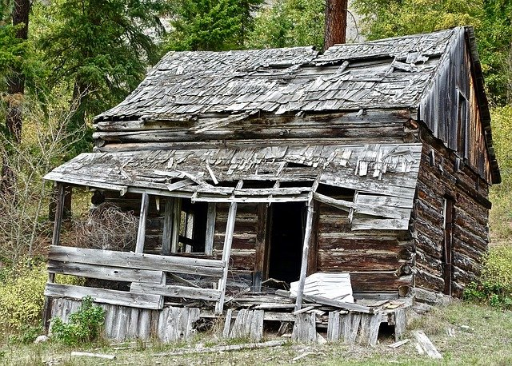
STEP 2: THE PLAN
This Photo by Unknown Author is licensed under CC BY-SA
Notes:
A great quote from Ben Franklin: BY FAILING TO PREPARE, YOU ARE PREPARING TO FAIL

Slide 26
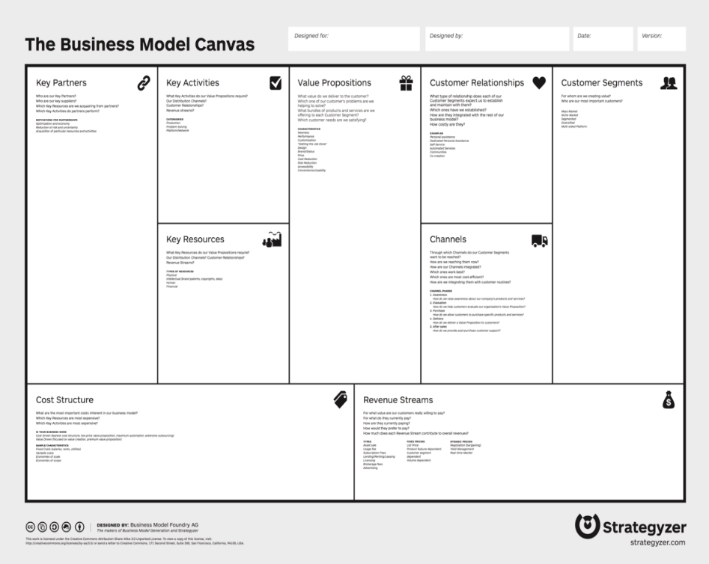
STEP 2: THE PLAN
A SIMPLE WAY TO START
** The Business Model Canvas lets you look at one page and see if your idea is viable in three ways:
Desirability
Feasibility
Viability
EXPLORE MORE: Our webinar on the Business Model Canvas
This Photo by Unknown Author is licensed under CC BY-SA

Slide 27
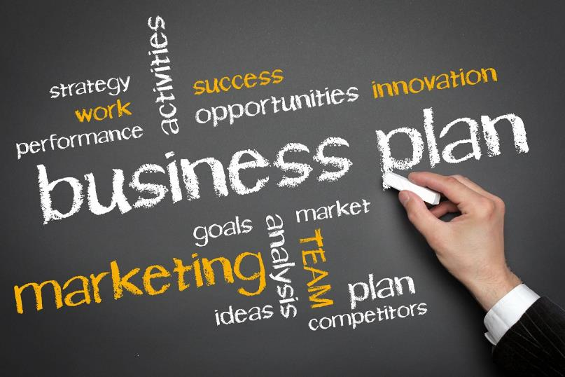
STEP 2: THE PLAN
THIS IS WHERE
IT ALL COMES TOGETHER
** What is it?
** Why are you doing it?
** How are you doing it?
** What are you spending?
** What are you making?
** What do you need?
This Photo by Unknown Author is licensed under CC BY-ND

Slide 28
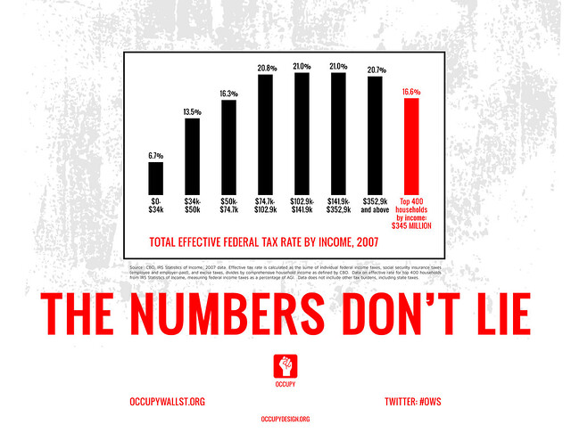
STEP 2: THE PLAN
BUSINESS PLAN, REASON 1
FOR THE VALIDATION
THE NUMBERS DON’T LIE
** If you map out all your expenses and project all your sales and/or revenue and those numbers don’t show profitability, you need to
RETHINK
EXPLORE MORE: Business plan templates from SCORE
This Photo by Unknown Author is licensed under CC BY-SA-NC

Slide 29
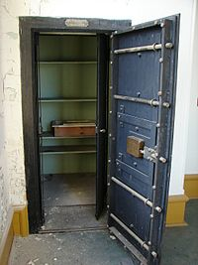
STEP 2: THE PLAN
BUSINESS PLAN, REASON 2
FOR THEM
** If you’re looking to borrow money from a lending institution or a private investor, they will want to see every penny you need to spend, both for startup and daily, and every penny you project to make for 2-3 years. They need to know how and when they will be paid back.
ARE YOU A GOOD RISK?
This Photo by Unknown Author is licensed under CC BY-SA

Slide 30
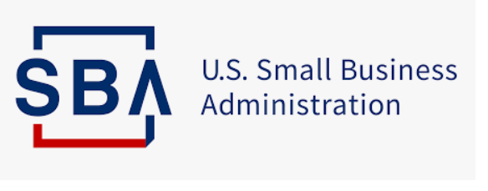
SBA LOANS: WHAT ARE THEY?
BUSINESS PLAN, REASON 2
PART 2
The SBA guarantees loans. But the guarantee is to the bank, not to you. If you can’t pay back the loan, the SBA will pay the bank.
But this doesn’t absolve you from paying. You’ll owe the SBA instead of the bank.
The SBA guarantee just makes it easier for banks to say YES.

Slide 31

STEP 2: THE PLAN
BUSINESS PLAN, REASON 3
FOR YOU
** Your business plan acts as a GPS for you. Review it often. Are you ahead of projections? Are you behind? You can adjust accordingly.
DON’T FLY BLIND
EXPLORE MORE: 20 Reasons You Need a Business Plan
This Photo by Unknown Author is licensed under CC BY-SA

Slide 32

STEP 2: THE PLAN
KEY FACTORS FOR SUCCESS
** Proper motivation
** Match between value proposition and customer needs/wants
** Access to funding
** Experience or education
** Support system
** Time to devote
** Ability to make decisions
This Photo by Unknown Author is licensed under CC BY-NC-ND

Slide 33
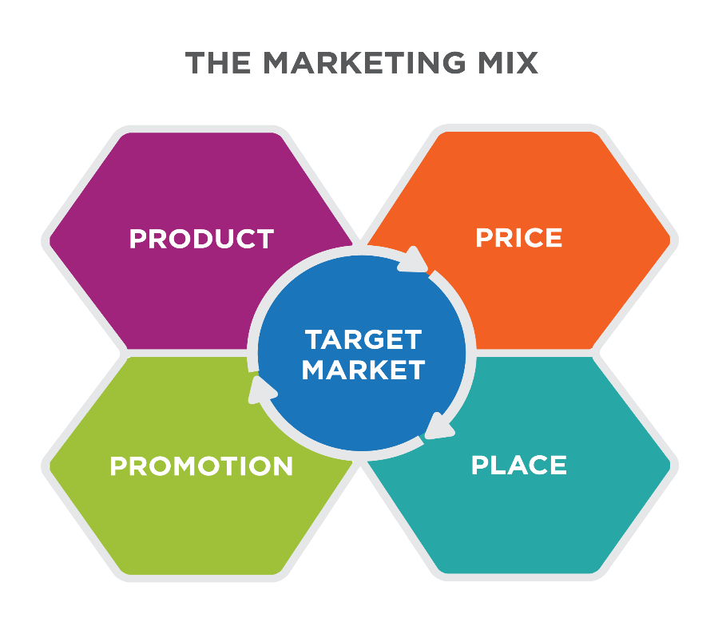
STEP 2: THE PLAN
GET THE WORD OUT
The big question about websites
Do you want to spend your time or your money?
Wix GoDaddy Shopify Weebly
SquareSpace Strikingly WordPress
MAKE IT EASY TO DO BUSINESS WITH YOU!
Social media
YOU NEED A STRATEGY
This Photo by Unknown Author is licensed under CC BY

Slide 34

STEP 2: THE PLAN
Top platforms to consider
Facebook: Great for community engagement and relationship building
Instagram: Thrives on visual story-telling to build branding
TikTok: A way to be informal and part of the pop-culture with humor, creativity
LinkedIn: Ideal for generating leads, building authority
YouTube: Value over viral. Informative videos drive long-term traffic, trust.
-- Source: MikeColeman.net

Slide 35
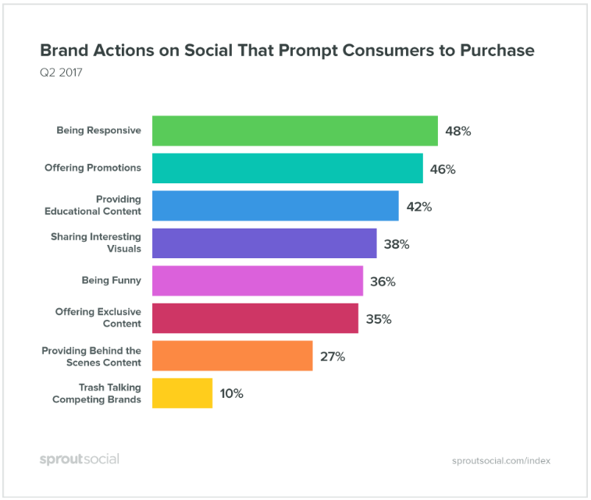
STEP 2: THE PLAN
SOCIAL MEDIA TIPS
Find out where your audience is.
Find out what your competitors do.
Be smart, be creative, have fun.
What does the customer really want to hear?
Always be responsive.
Kill them with kindness.
CALL TO ACTION!!!
EXPLORE MORE: 18 Great Tips for Social Media Use

Slide 36


STEP 3: BEFORE YOU OPEN
This Photo by Unknown Author is licensed under CC BY-SA

Slide 37

STEP 3: BEFORE YOU OPEN
QUESTIONS
** Do you need to register with the state?
** What licenses do you need? State? County? City?:
** Tax numbers? How do you get them?
CHECK OUT OUR INFORMATION
This Photo by Unknown Author is licensed under CC BY-SA

Slide 38
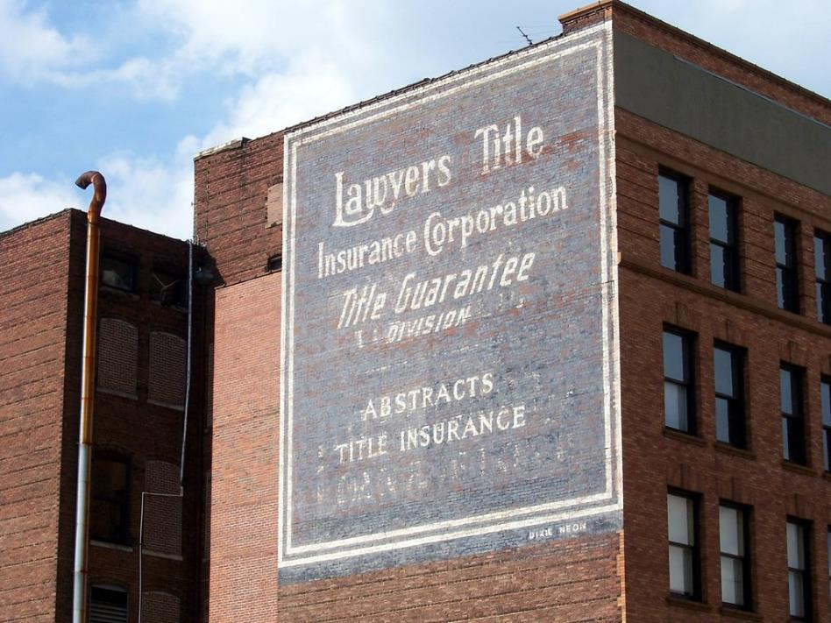
STEP 3: BEFORE YOU OPEN
FIND YOUR SILENT PARTNERS
** A lawyer
** A banker
** An accountant (not a bookkeeper)
** An insurance agent
They are not on retainer. They should know you and your business enough to help when you need them.
PUT THEM ON SPEED DIAL
This Photo by Unknown Author is licensed under CC BY-NC-ND

Slide 39
ABOUT THOSE SILENT PARTNERS
If you’re getting startup money – or any kind of money – from family or friends …
You and the other party should sign a WRITTEN agreement. Get a LAWYER to draw it up. Yes, you’re friends now, but money can ruin a friendship.
And while we’re talking money, it’s YOUR business. Even if you have a bookkeeper or an ACCOUNTANT to look after all things financial, you MUST understand the reports.
Otherwise, people might be robbing you and you won’t even notice!

Slide 40

STEP 3: BEFORE YOU OPEN
OTHER THINGS TO LEARN
Industry trends
Inventory control
Billing
Selling
Cash flow
Taxes
Payroll
EXPLORE MORE: 10 Things Every Small Business Needs to Do

Slide 41
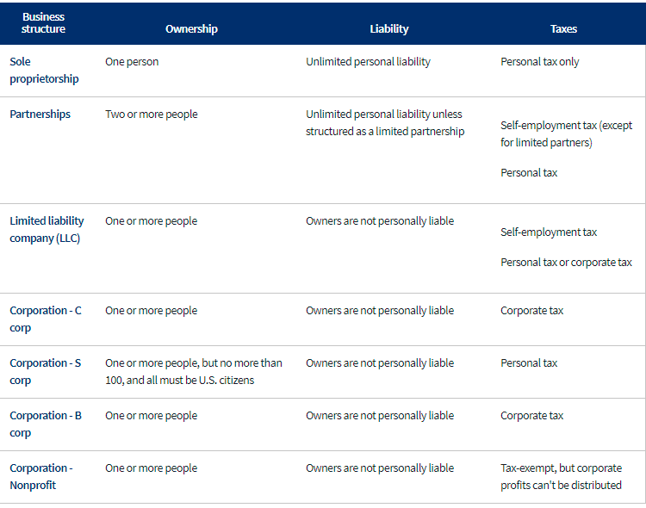
STEP 3: BEFORE YOU OPEN
YOUR BUSINESS ENTITY MATTERS
Sole proprietorship
Partnerships
Limited Liability Companies
Your business structure will determine how you pay taxes.

Slide 42
LET’S SUM IT UP (10 THINGS TO JUMPSTART)
1. STOP THE EXCUSES: If you want to make it happen, don’t let things stand in your way.
2. FIND YOUR GROOVE: What inspires you?
3. JUMP INTO SOCIAL MEDIA: It’s your new best friend.
4. TAKE TIME TO PERFECT YOUR CRAFT: Don’t sell something you won’t buy.
5. DON’T RUSH: Find your audience first. Licenses and websites can wait.
6. LEARN AS MUCH AS YOU CAN: Research, research, research
7. DON’T THINK “What can I sell?”: Think “What does my audience want to buy?”
8. KEEP IT SIMPLE: Business name, logo, more.
9. CALCULATE THE COST:
10. WHAT CAN YOU OFFER WITHOUT PAYING A CENT: Is there a free service you can offer?
** Source: Jazmine Tricoche, 1800DreamLife.com

Slide 43
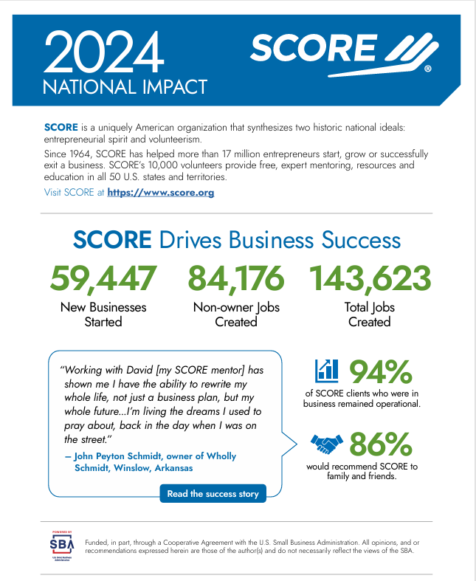
ABOUT SCORE
** Founded in 1964
** About 160 chapters nationally
** About 10,000 volunteers
** FREE one-on-one mentoring with experienced volunteers for the life of your business
** FREE OR LOW COST workshops and webinars
** FREE OR LOW COST access to nationally recorded webinars

Slide 44
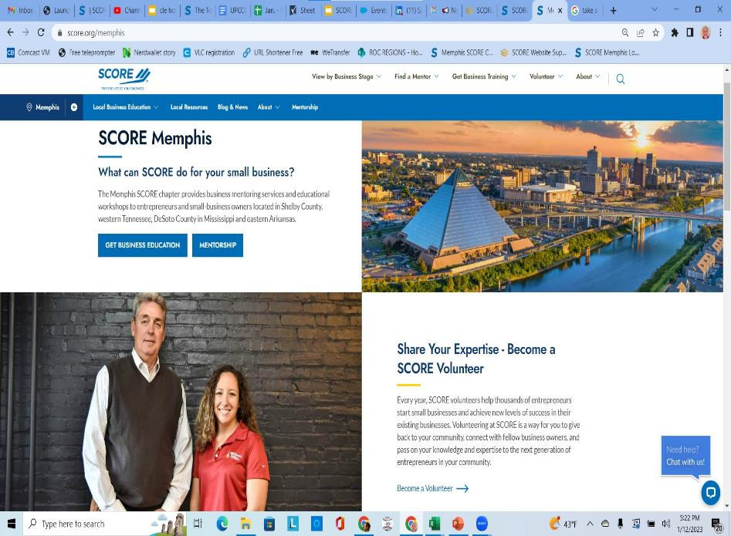
ABOUT SCORE
Go to SCORE.org/Memphis to
** Request a mentor
** Check out our workshop/webinar schedule
** Search our vast resource library
** Find quick answers HERE!
It’s great to be a startup. It’s better to be a STAYUP!
WE ARE HERE TO HELP YOU
My email: gary.robinson@scorevolunteer.org

Slide 45

BONUS ENDING: FAIRY TALES CAN COME TRUE
SOME WORDS ABOUT WORDLE
** Created by Josh Wardle, Brooklyn-based software engineer.
** Started in Oct. 2021 for his partner.
** Had 90 users on Nov. 1, 2021.
** By mid-January 2022, it was 2 million. MILLION.
** Sold to The New York Times for LOW SEVEN FIGURES the following month.

