Slide 1

SCO
Jayne Crosby Giles Certified SCORE Mentor
RE Northern Maine
Financing Your Business

Slide 2
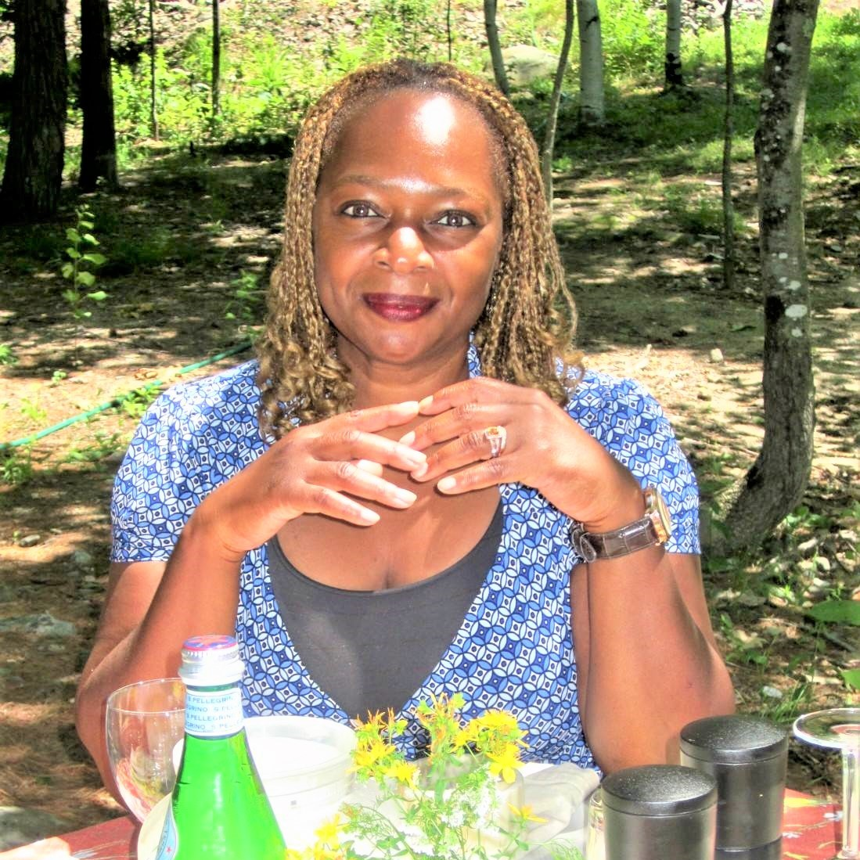
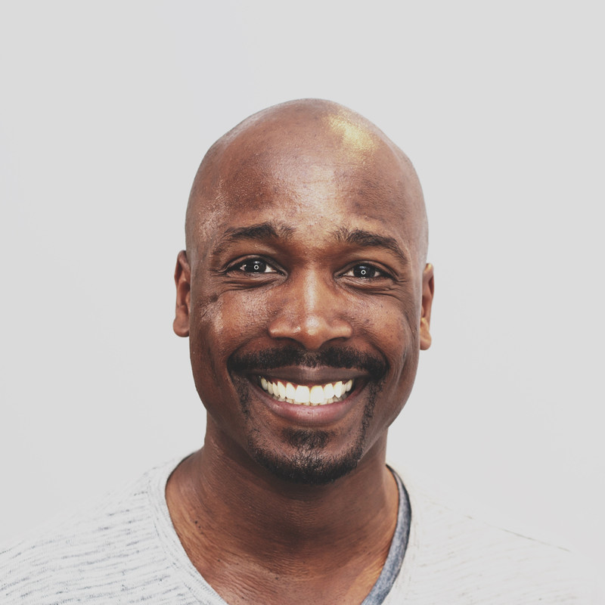
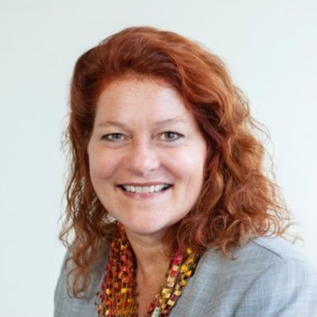
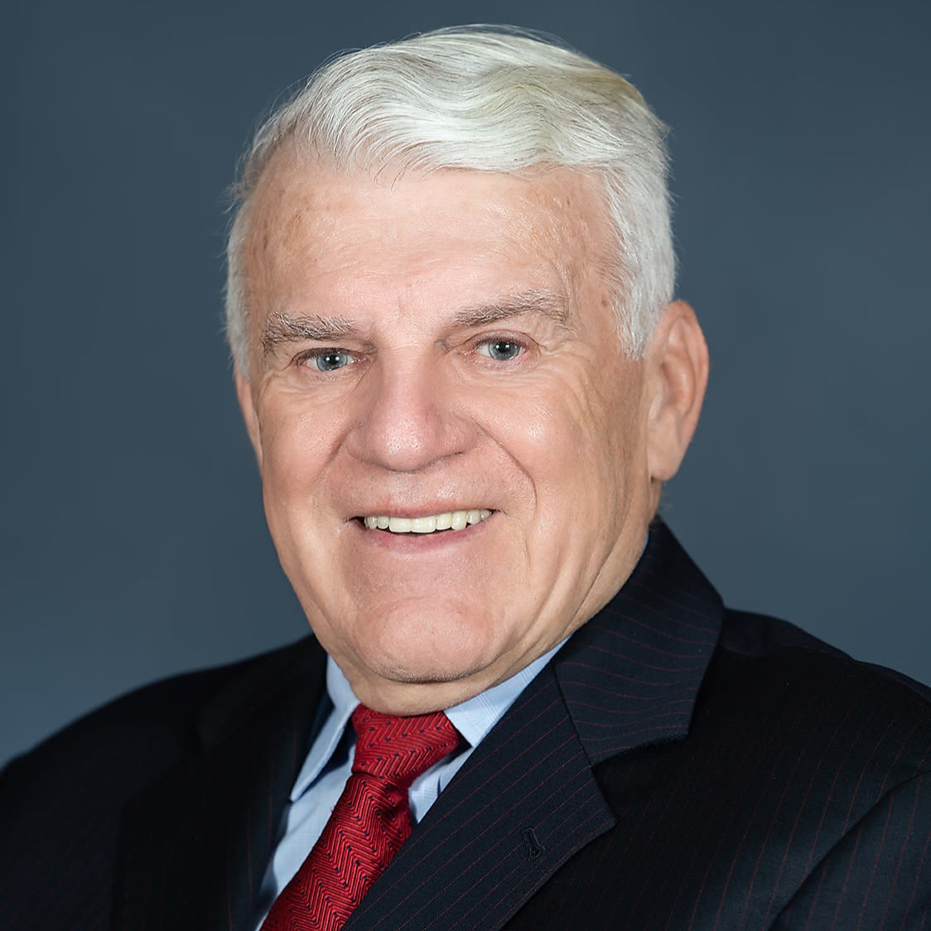
SCORE – For the life of your business
Established in 1964
Mentors to help businesses start & grow
10,000+ volunteers nationwide
Diverse. Experienced. Entrepreneurial.

Slide 3
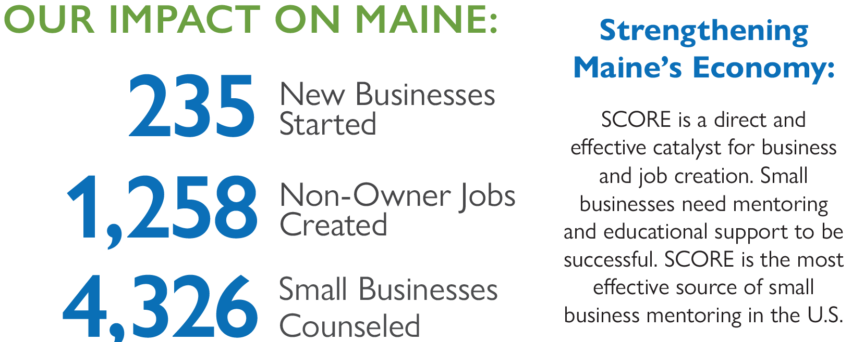
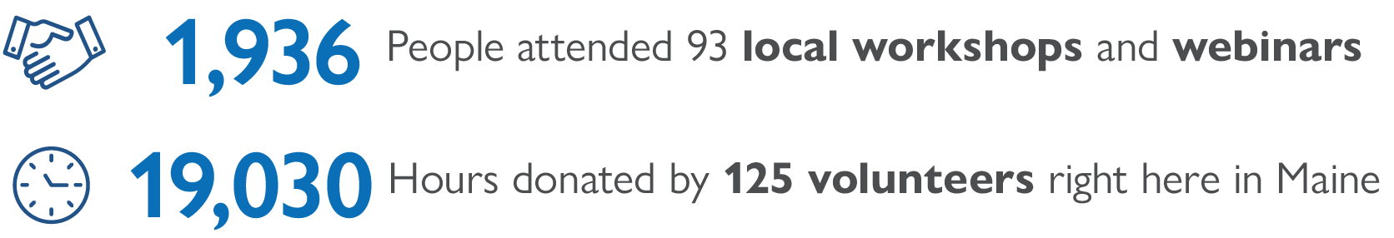

Slide 4

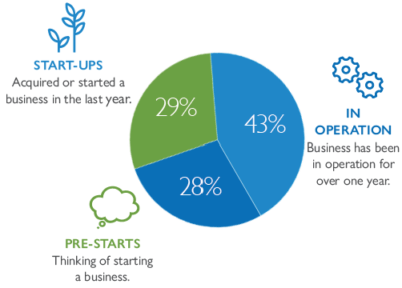
Maine SCORE Profile – Clients Served

Slide 5

Business Loans: Where to start?
ME
VT
VC
Bank

Slide 6
Proper Planning is Key
After 2 Years
Percent of New Businesses (2+ employees)
Source: Bureau of Labor Statistics, Business Employment Dynamics, Entrepreneurship and the U.S. Economy
Notes:
Now let’s discuss the biggest reality in business ownership: 24% of businesses fail within the first 2 years. (continues on next slide) According to data from the Bureau of Labor Statistics, 76% of new businesses are successful after 2 years;
Sources cited:
Bureau of Labor Statistics, Business Employment Dynamics, Entrepreneurship and the U.S. Economy, http://www.bls.gov/bdm/entrepreneurship/bdm_chart3.htm

Slide 7
Different types of lenders
Non-bank lenders
Federal/State/Local
Benefits
More flexible financing terms
Lower down payment
Longer term
More manageable payments
Critical for borrowers to be “loan ready”
Business Plan
Financial Projections

Slide 8
Loan Readiness
Top Ten Readiness Checklist
Determine how much & why
Establish a timeline
Complete Business Plan
Gather historical financials
Complete financial projections

Slide 9
Loan Readiness (con’t)
Top Ten Readiness Checklist
Develop best-case & break-even scenarios with assumptions
Check personal credit
List personal assets & liabilities
Examine insurance(s)
Talk to accountant & attorney

Slide 10

Sources of Loans
SBA
Rural Development
Community Dev Financial Inst (CDFIs)
State
Regional
Banks
Credit Unions

Slide 11
US Small Business Administration (SBA)
SBA loan programs
7a and 504
7a
Microloans to loans up to $5M
Average loan size is $350K
Apply to an SBA Preferred Lender – includes banks, credit unions, and community development lenders
504
Large project financing
Work with a lender and local CDC

Slide 12
SBA 7a Loans
SBA’s primary business loan program
Eligibility
Be an operating business
Operate for profit
U.S.-based
Unable to obtain conventional bank financing
Be creditworthy
Show ability to repay the loan
Check www.sba.gov for:
Meet SBA size guidelines
Not on ineligible business list

Slide 13
SBA 7a Loans (con’t)
Loan purposes
Fund short- and long-term working capital
Acquire, refinance, or improve real estate and buildings
Refinance existing business debt
Purchase machinery and equipment, including AI-related expenses
Purchase furniture, fixtures, and supplies
Finance changes of ownership (complete or partial)
Use for multiple purposes (as above)

Slide 14
SBA 7a Loans (con’t)
Repayment terms
SBA is a cash flow lender
Past history is reviewed
Financial projections are important
General guidelines
Working Capital: 1 to 5 years
Equipment: 3 to 7 years
Real Estate: Up to 25 years
Rates available per current environment

Slide 15
SBA 504 Loans
Main purposes: Real estate & major fixed assets
Economic focus: Promote business growth and job creation
Eligibility
Meet company size standards
<$20M sales and <$6M in net income
Affordable fixed-rate financing available
Debentures (50%), Bank/Lender (40%), CDC (10%)
Apply to local Certified Development Corp (CDC)

Slide 16
Rural Development
RD Business & Industry Program (B&I)
Business loans for medium to longer-term purposes
Who may apply?
For-profit, non-profit businesses or cooperatives
Federally-recognized Tribes
Public bodies
Existing or start-up businesses
Must be located in communities <50K population
Contact local USDA Rural Development Office
www.rd.usda.gov

Slide 17




CDFIs: Mission-driven lenders
Development Corporation
four directions Development Corporation

Slide 18

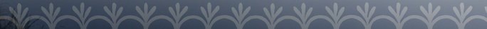
Four Directions
Development Corporation
A non-profit Community Development Financial Institution (CDFI), certified by the U.S. Department of Treasury, and Supervised Lender, licensed by the State of Maine.
To improve the social and economic conditions of the Wabanaki tribes in Maine – the Maliseet, Micmac, Passamaquoddy, and Penobscot – through education and investment in affordable housing, tribal ventures and Native entrepreneurship.
Notes:
Established in 2001 – first native-governed CDFI in northern New England.
Developed to address some of the credit needs of tribal members, in some of the most remote areas of the state in Aroostook, Washington, and Penobscot counties.

Slide 19
Four Directions -
Small Business Program
Makes loans up to $250K
Offers affordable rates and terms
Finances multiple types of needs
Working capital
Equipment
Real Estate
Inventory, materials, supplies
Provides technical assistance
Assists Native Artisans with online FDDC Marketplace

Slide 20
State programs
Finance Authority of Maine
www.famemaine.com
Offers direct loan guarantee programs (similar to SBA & RD)
Provides many state-specific loan programs
Small business loans
Agricultural loans
Linked investment loan (reduce interest costs)
Funds regional/local development organizations
Outside Maine: check with your State’s economic development or similar agency(ies) programs

Slide 21
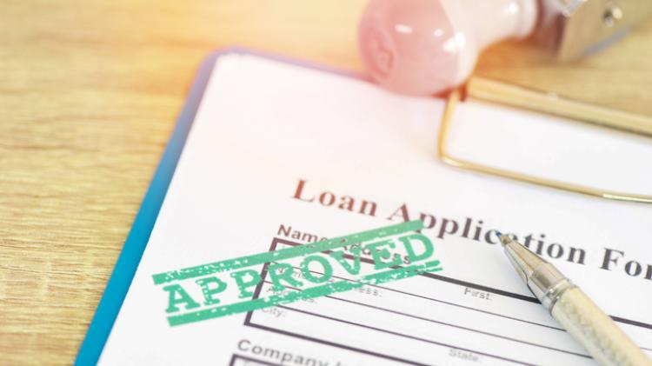
Local & Regional Sources
Other local sources of small business loans -
Tribal economic development departments
Municipalities
Regional CDCs
EMDC
NMDC

Slide 22
Banks and Credit Unions: Should I use personal loans?
PROS
Convenience
Ease
Already have availability
Home Equity
Lower interest rate
No new closing costs
Credit Card
Easily accessed
CONS
Business is not building its own credit
Personal loan(s) may not keep up with business growth
Interest starts low BUT ends up high (credit card)
Lowers personal credit score

Slide 23
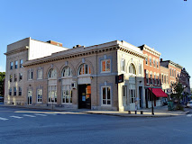
Banks & Credit Unions: Building credit for your business
Open a checking account and other non-lending accounts with a local bank
Get to know the branch staff
Meet with a lender to discuss your business
Build a banking relationship – even if non-borrowing

Slide 24
Summary: Financing Your Business
Know where to start & what you need
Check your “loan readiness”
Identify best lending choices for you
Weigh pros and cons of business vs. personal loans
Build financial relationships
Take that first step – contact a lender

Slide 25

For more information:
Jayne Crosby Giles, Certified Score Mentor
jayne.giles@scorevolunteer.org
www.score.org

