Slide 1
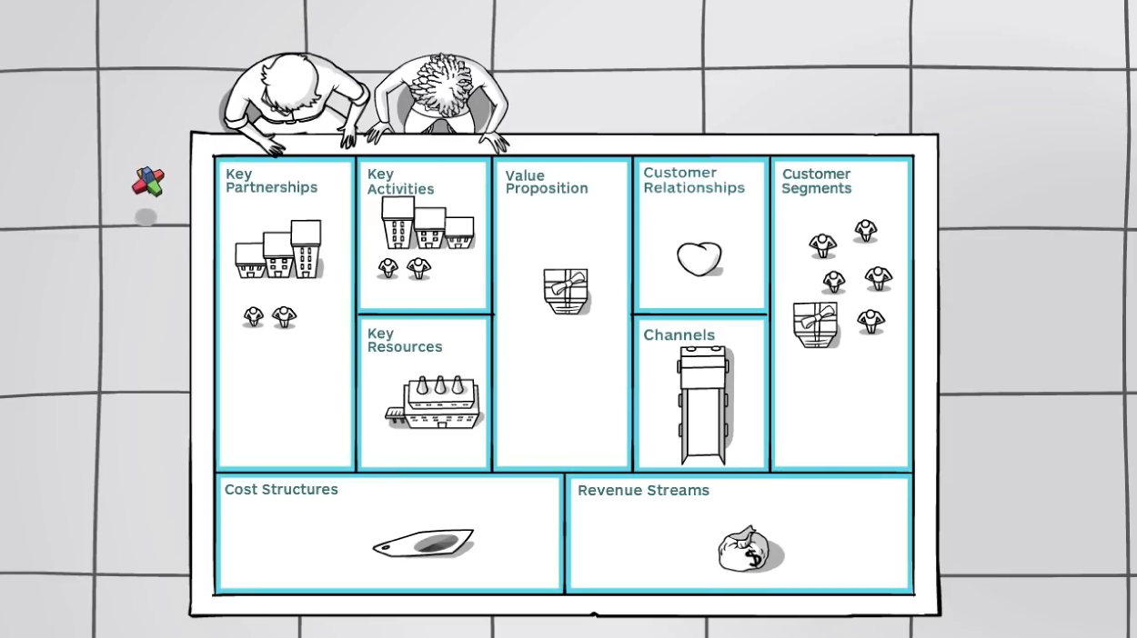
Visualizing Your Business Model
Notes:
Instructor Notes:
This 3:38 second video describes how to use the business model canvas, a visual tool to craft powerful business models. (You’ll explain how students can fill out their own business model canvas on the next slide).
(Place cursor over video on screen to bring up playback control. Press the “play” button when it appears in lower left corner of the screen)
Direct link to this video from YouTube = https://www.youtube.com/watch?v=wlKP-BaC0jA

Slide 2
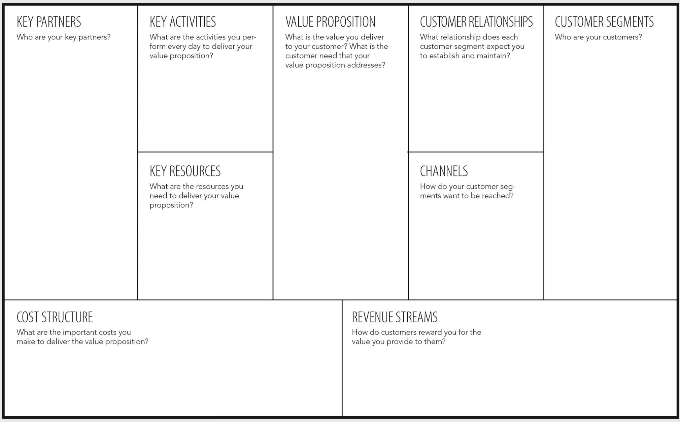
Introducing the Business Model Canvas

