Slide 1

Checking Out Small Business Help from the Public Library – Laura Bontrager

Slide 2

First Tennessee Small Business Resource Center
Benjamin L. Hooks Central Library – 3rd floor

Slide 3
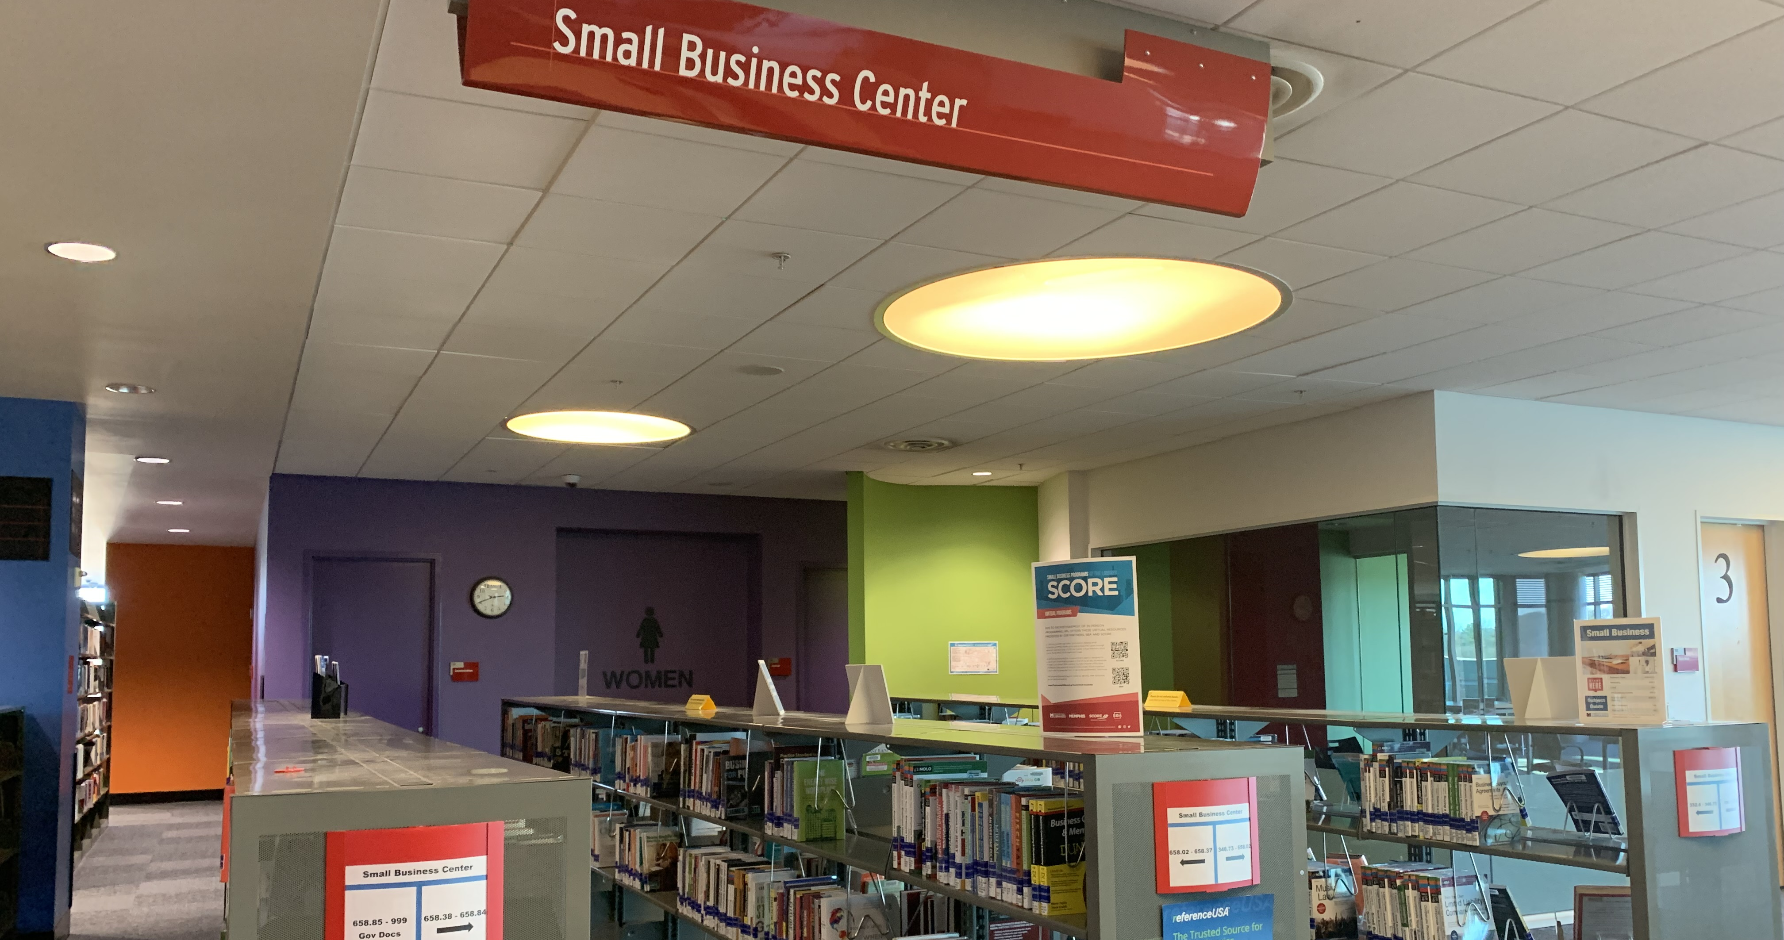

Slide 4
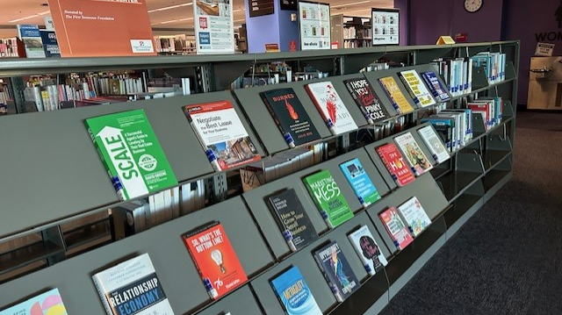

Slide 5




Start Your Own: Business Series

Slide 6




NOLO Press
DESK copy
DESK copy

Slide 7
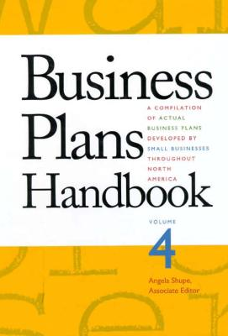
Reference: Business Plans Handbook
Real business plans created by real small businesses
Find this series at the reference desk, 3rd floor
Reference materials must stay in the library

Slide 8
memphislibrary.org

Slide 9

Hover on
When the menu appears, choose Business and Entrepreneurship

Slide 10


Slide 11
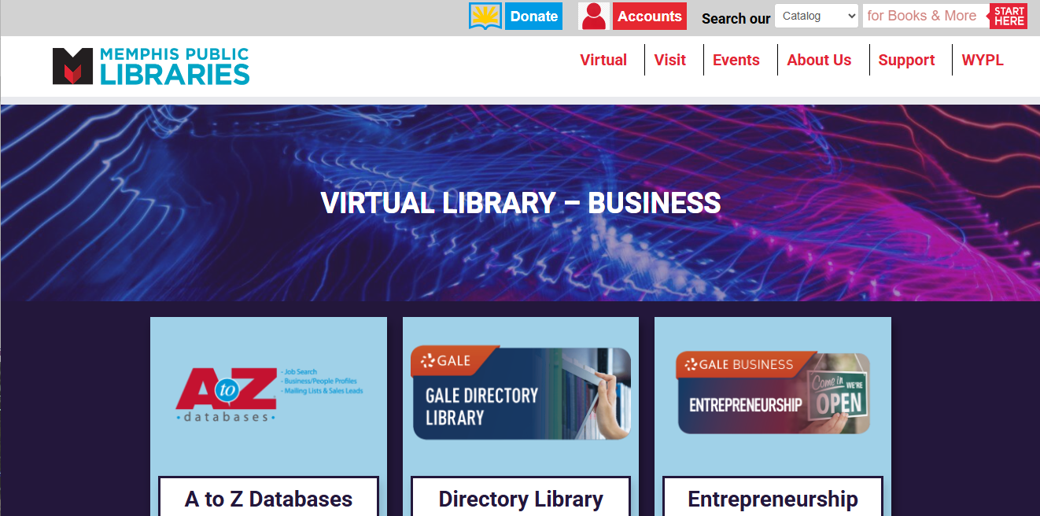
memphislibrary.org/learn/business
Memphis Public Libraries: Business Resources

Slide 12
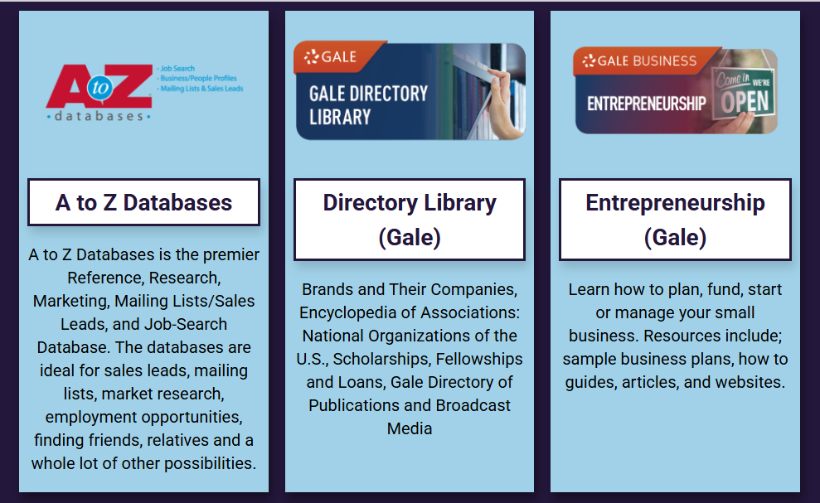

Slide 13


Slide 14
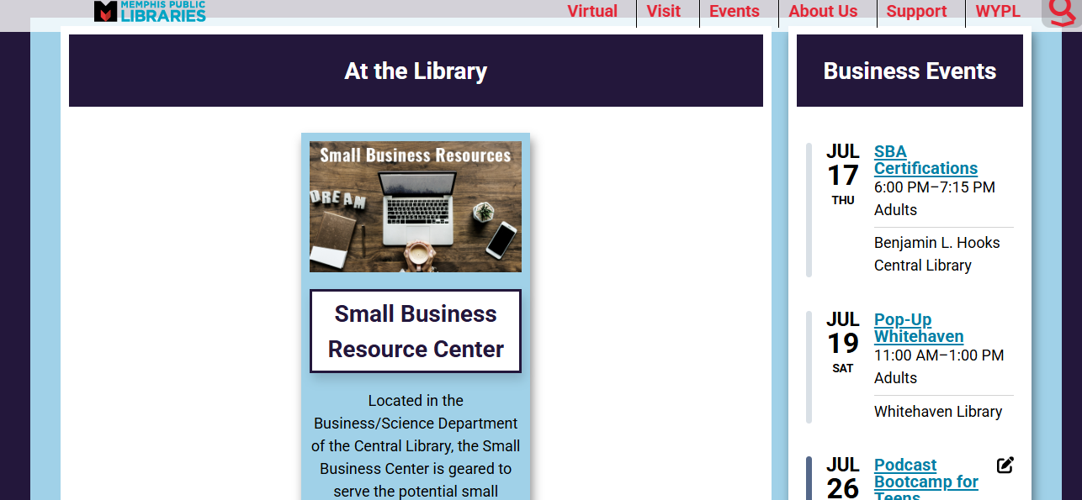

Slide 15
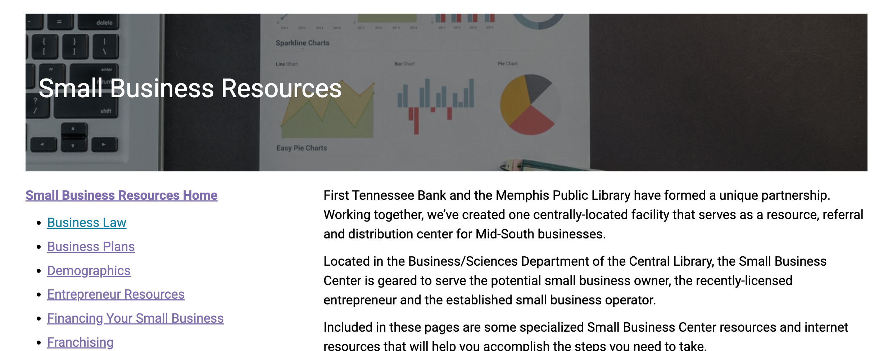

Slide 16
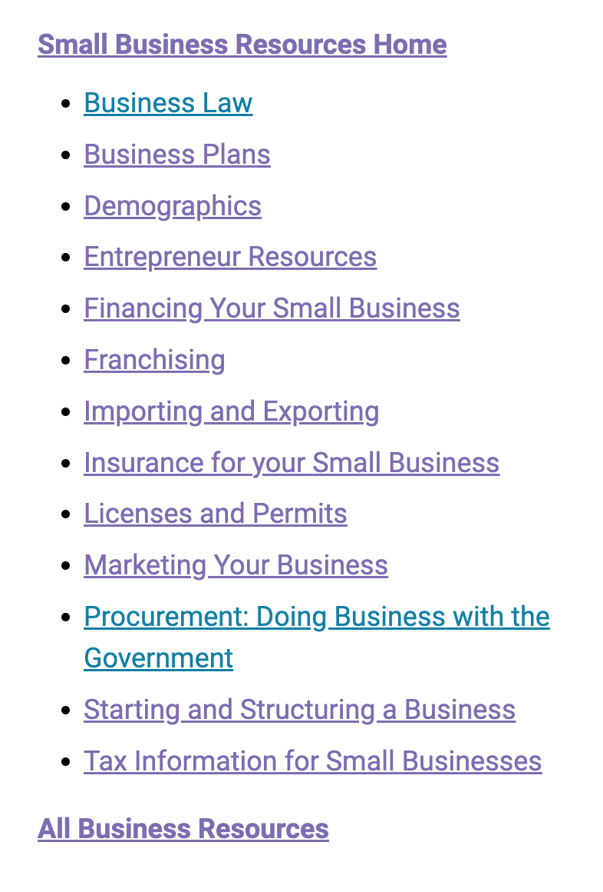
Resources Menu
Use the navigation menu to narrow down your focus
Each menu item goes to a librarian-curated list of further research materials for that subject
Find guides, TN-related laws or information, and steps to create or further your small business

