Slide 1


HOW HAVING A BRAND STORY THAT CLEARLY DIFFERENTIATES YOUR BUSINESS HAS A DIRECT IMPACT TO YOUR BOTTOM LINE.
YOUR BRAND STORY MATTERS

Slide 2





OVERVIEW
What is a Brand Story
Why is a Brand Story Important
Do you know your Brand Story?
Defining Your Differentiators
How can a Brand Story impact your bottom line

Slide 3
“EFFECTIVE CONTENT MARKETING IS ABOUT MASTERING THE ART OF STORYTELLING.”
“FACTS TELL, BUT STORIES SELL!”
Bryan Eisenberg
YOUR BRAND STORY MATTERS

Slide 4
WHAT IS
A BRAND
STORY?

Slide 5

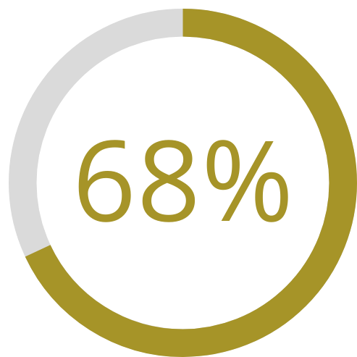

WHY IT'S IMPORTANT
68% of consumers say brand stories influence their
purchasing decisions
Source: Ad Age

Slide 6






Apple’s story is about innovation, design, and the empowerment of creativity. Their products are marketed not just as technology but as tools that enhance and simplify lives.
BRAND STORIES THAT INFLUENCE
Apple
Impact: Says innovation, simplicity and design
Nike’s brand story revolves around the spirit of overcoming obstacles and achieving greatness. Their "Just Do It" slogan and compelling athlete stories reinforce themes of perseverance and empowerment.
NIKE
Impact: Inspires to push ones limits
LEGO’s story centers on creativity, imagination, and the power of play. They emphasize the importance of building and creating, both literally and metaphorically.
LEGO
Impact: Promotes imagination & problem solving

Slide 7
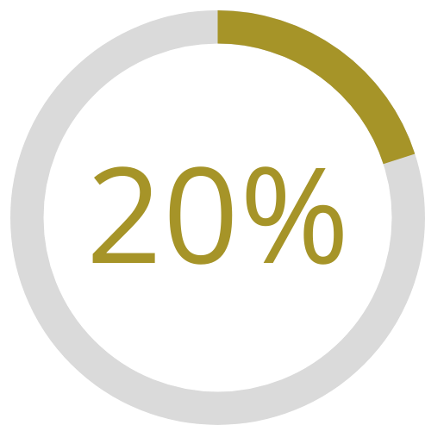
WHY IT'S IMPORTANT
Compelling brand stories enhance customer loyalty by 20%.
Source: The Brand Shop

Slide 8


Marriott attracts and retains loyalists through a combination of strategic benefits, personalized experiences, and a strong rewards structure.
BRAND STORIES THAT CREATE LOYALTY
Bonvoy
What they sell: Consistency & Rewards
Amazon’s emphasis on customer-centric services and continuous innovation helps build strong loyalty among its users.
Amazon
What they sell: Convenience & Variety
Premium quality, performance, and a strong brand identity centered around driving pleasure.
BMW
What they sell: Luxury & Driving Experience

Slide 9
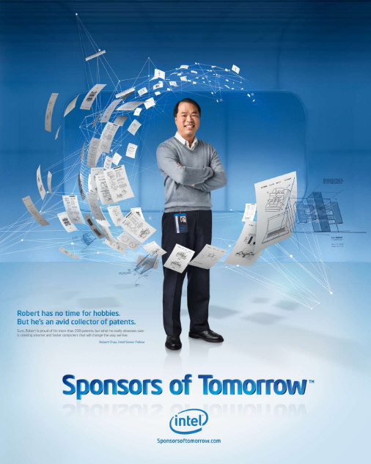

USING THE STORY TO REPOSITION OR REFRESH YOUR BRAND

Slide 10
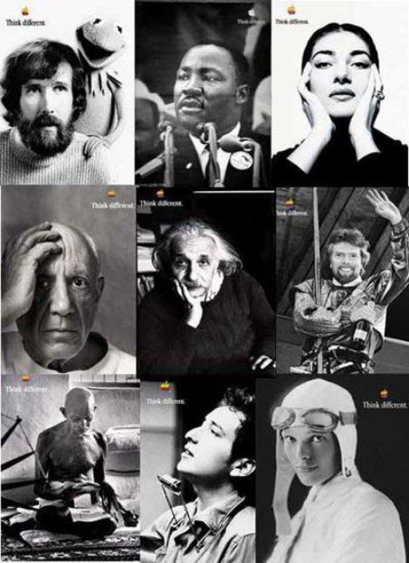
USING THE STORY TO REPOSITION OR REFRESH YOUR BRAND

Slide 11

DO YOU KNOW YOUR BRAND STORY?

Slide 12

DON'T DESPAIR.
YOU ARE NOT ALONE!

Slide 13
TOP THREE REASONS PEOPLE START A BUSINESS
Wanting to be independent
Wanting freedom/flexibility
Wanting the extra income.
Source: Commerce Institute

Slide 14
START DEFINING
WHAT MAKES YOU DIFFERENT!
The Ice Cream Story...

Slide 15

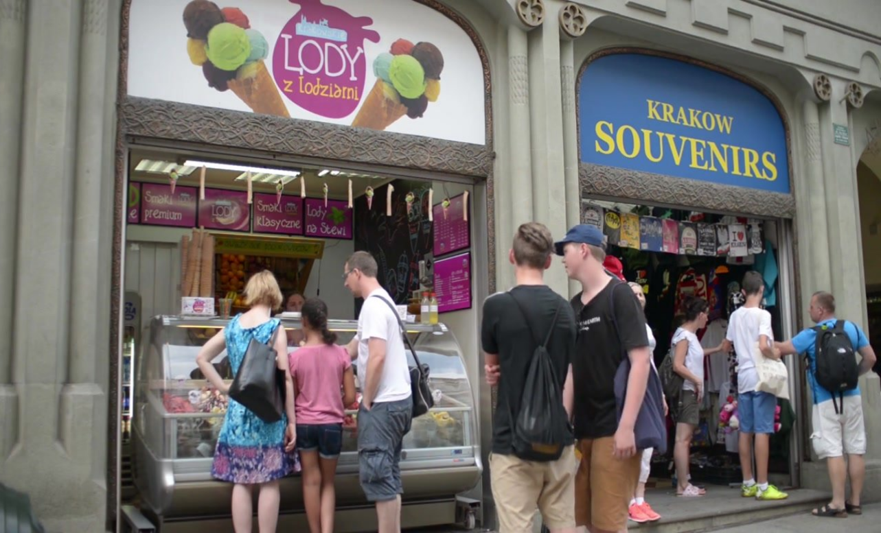
WHAT YOU DO...
YOU OWN AN
ICE CREAM SHOP

Slide 16
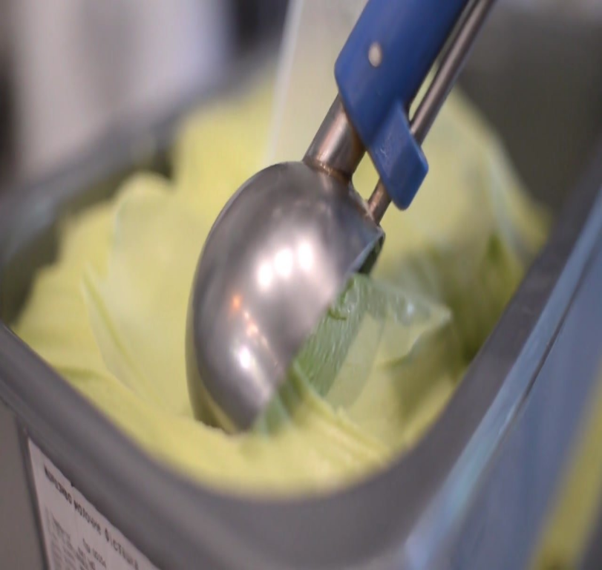

DO YOU OFFER A UNIQUE PRODUCT?
NOT JUST ICE CREAM - IT'S GELATO!

Slide 17

WHAT MAKES SAID PRODUCT UNIQUE?
UNIQUE FLAVORS & DAIRY FREE, MADE WITH PLANT BASED MILK
YOU SELL TO PEOPLE WHO CAN'T USUALLY HAVE ICE CREAM

Slide 18

WHAT MAKES YOUR BUSINESS UNIQUE?
LOCAL, WOMEN
OWNED BUSINESS

Slide 19

WHAT ELSE MAKES SAID PRODUCT UNIQUE?
LESS CALORIES THAN OTHER GELATO
YOUR ICE CREAM APPEALS TO
A HEALTH-CONSCIOUS CROWD

Slide 20

WHY DO YOU APPEAL TO YOUR CUSTOMERS OVER YOUR COMPETITION?
DRIVE-THRU
SERVICE

Slide 21


UNIQUE FLAVORS
DAIRY FREE!
LOWER CALORIES
CONVENIENT FOR BUSY SCHEDULES
LOCAL & WOMEN OWNED BUSINESS

Slide 22
OTHER THINGS TO CONSIDER...
Why did you start your business/brand?
Is there a cause that matters to your brand?
Do you support any social movements?
Is there something you would like your business to be known for?

Slide 23

THE BRAND STORY?
Brand Story: Gelato Delights
At Gelato Delights, we believe that indulging in a sweet treat doesn’t have to come with a side of guilt. Our journey began with a simple idea: to create gelato that is not only delicious but also aligns with a healthier lifestyle and a commitment to social responsibility.

Slide 24
THE BRAND STORY?
The whole story:
Our founder Jane, was a passionate gelato enthusiast who faced a challenge: she wanted to enjoy creamy, rich flavors without compromising her health or values. Driven by this challenge, Jane set out to craft unique, dairy-free gelato that would cater to both health-conscious individuals and those with dietary restrictions. Through countless experiments and taste tests, Gelato Delights was born—a place where every scoop is crafted from plant-based ingredients, lower in calories, and bursting with innovative flavors.
But we didn’t stop there. Understanding the fast pace of modern life, we introduced a drive-through option, allowing you to enjoy your favorite gelato with ultimate convenience. Whether you're on a quick lunch break or picking up a treat after a long day, Gelato Delights is designed to fit seamlessly into your lifestyle.

Slide 25
THE BRAND STORY
A step further...
Our commitment extends beyond your taste buds. We’re deeply invested in our community and support initiatives that promote sustainability and social well-being. A portion of every sale goes toward local programs that aid in environmental conservation and provide support to underserved communities.
By choosing Gelato Delights, you’re not only savoring a guilt-free dessert but also contributing to meaningful change.
From our inventive flavors to our drive-through convenience and our dedication to social responsibility, Gelato Delights is more than just a gelato store. It’s a celebration of better choices, both for you and for the world around us.

Slide 26

Example:
SOCIAL MEDIA
POST
At Gelato Delights, every scoop supports local sustainability and community programs. Enjoy a delicious, plant-based treat and make a positive impact with every purchase.
#SustainableLiving #LocalEats #GelatoLovers #TasteTheChange

Slide 27

HOW CAN YOUR BRAND STORY IMPACT YOUR BOTTOM LINE?

Slide 28
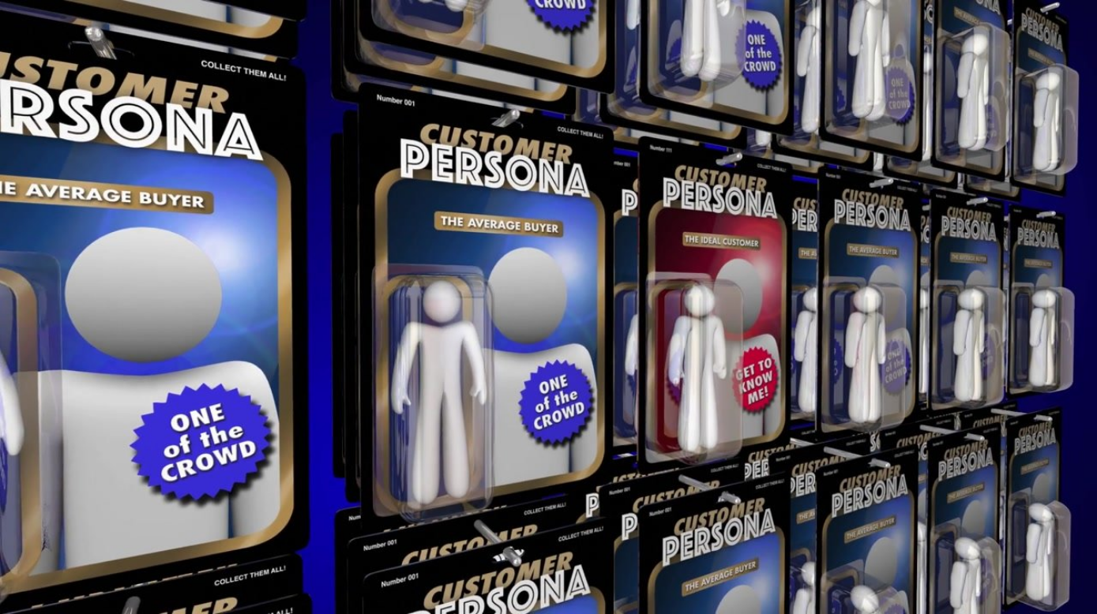

QUESTIONS TO ASK
Who are you serving?
What are their needs and desires?
Demographics - Age, Gender, Occupation, Location
Psychographics - Values, Lifestyle, Interests, Motivations
Behavioral Habits - Shopping Habits, Media Consumption, Spending Habits
Pain Points - Health Concerns, Busy Lifestyle, Ethical Consideration

Slide 29

MARKETING WISELY
= SAVINGS!

Slide 30
PART 2
5
Brand
Engagement Tips
Turn your employees into brand ambassadors
YOUR BRAND STORY MATTERS

Slide 31

WHAT IS
A BRAND
AMBASSADOR?

Slide 32

Increase brand awareness & credibility
Drive sales & leads
Build trust & engagement
Provide cost effective marketing
HOW DO BRAND
AMBASSADORS CONTRIBUTE?
Extend social reach

Slide 33
5
Brand
Engagement Tips
YOUR BRAND STORY MATTERS

Slide 34

1
CLEARLY DEFINE
YOUR BRAND STORY

Slide 35

2
COMMUNICATE
YOUR BRAND STORY

Slide 36

3
Clearly articulate story to your team and identify how your team contributes to communicating that story.

Slide 37

4
Identify your ideal customer personas and how your story appeals to them.

Slide 38

5
IMPLEMENT INITIATIVES AND TOOLS
TO SPREAD
YOUR BRAND STORY

Slide 39
INTERNAL
Activities that connect
Training Materials
Create opportunities for ideation & contribution
Share information about the company's vision

Slide 40
EXTERNAL
Marketing & external communications (Social media, traditional advertising, sponsor community activities)

Slide 41
HOW CAN YOUR BRAND STORY IMPACT YOUR BOTTOM LINE?

Slide 42

QUESTIONS?
Bob Vornbrock
robert.vornbrock@scorevolunteer.org
www.score.org/memphis

