Slide 1
Making Budgets Work

Slide 2

Workshop
Goals
In this workshop, you will...
1
Determine your personal obstacles
to budgeting.
Create a format to track and analyze your spending.
List your short- and long-term goals.
Discuss the importance of debt reduction and emergency savings.
Apply strategies to manage your
day-to-day spending.
2
3
4
5
Copyright 2022 EVERFI, Inc.

Slide 3
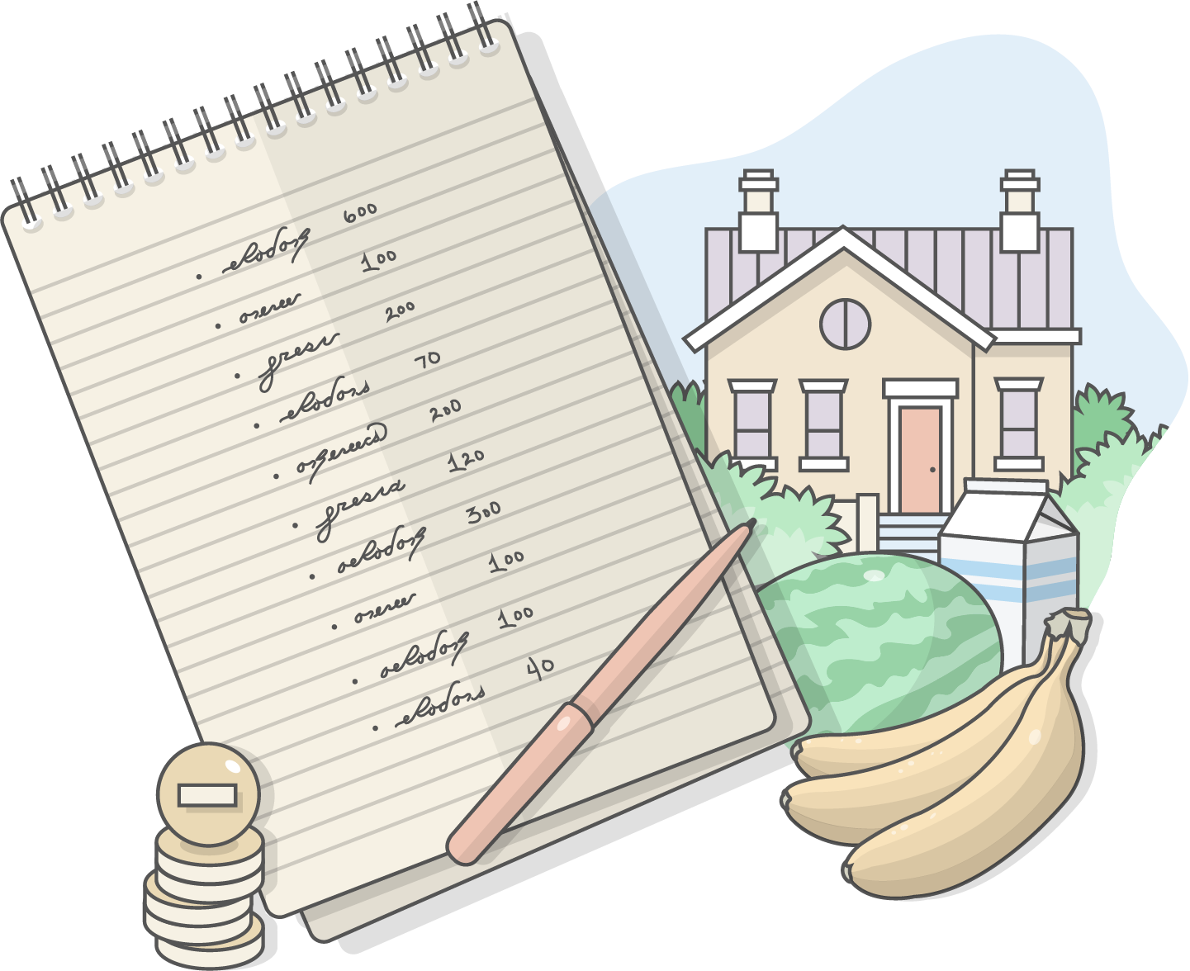
What Is Budgeting?
Budgeting is the process of creating a plan to spend your money.
How can a budget help me?
Helps you live within your means.
Helps you pay down debt.
Helps you save for the future
and emergencies.
Poll Question:
What are some obstacles to budgeting?
Response choices:
It takes too much time.
It’s too complicated.
It’s stressful.

Slide 4
Why We Don’t Budget
    I don’t want to think about the future.
    It’s too complicated.
    It takes too much time.
    My income and spending
    is not consistent enough.
    I’d rather just keep doing
    what I’m doing.
    I have no self-control.
    Budgeting causes more
    stress than it’s worth.
    It’s a hassle.
    I can’t keep up, so why start?
‘‘
‘‘
‘‘
‘‘
‘‘
‘‘
‘‘
‘‘
‘‘

Slide 5



Goal Setting
Paying off a credit card
Setting up emergency savings
Saving for a vacation, medical procedure, furniture, home improvements
SHORT-TERM GOALS
Less than 3 years
Buying a car
Down payment on a home
Paying off a debt
MID-TERM GOALS
3–10 years
Saving for retirement
Paying off a mortgage
Creating a college savings fund
LONG-TERM GOALS
10+ years

Slide 6
Participant Guide: Setting Your Goals
Goal | Amount | Time
Build emergency savings

Slide 7

How Can I Get Organized?
Before creating a budget, organize your financial documents.
You’ll need:
All your sources of income.
A record of your average monthly expenses. If possible, keep track of your expenses for at least three months so that you know how much you spend on each item on average.
A list of your debts.

Slide 8
Participant Guide: Sources of Income
Income Source | Amount Each Month
TOTAL MONTHLY INCOME | $

Slide 9
Participant Guide: Expense Tracker
Expense | Average Monthly Cost | Want or Need?
DEBTS
TOTAL MONTHLY EXPENSES (Average): | $

Slide 10
Participant Guide: Listing Debts
Debt | APR% | Monthly Payment | Balance
TOTALS |  | $ | $

Slide 11
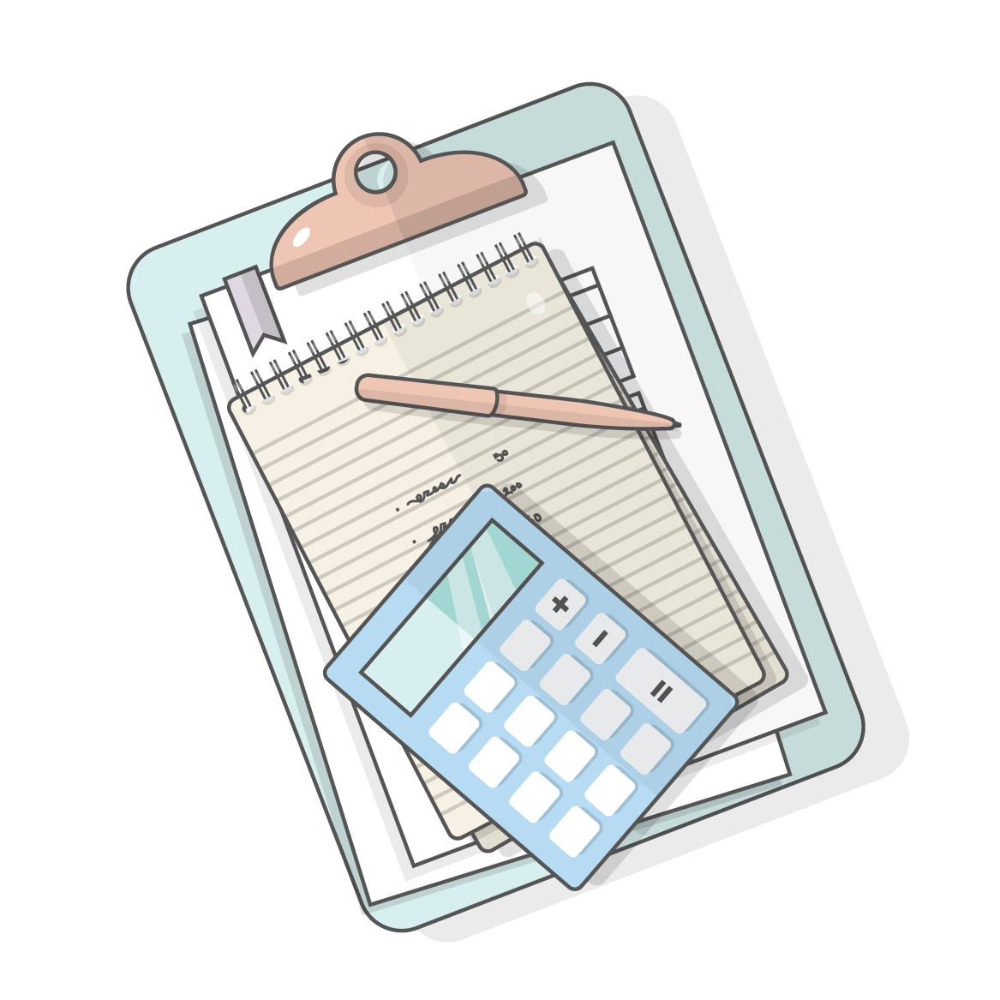
Participant Guide: Your Discretionary Income
To calculate your discretionary income
Subtract your monthly expenses (including Debts) recorded in Section ll of your Expense Tracker from your total income recorded in Section l under Sources of Income.
This is the amount you are able to apply currently towards savings or paying down your debts.
Total Monthly Net Income |  | Total Monthly Expenses |  | Discretionary Income
$ | – | $ | = | $

Slide 12
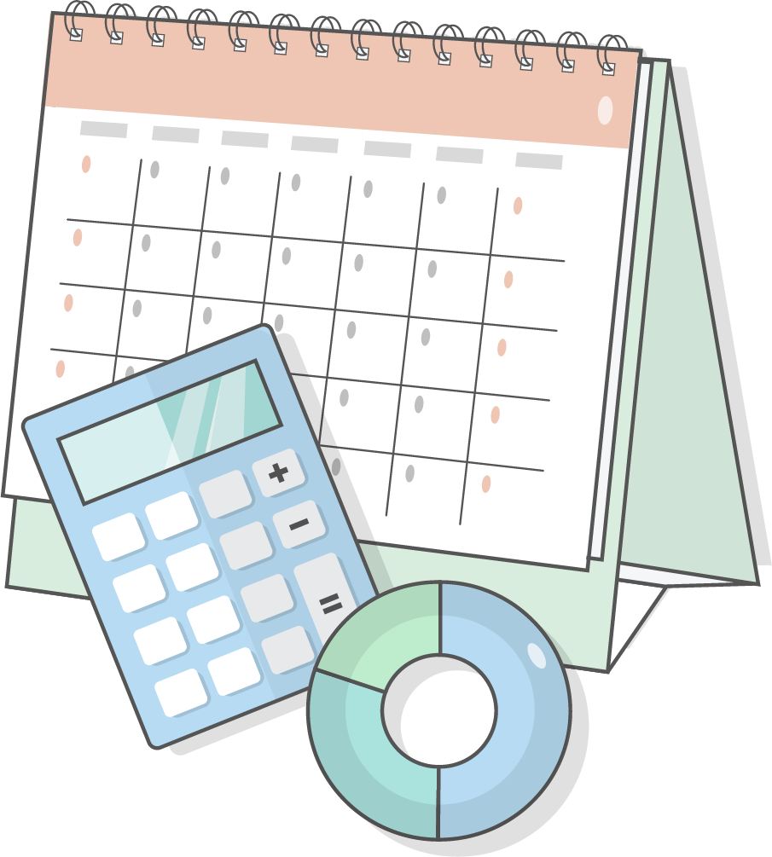
The 50/30/20 Budget Rule
Use the 50/30/20 rule to create your personal budget.
Wants
30%
Needs 50%
Savings & Debts
20%

Slide 13
Participant Guide: The 50/30/20 Rule
The 50/30/20 Budgeting Rule
Your Monthly Net Income $______________
Calculating Percentage Spent:
Needs and Wants
What percentage of your income is paying for your “NEEDS”?
Wants
30%
÷
=
$_______
$_______
___ x 100 ___%
NEEDS
Total
Monthly
net income
$
Needs 50%
What percentage of your income is paying for your “WANTS”?
Savings 20%
$
$_______
=
÷
$_______
___ x 100 ___%
$
WANTS
Total
Monthly
net income

Slide 14
Participant Guide: Needs and Wants
The 50/30/20 Budgeting Rule
Your Monthly Net Income $______________
Calculating Percentage Spent:
Needs and Wants
What percentage of your income is paying for your “NEEDS”?
Wants
30%
÷
=
$_______
$_______
___ x 100 ___%
NEEDS
Total
Monthly
net income
$
Needs 50%
What percentage of your income is paying for your “WANTS”?
Savings 20%
$
$_______
=
÷
$_______
___ x 100 ___%
$
WANTS
Total
Monthly
net income

Slide 15
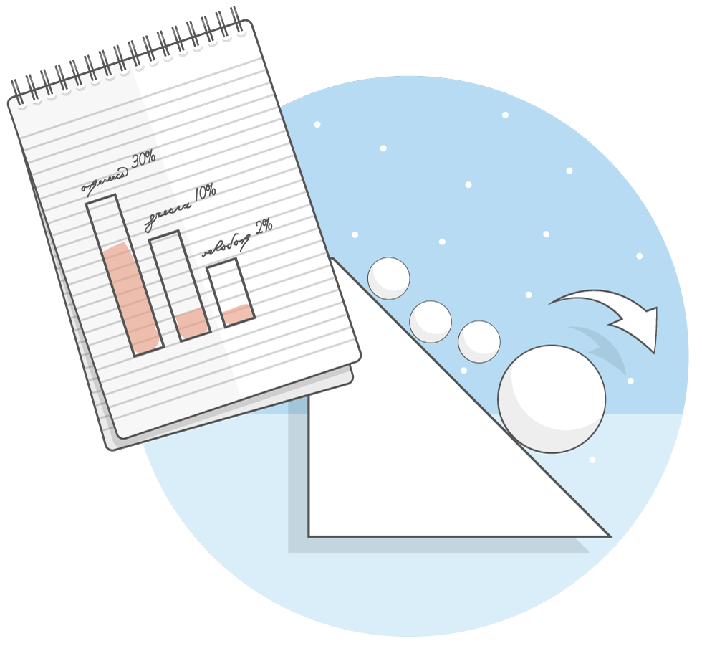
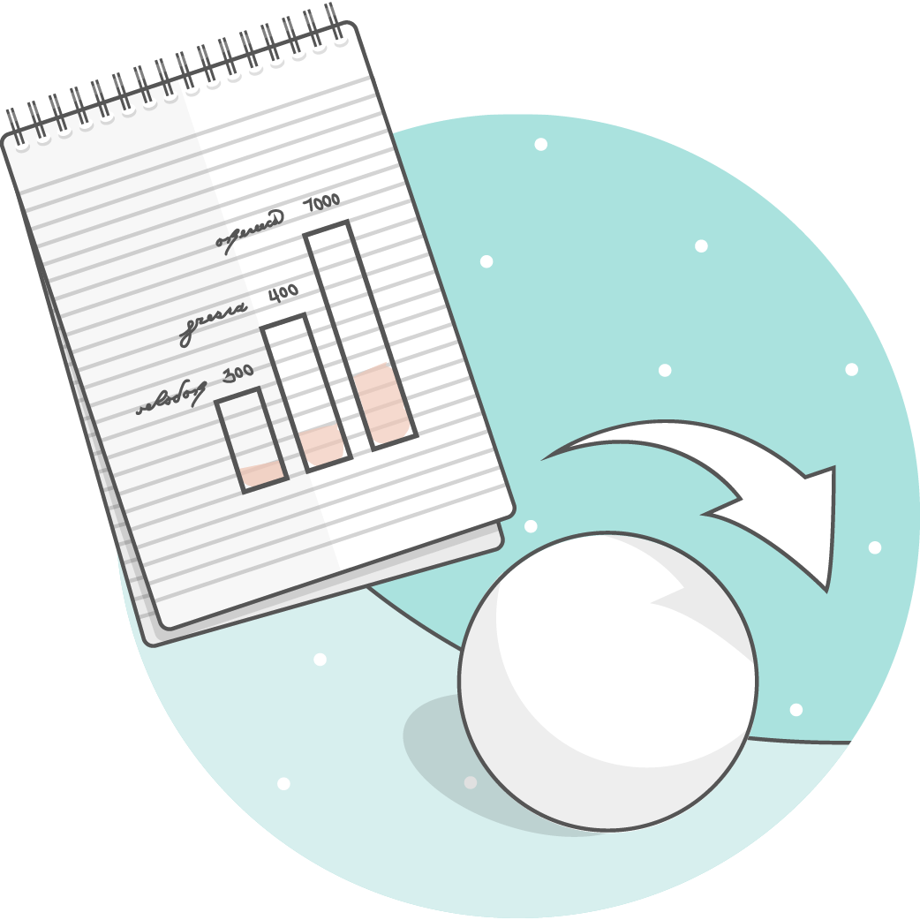
Debt Repayment Strategies
The Avalanche
Method:
Pay off debts with the highest interest first
Debt | Interest Rate | Balance
A. Major Credit Card | 26% | $3,000
B. Retail Credit Card | 22.3% | $800
C. Personal Loan | 15% | $1,800
D. Student Loan | 5% | $21,000
The Snowball Method:
Pay off debts with the lowest balance first

Slide 16

How Would You Deal with an Emergency?
Protecting Yourself
The average emergency financial shock is $2,000.
Aim to save at least 3 months of living expenses.
Remember to get insurance.

Slide 17
Participant Guide: Cutting Expenses
Expense | How much or what can be cut?

Slide 18
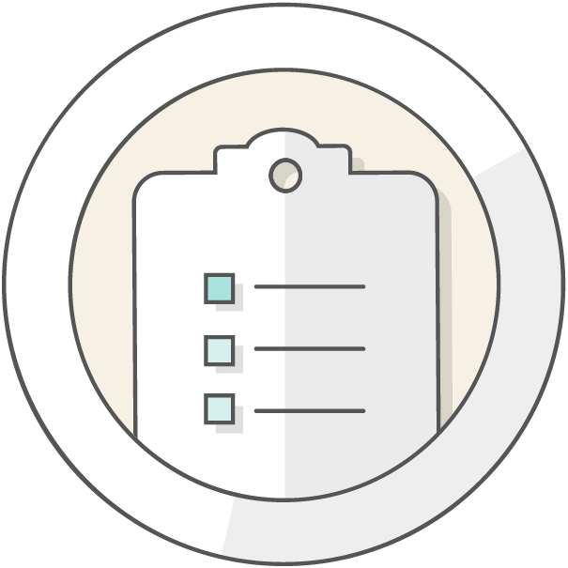
Strategies to Free Up Funds
Tips for Spending and Saving
Review subscriptions
Shop around
Check clearance aisles
Check mark-down sites
Buy in bulk
Get it when it’s hot
Rules for Deals
Check expiration dates
Look for defects and damage
Shop around
Will you use it?
Do you need it?

Slide 19

Strategies for Sticking to a Budget
Strategy #1
Focus on rewards versus punishments
Strategy #2
Make it automatic
Strategy #3
Create buckets
Strategy #4
Get real-time spending feedback, and set reminders
Don’t forget about your financial institution representatives. They might be able to help!

Slide 20


Summary
Today you have learned the following:
The 50/30/20 Rule can be used to help you create a manageable budget.
Increasing your emergency savings and decreasing debt will help you save more.
There are a variety of tips and strategies to help you free up funds and stick to a budget. Use the ones that work for you.
1
2
3
Copyright 2022 EVERFI, Inc.

