Slide 2
SBA 101
SBA Michigan District Office
February 28, 2023

Slide 3
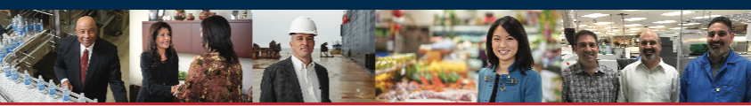
The SBA works to ignite change and spark action so small businesses can confidently
START • GROW • EXPAND • RECOVER
Notes:
Talking Points:
Working with the SBA, small business owners and entrepreneurs are empowered to succeed with access to capital, valuable resources, business know-how, and the right expertise for each stage of the business lifecycle.
Where are you in your business lifecycle? What are you looking to achieve? (lead-in to following topic slides)

Slide 4
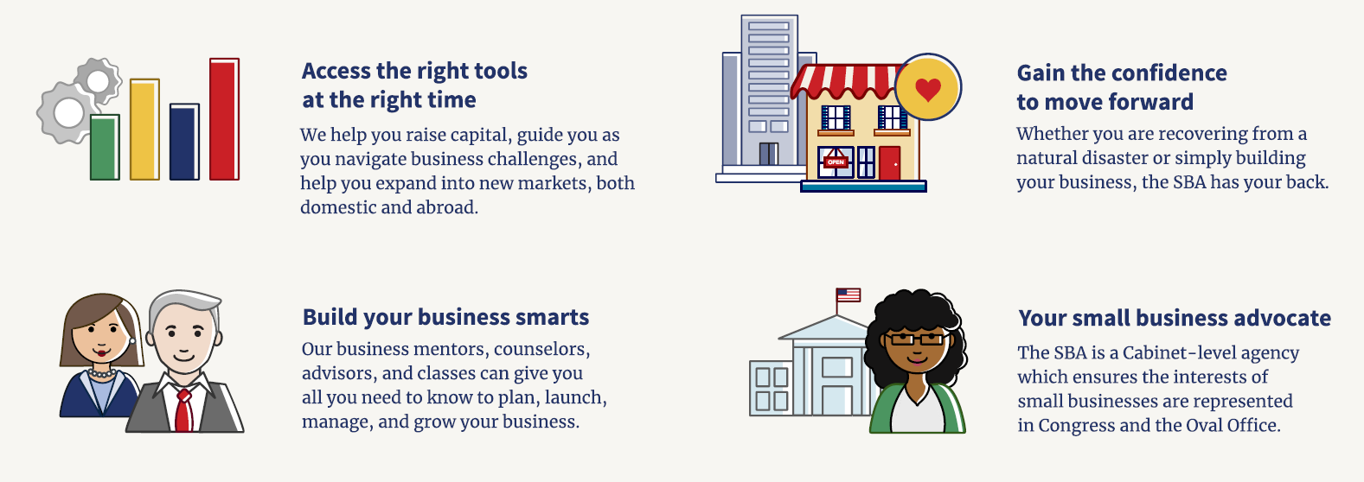
SBA Overview
The U.S. Small Business Administration makes the American dream of business ownership a reality.

Slide 5
Small Business Administration
The SBA is a federal agency dedicated to helping small business get started, grow and sustain viability, using the “4 C’s”
Access to Capital – through loan guaranty programs
Government Contracting
Counseling and entrepreneurial development
Crisis assistance through disaster loan programs

Slide 6
CAPITAL
Uses & Requirements

Slide 7

Financing Options – SBA Loans
How does the SBA help small businesses access capital?
SBA loans can mitigate reasonable policy or credit issues, helping you get a loan you couldn't get conventionally! For example,
Insufficient collateral available
Start ups (less than two years)
Business expansions
New management
Business acquisitions
High-risk industries - e.g. hotels/motels, restaurants,
car washes, gas stations
Uneven earning performance
Longer loan terms/maturities
When SBA IS NOT a Viable Option
An SBA guaranty does not make a bad deal good. Certain issues are ineligible and cannot be mitigated using SBA financing
Poor personal credit
Judgments and tax liens
Insufficient or unsupportable cash flow
No down payment / equity injection
Lack of collateral due to refusal to pledge assets
When the request or structure is ineligible

Slide 8
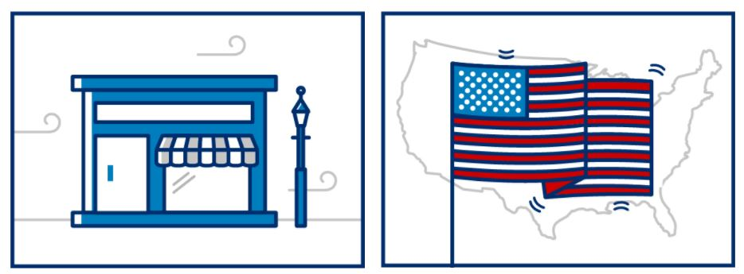
CAPITAL: REQUIREMENTS
The SBA works with lenders to provide loans to small businesses. We do not lend directly to small business owners.
Be a for-profit business: The business is officially registered & operates legally.
Do business in the U.S.: The business is physically located & operates in the U.S. or its territories.

Slide 9


CAPITAL: USES
Get $500 to $5.5 million to fund your business.
Working Capital: Seasonal financing, export loans, revolving credit & refinanced business debt.
Fixed Assets: Furniture, real estate, machinery, equipment, construction & remodeling

Slide 10

CAPITAL: REQUIREMENTS
The lender will provide you with a full list of eligibility requirements for your loan.
Have invested equity: The business owner has invested their own time or money into the business.
Exhaust financing options: The business cannot get funds from any other financial lender.

Slide 11
Financing Options – SBA Loans
SBA Loans from Traditional Lenders: Banks & Credit Unions
While the SBA does not provide direct loans to businesses, with the exception of disaster loans, the SBA provides a guaranty to participating (traditional) lenders.
The guaranty serves as a kind of “insurance” policy to the lender in the event a loan goes into default, the lender’s risk is offset by SBA’s guaranty.
SBA Loans from Non-Traditional Lenders: CDFIs and Micro Lenders
Loans are administered by nonprofit entities including quasi-governmental economic development entity such as a planning and development districts.
The purpose of the non-traditional loans is to assist women, low income, veteran, and minority entrepreneurs in need of small amounts of financial assistance.

Slide 12

Financing Options – SBA Traditional Loans
7(a) Loan Program
Term loans up to $5 Million
SBA Express: Term loans and lines of credit up to $500,000
SBA Veterans Advantage (SBA Express): Term loans and lines of credit up to $500,000 ; for veterans, active-duty military, and spouses (discount on guaranty fees)
Specialty Programs
Export Express, Export Working Capital, International Trade Loan
CAPLines: Asset-based financing
Loan Terms
Based on the useful life of the assets being financed
Loan Purpose Loan Terms
Working capital 1-10 years
Equipment, furniture, fixtures, etc. 5-10 years
R/E purchase and/or construction 25 years

Slide 13

EXPORTING: FINANCE OPTIONS
The SBA will provide lenders with up to a 90 percent guaranty on export loans.
Export Express Loan: Typically approved within 36 hours & can be up to $500,000.
International Trade Loan: Combination of fixed asset, working capital financing & debt refinancing. SBA’s maximum guaranty of 90%. Up to $5 million.
Export Working Capital Loan: Can apply in advance of finalizing export sale/contract. Approved within 5-10 days & can be up to $5 million.

Slide 14

SBA – State Trade Expansion Program (STEP)
The MEDC International Trade Program has a new allocation of State Trade Expansion Program (STEP) funds available for eligible small business concerns.
On September 8, 2022 the U.S. Small Business Administration (SBA) awarded Michigan the maximum state award of $1,400,000 in MI-STEP funds for FY23. With additional state match funding, total funds available are $1.86 million.
The program has three primary objectives:
Increase the number of Michigan small businesses that export
Increase the dollar value of Michigan exports
Increase the number of Michigan small businesses exploring significant new trade opportunities
Michigan’s State Trade Expansion Program | Michigan Business

Slide 15
Financing Options – SBA Traditional Loans
504 Loan Program
What is the 504 loan program?
The CDC/504 Loan Program provides long-term, fixed rate financing of up to $5 million for major fixed assets that promote business growth and job creation.
504 loans are available through Certified Development Companies (CDCs), SBA's community-based partners. CDCs are certified and regulated by SBA.
Am I eligible?
To be eligible for a 504 Loan, your business must:
Operate as a for-profit company in the United States or its possessions
Have a tangible net worth of less than $15 million
Have an average net income of less than $5 million after federal income taxes for the two years preceding your application
Other general eligibility standards include falling within SBA size guidelines, having qualified management expertise, a feasible business plan, good character and the ability to repay the loan.
Loans cannot be made to businesses engaged in nonprofit, passive, or speculative activities. For additional information on eligibility criteria and loan application requirements, small businesses and lenders are encouraged to contact a Certified Development Company in their area.

Slide 16
Financing Options – SBA Non-Traditional Loans
Micro-Loan: Under the Microloan Program, SBA makes direct loans to Intermediaries that, in turn, use the proceeds to make small loans to eligible Micro-borrowers.
Non-7(a) Loans
Loans through nonprofit lending organizations; technical assistance also provided.
Maximum loan amount is $50,000
Use of Proceeds: Purchase machinery & equipment, fixtures, leasehold improvements; working capital; etc. Cannot be used to repay existing debt.

Slide 17
Financing Options – SBA Non-Traditional Loans
Community Advantage: Community Advantage (CA) is a pilot loan program introduced by the U.S. Small Business Administration (SBA) to meet the credit, management, and technical assistance needs of small businesses in underserved markets. CA provides mission-oriented lenders, primarily nonprofit financial intermediaries focused on economic development, access to 7(a) loan guaranties for loans of $350,000 or less.
SBA’s goals for CA are to:
Increase access to credit for small businesses located in underserved areas;
Expand points of access to the SBA 7(a) loan program by allowing nontraditional, mission-oriented lenders to participate;
Provide Management and Technical Assistance (M&TA) to small businesses as needed; and
Manage portfolio risk. CA is scheduled to operate through September 30, 2024 unless extended or made a permanent part of SBA’s financial assistance programs

Slide 18
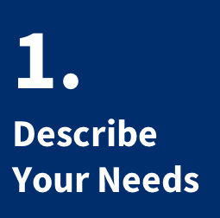
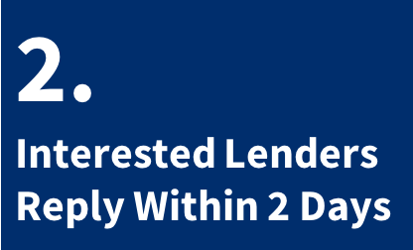
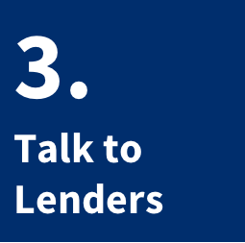
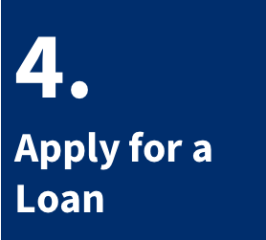
Lender Match
Find an SBA-approved lender that’s right for you by visiting
SBA.gov/lendermatch
Notes:
Talking Points:
Lender Match can help you connect with SBA approved lenders if you are credit worthy.

Slide 19
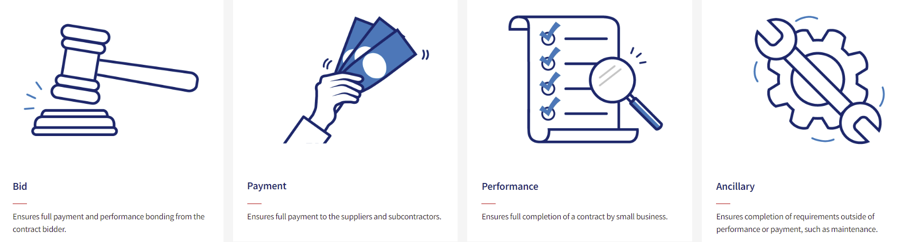
SBA Surety Bond Guarantee Program
SBA’s guarantee provides small businesses with contracting opportunities
Construction, service, supply & manufacturing firms
Limited financial resources
Internal financial statements
Need current bond limits increased
Subcontractors establishing prime bonding
New & emerging
To learn more or find authorized agents click here: Surety bonds (sba.gov)
Notes:
SBA assists many different types of small businesses through the Surety Bond Guarantee Program. Some of the types of small businesses that come to SBA for assistance with bonding are startups and newer firms, those with limited or insufficient capital, and those wishing to make the leap to larger project sizes or increased bonding limits. Maybe you’re in the subcontract trades and your GC bonds all of the projects you work on. If you want to be able to secure prime contracts in the future, bonding projects today and growing your bonding capacity can help you get there. SBA guarantees 80% - 90% of each bond based on the demographics of your business and it is our guarantee that allows our partner sureties to provide bonds for small businesses that they otherwise would consider too risky.

Slide 20
Fund Innovations with the SBIR-STTR Program
Technology-focused small businesses looking to fund research and development or prototyping operations, may qualify for federal grants from 11 federal agencies participating in the SBIR-STTR program.
Key areas for funding include:
Artificial intelligence
Nanomaterials
Clean energy
Water filtration
Education technology
Wearable technology
Learn more at SBIR.gov
For one-on-one support please contact the MISBDC Tech Team
Notes:
Talking Points:
Organized by the SBA, this program allows 11 federal agencies to fund promising technology without forcing entrepreneurs to give up equity or ownership of their company.
Technology-focused small businesses looking to fund research and development or prototyping operations can take advantage of the $2.5 billion in federal funding that is made available every year through the SBIR/STTR programs.
Federal agencies with SBIR programs: Department of Energy, National Science Foundation, Department of Education, Department of the Navy

Slide 21
CONTRACTING
Certifications & Registration

Slide 22



Are You Ready to Consider Federal Contracting?
U. S. Federal government is the world’s largest buyer of goods and services.
Government purchases total over $533 billion a year.
Required by law to provide contract opportunities to small businesses
The statutory goals:
23% to small businesses
5% to small disadvantaged businesses for prime
and subcontracts, including 8(a)
5% to women-owned small businesses for prime
and subcontracts
3% to Historically Underutilized Business Zone
(HUBZone) small businesses
3% to small service-disabled, veteran-owned
businesses for prime and subcontracts
Evaluate your readiness & learn more by visiting:
SBA.gov/contracting

Slide 23

CONTRACTING: CERTIFICATIONS
The federal government tries to award a significant percentage of government contracting dollars to small businesses, including those in the following programs:
8(a) Business Development: Owned by socially & economically disadvantages people or entities.
HUBZone Program: In historically underutilized business zone, w/ 35 percent of employees living in a HUBZone.

Slide 24
CONTRACTING: CERTIFICATIONS
The federal government tries to award a significant percentage of government contracting dollars to small businesses, including those in the following programs:
Women-Owned Small Business Program: Be 51% owned & controlled by women who are U.S. citizens; women manage day-to-day operations.
Service-Disabled Veteran-Owned Small Business Program: Be 51% owned & controlled by service-disabled veteran; must have service-connected disability.

Slide 25

Contracting Programs
Resource Partner Engagement
SCORE/SBDC/WBC/ VBOC (VetBizCentral):
SBA:
Maintain Compliance
Marketing to Federal Government
Handling Protests
PTAC:
Business Assessment
Government Contract Specific Research
Procurement Training
Idea Stage/Startups
SAM registration
Business Counseling in the areas of Finance, Management and Marketing
Market Research
Eligibility
Certification
Existing businesses

Slide 26
COUNSELING
Mentors & Advisors

Slide 27
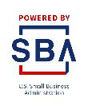



The SBA Resource Partner Network
Access the right tools at the right time—wherever you are.
Approved and funded by the SBA
1,400+ partner offices nationwide
Find local resource partners near you at
SBA.gov/local-assistance
Notes:
Talking Points:
When you need reliable advice to start or grow your business, the SBA can connect you with experts who understand the business climate at both a national level, as well as in your specific region or market.
The SBA’s Resource Partner Networks helps to extend our reach to serve the nation’s small business community outside of our District Offices.
Whether you need to create successful business plan, get expert advice on expanding your business, or train your team, the SBA makes sure you’re never far from the help you need.
In FY 2017, over 1.4 million small business owners received counseling or training from an SBA resource partner.
You can find resource partners closest to you using our local partners search page at SBA.gov/local-assistance.
Tips:
Provide a few examples of experts and resource partners in your community in your community.
Distribute or reference the associated Fact Sheet.

Slide 28

Which Resource Partners are Right for You?

Slide 29

COUNSELING: RESOURCES
The SBA has a number of resource partners to help you achieve success.

Slide 30
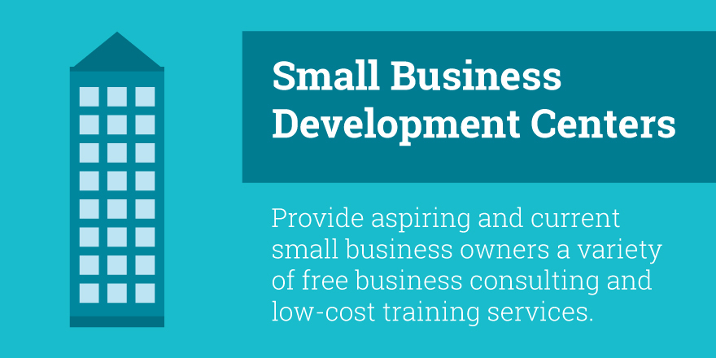
COUNSELING: RESOURCES
The SBA has a number of resource partners to help you achieve success.

Slide 31
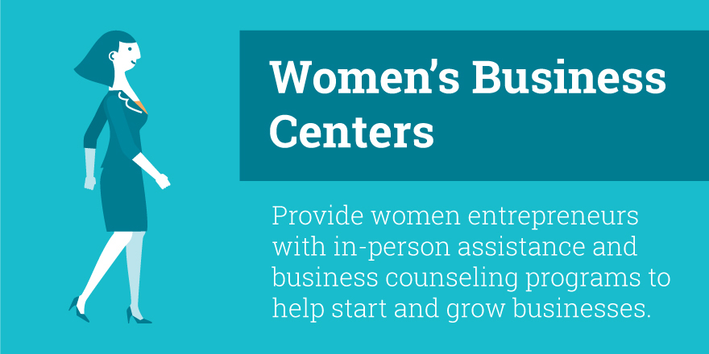
COUNSELING: RESOURCES
The SBA has a number of resource partners to help you achieve success.

Slide 32
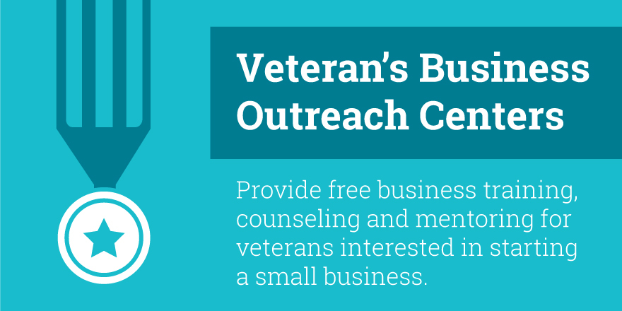
COUNSELING: RESOURCES
The SBA has a number of resource partners to help you achieve success.

Slide 33
SBA Resource Partner Contacts
ORGANIZATION | LOCATIONS | CONTACT | WEBSITE
SBA | Detroit | 313-226-6075 Michigan@sba.gov | www.sba.gov/mi
Small Business Development Center Network | MISBDC Lead Center/HQ | 833-522-0025 | Find local contacts at www.sbdcmichigan.org
SBA Funded Women’s Business Centers | Livonia – Southeast MI Grand Rapids – West MI Benton Harbor – Southwest MI | 734-677-1400 616-458-3404 269-925-6100 | www.greatlakeswbc.org www.growbusiness.org www.cornerstonewbc.com
SCORE – Mentors to Small Business | Ann Arbor Southeast MI Grand Rapids Kalamazoo Muskegon Petoskey Traverse City | 734-929-1121 313-226-7947 616-771-0305 269-888-6667 231-347-4150 888-796-4913 | www.annarborarea.score.org www.semichigan.score.org www.grandrapids.score.org www.swmiscore.org www.muskegon.score.org www.tipofthemitt.score.org www.traversecity.score.org
Veterans Business Outreach Center | Statewide | 810-767-8387 | www.vetbizcentral.org
All locations are working remotely. Contact by phone or email.
Notes:
Cashflow management
Messaging and social media
Import/Export
Supply chain issues
Strategic planning Risk managment

Slide 34
SBA Non-Bank Lenders
Lender Name | SBA Lender Type/Loan Program | Phone | Website
Michigan Certified Development Corporation (MCDC) | CDC-504; Community Advantage | 517-886-6612 | https://michigancdc.org/
Great Lakes Commercial Finance (GLCF) | CDC-504 | 616-459-4825 | https://glcf.org/
Oakland County Business Finance Corporation | CDC-504 | 248-858-0765 | SBA 504 Loans (oakgov.com)
Metro Community Development | Community Advantage and Microlender | 810-767-4622 | https://metrocommunitydevelopment.com/
Northern Great Lakes Initiative | Community Advantage and Microlender | 906-228-5571 | https://northerninitiatives.org/
Opportunity Resource Fund | Community Advantage | 517-372-6001 | https://oppfund.org/
CEED Lending (Great Lakes Women's Business Council) | Microlender | 734-677-1400 | https://www.greatlakeswbc.org/ceed-lending/
Michigan Women Forward | Microlender | 313-962-1920 | https://miwf.org/
Grand Rapids Opportunities for Women (GROW) | Microlender | 616-458-3404 | https://growbusiness.org/
CDC Small Business Finance | Community Advantage | 313-648-2838 | https://cdcloans.com/
National Development Council | Community Advantage | 959-888-1728 | www.ndconline.org
Detroit Development Fund (DDF) | Community Advantage | 313-784-9547 | https://www.detroitdevelopmentfund.com/
All locations are working remotely. Contact by phone or email.
Notes:
Cashflow management
Messaging and social media
Import/Export
Supply chain issues
Strategic planning Risk managment

Slide 35
CRISIS
Disaster Financing Assistance

Slide 36
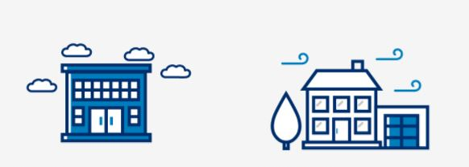

CRISIS: QUALIFYING
The SBA provides low-interest disaster loans to help small businesses & homeowners recover from declared disasters for a number of purposes:
Disaster assistance (sba.gov)
Real Estate
Personal Property
Economic Injury
Machinery & Equipment
Inventory
Active Military Duty

Slide 37

RECOVERY: APPLYING
To qualify, your business or home must be in an affected area as stated by a disaster declaration.
Check disaster declarations: See if the SBA has issued a disaster declaration in your area.
Apply for a disaster loan: Loans are available for businesses & homes affected by disaster.
Check your status: Log into your account & check your email for updates.

Slide 38
Questions?

Slide 39
To Learn More About All of the SBA’s Programs
Visit: www.sba.gov
&
www.sba.gov/mi

Slide 40
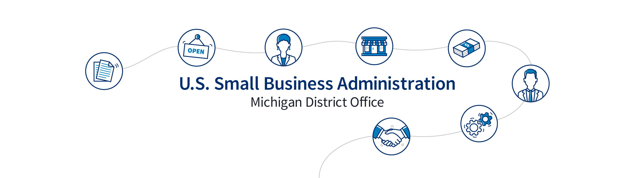
Contact Us!
General Email: Michigan@sba.gov
Michigan District Office: 477 Michigan Ave., Suite 515, Detroit, MI 48226
Phone: 313-226-6075
Grand Rapids Branch Office: Ford Federal Bldg., #307,
110 Michigan St. NW , Grand Rapids, MI
Phone: (616) 456-5512

