Slide 1

SCORE Workshop: Aiken Chamber of Commerce
Aiken, SC USA
June 23, 2017
Dr. Paul Newsom CFA
University of South Carolina Aiken |CSR Angels
Associate Professor of Finance | Managing Director

Slide 2
Welcome to the SCORE workshop on Working Capital & Cash Flow!
This workshop will evaluate and analyze working capital and measures of cash flow.

Slide 3
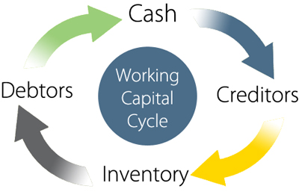

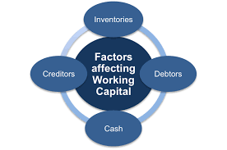
Working Capital
What is it?
Why is it important?
Who cares?

Slide 4
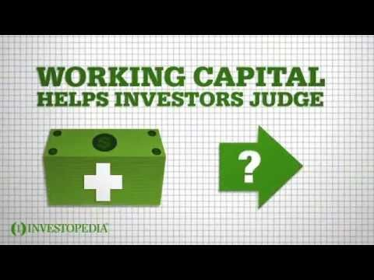
Working Capital

Slide 5
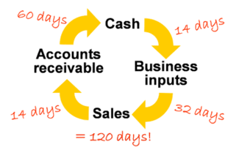

Ratios Reflecting Working Capital
Inventory conversion period:
$\text{ICP}\text{ = }\frac{inventory}{cost of goods sold}×365$
Receivables collection period:
$RCP= \frac{receivables}{credit sales}×365$
Payables deferral period:
$PDP= \frac{payables}{cost ofgoods sold}×365$

Slide 6

Cash Conversion Period
c$ash conversion period \left(CCP\right)=$
$$inventory conversion period \left(ICP\right)+receivables collection period \left(RCP\right)− payables deferral period (PPD)$$

Slide 7
CCC Timeline
Purchase materials or inventory
Pay cash for materials or inventory
Sale of product or service
Collect cash from sale of product or service
Payables deferral period =
30 days
Inventory conversion period = 45 days
Receivables collection period =
30 days
Cash conversion cycle (CCC) = 45 + 30 – 30 = 45 days
Day 1
Day 30
Day 45
Day 75

Slide 8
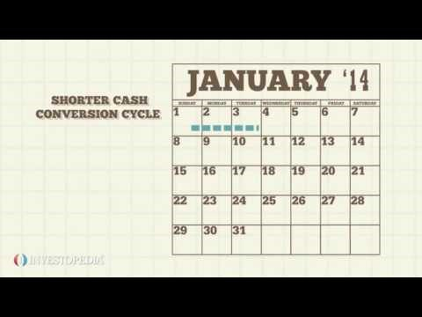
Cash Conversion Period

Slide 9

Important Working Capital Ratios
Net working capital:
$NWC=CA −CL$
Current ratio:
$CR= \frac{current assets (CA)}{current liabilities (CL)}$
Quick ratio:
$QR= \frac{CA −inventory}{CL}$

Slide 10
Practice Time!
Use your own financials to compute ratios and cash conversion cycle.
OR
Use financials statements provided.
Application: What does the ratio say? What does the ratio mean? How can you use this ratio to help you make better decisions?

Slide 11
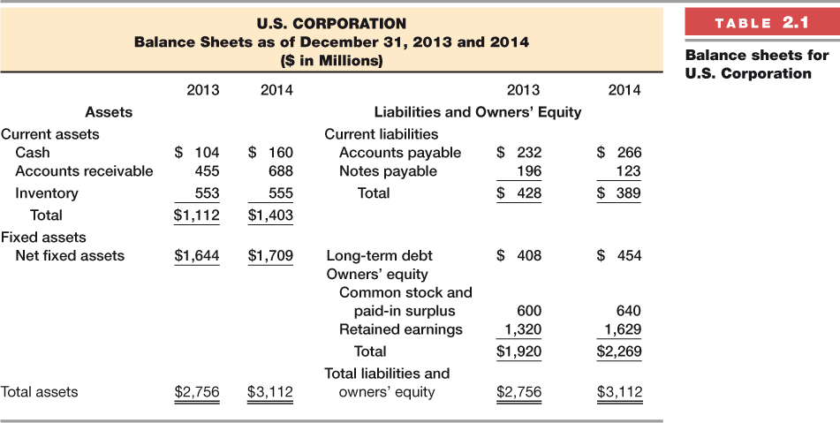

Slide 12
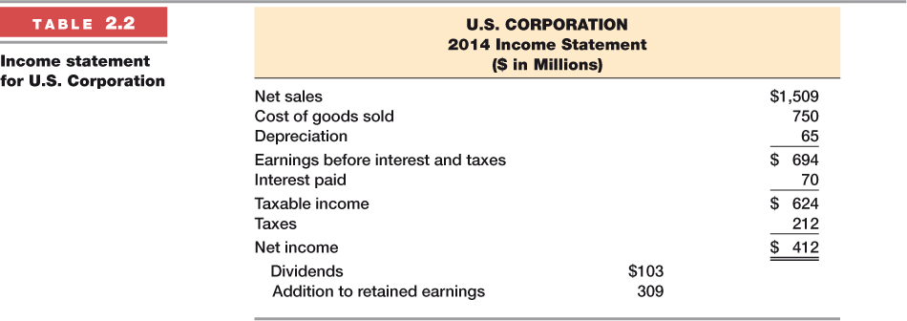

Slide 13
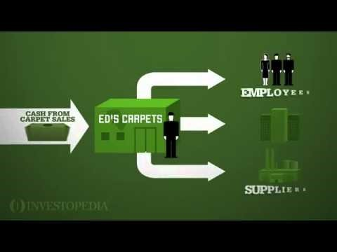
Cash Flow Process

Slide 14

Operating Cash Flow (OCF)
Measures the cash produced by operating your business before making any investment in working capital or fixed capital (property, plant, and equipment) necessary to grow the business or keep the business a going concern.
It’s the cash flow that debt investors and equity investors have claim to.
$$OCF=EBIT −taxes+depreciation$$
Income Statement
Sales
- Variable operating expenses (cogs)
= Gross profit
- Fixed operating expenses (S,G, & A)
= EBITDA
- Depreciation & amortization
= EBIT
- Interest expense
= EBT
- Tax
= Net income (profit)
Noncash expense!!

Slide 15

Net Cash Flow (NCF)
Measures the cash produced by operating your business before making any investment in working capital or fixed capital (property, plant, and equipment) necessary to grow the business or keep the business a going concern.
It’s the cash flow that equity investors (business owners) have claim to.
$$NCF=Net income+depreciation$$
Income Statement
Sales
- Variable operating expenses (cogs)
= Gross profit
- Fixed operating expenses (S,G, & A)
= EBITDA
- Depreciation & amortization
= EBIT
- Interest expense
= EBT
- Tax
= Net income (profit)

Slide 16


Free Cash Flow to Equity (FCFE)
Free Cash Flow to Firm (FCFF)
$$FCFF=EBIT−Taxes+Depreciation−WCInv−FCInv$$
$$FCFE=NI+Depreciation−WCInv−FCInv+Net borrowing$$
Measures the cash produced by operating your business after making all investments in working capital or fixed capital (property, plant, and equipment) necessary to grow the business or keep the business a going concern.
It’s the cash flow that equity (business owners) and debt investors are FREE to distribute to themselves.
Measures the cash produced by operating your business after making all investments in working capital or fixed capital (property, plant, and equipment) necessary to grow the business or keep the business a going concern.
It’s the cash flow that equity investors (business owners) are FREE to distribute to themselves.

Slide 17

Free Cash Flow Firm (FCFF)

Slide 18

Practice Time!
Use your own financials to compute ratios and cash conversion cycle.
WCInv = NWC_{yr=t} – NWC_{yr=t-1}
FCInv = netFixedAssets_{yr=t} – netFixedAssets_{yr=t-1} + Depreciation Expense
$FCFE=NI+Depreciation−WCInv−FCInv+Net borrowing$
OR
Use financials statements provided.

Slide 19
Cash Budgeting (short-term financial planning)
A process used to plan for storage of excess cash or financing of cash shortfalls (not enough cash).
It records estimates of cash receipts and cash disbursements
  Daily, weekly, monthly, quarterly
Starting point: Forecasting Sales (i.e., sales budget)
  Many important items on the income statement and on the balance sheet are related to sales.

Slide 20
Example: Cash Budget

Slide 21
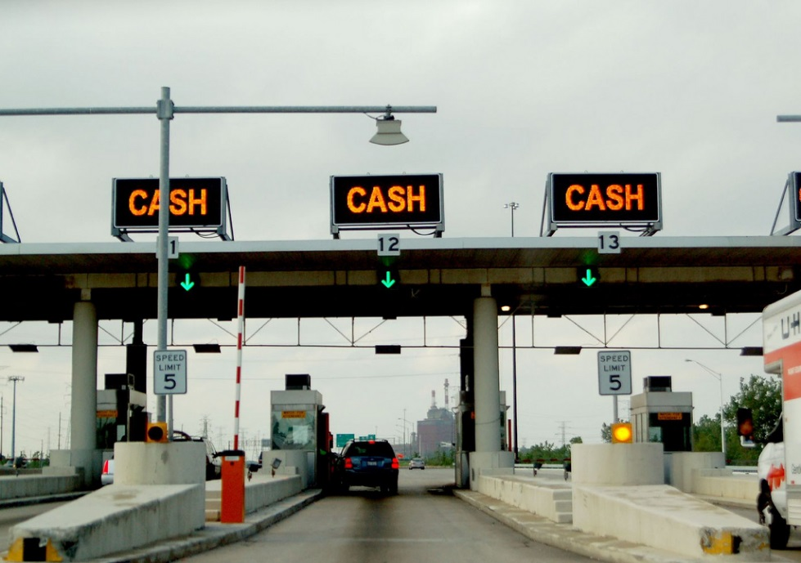

Cash Collections

Slide 22
Cash Disbursements

Slide 23
Cash Disbursements

Slide 24
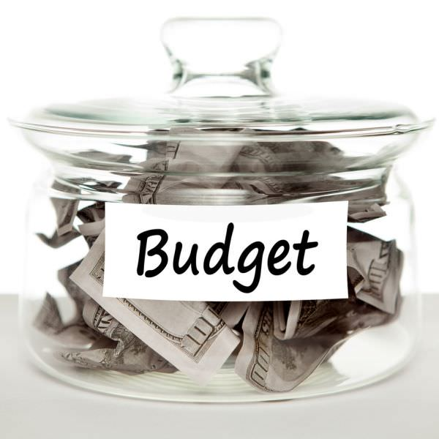
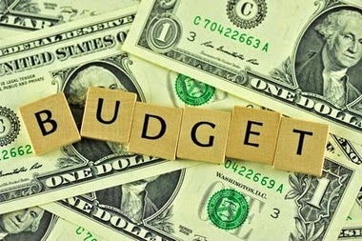
Cash Budget

Slide 25
Thank You for attending the SCORE Workshop on Working Capital and Cash Flow!
June 23, 2017
Dr. Paul Newsom CFA
University of South Carolina Aiken |CSR Angels
Associate Professor of Finance | Managing Director

