Slide 1

Social Media Marketing
www.BlueSalamanderSolutions.com
803-270-3762
laura@bluesalamandersolutions.com

Slide 2

Where do I start?
Social media: Websites and apps than enable users to create and share content to participate in social networking
Social Media Platforms:
  Pinterest
  Google Plus
  YouTube
  LinkedIn
  Twitter
  Blogs
  Facebook
  Apps, e.g., NextDoor, Instagram: Software application that you can download to a mobile device

Slide 3

Pinterest
Pinterest is an online site where you can save (pin) and organize images and videos into different groupings (boards). You can upload images and videos yourself, or you can add images and videos that you’ve found on other web sites. You can also “re-pin” pictures and videos that other people have added to their Pinterest boards.
Tips:
  Complete Your Profile on Your Biz Account
  Verify Your Website
  Set Up Pinterest Rich Pins (e.g., Recipe Pins, Purchase Pins)
  Get Your Pinterest Terminology Down
  Resources: Pinterest for Beginners

Slide 4

Google +
Google + allows businesses to connect with fans, join communities, and also works with Google search engines.
Features:
Works with Google Search Listings
Storefront
Circles
Community Engagement
Share Circle
2017 options include Image Zooming, comments filtering, new interface, Events
Resources: Tips
Resources: Creating a Google + Page

Slide 5

YouTube
YouTube is an video sharing website where you can create a channel with a Gmail account.
Features:
  Allows you to edit videos
  Allows you to embed videos into websites or social media and create a following
  Allows disabling of ads
  Can be used with Google Adwords
  Resources: YouTube Tips for Business

Slide 6

LinkedIn
LinkedIn is a Professions Networking Platform, which works well with B2B organizations, and allows you to network with other professionals.
Options:
Share articles, documents, photos, courses, or updates
Create Leads
Show Projects
Join Groups
Connect with other professionals
Use as Networking tool to meet like-minded professionals
Resources: 45 Experts Share Their Biggest Linkedin Marketing Strategy

Slide 7


Other Platforms
Blogs and Apps can be a great supplement to your other platforms.
Regularly updated website that allows for users to contribute
Great for using in conjunction with other Platforms
Resources: Writing a Successful Blog
Podcast Apps
NextDoor
Resources: Best Social Media Apps

Slide 8
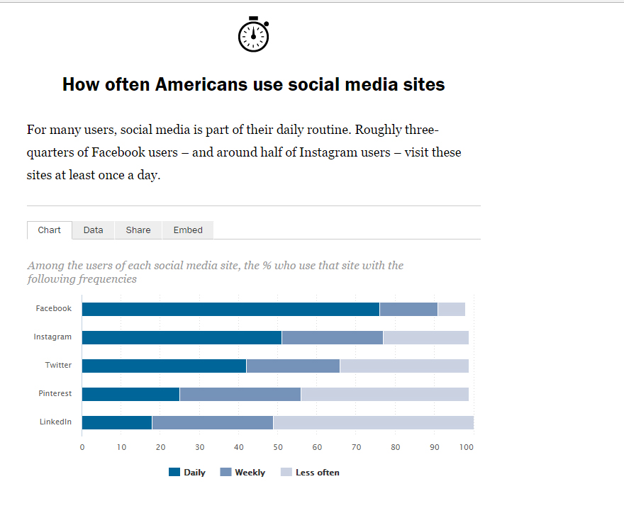
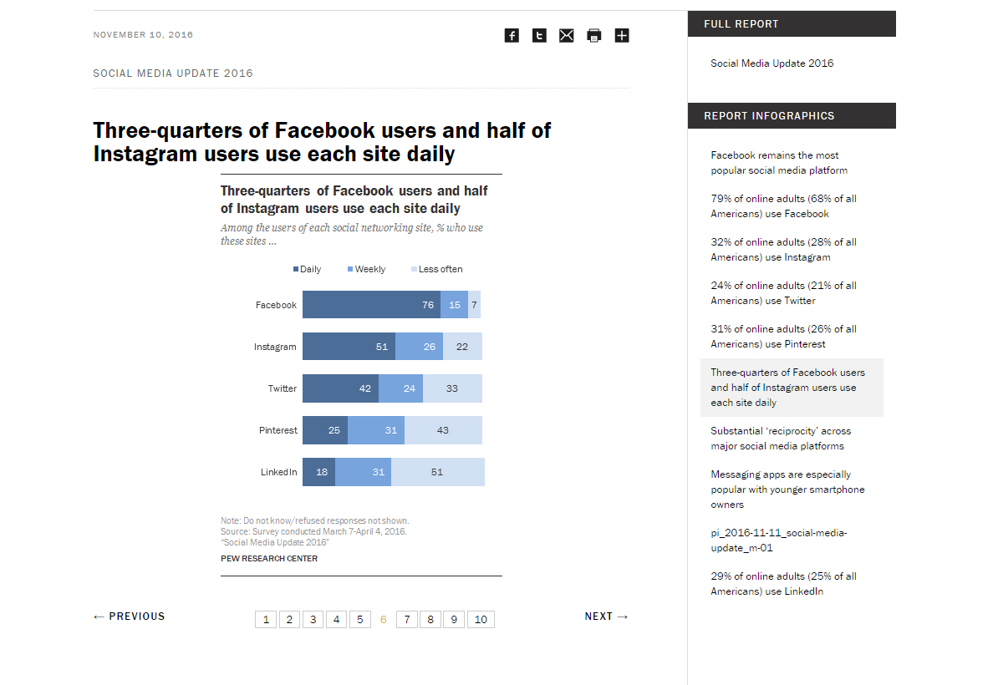
Social Media Trends
Source: Pew Research Center

Slide 9
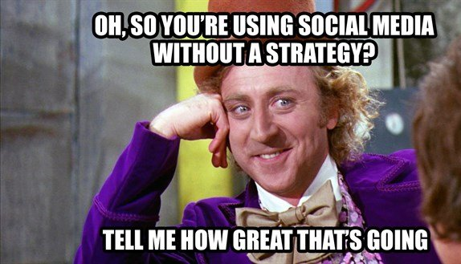
Creating a Strategy for Campaigns

Slide 10


What are you trying to accomplish?
What actions will help you achieve these goals?
Goals
Actions
Brand Management
Responses (e.g., website traffic, purchases, donations, leads)
Maintaining a market presence
Creating awareness about a cause
Promoting events
What actions will help me achieve these goals?

Slide 11
Social Media Management Tools
Best Practices
Use a social media calendar for your campaign, keeping your goals in mind
Schedule posts
Resource: Social Media Strategy Template
Resource: Social Media Content Calendar Template
Social Media Content Platforms
Use a social media content platform to manage your various social media sites
Use HootSuite as a Social Media Management Platform
Resource: Manage multiple social networks, connect with customers

Slide 12

How Often Should I Post?
Source: Constant Contact: Social Media Posting Guidelines
Guidelines
Facebook: 3-10 times per week
Twitter: at least 5 times a day
LinkedIn: 2-5 times per week
Google+: 3-10 times per week
Pinterest: 5-10 times per day
Blog: It depends on your goal

Slide 13

Twitter
Source: Pew Research Center
21% of US adults use Twitter
36% of Twitter users are ages 18-29

Slide 14

Twitter Uses
Campaigns
Events
Lifestyle hashtags (#outdoorlife)
Trending hashtags
Q&A sessions
Encourage participation
Brand management
Promoting new products
Asking customers to live-tweet

Slide 15

Best Practices
Use the 80/20 Rule:
  20%: Content that deals with your brand and info that benefits your audience (discounts, etc.)
  80%: Interesting Content that is shareable
Follow influencers, and learn from what they find interesting.
Share interesting content with your own followers, and try to connect to them.
Engage with your influencers so it motivates them to want to share your own content.

Slide 16

Hashtags
Hashtag: A word or phrase preceded by a hash or pound sign (#) and used to identify message on a single topic messages on a specific topic.

Slide 17
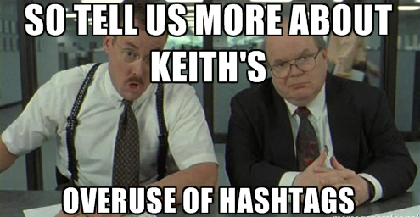
Hashtags Best Practices
Don’t #overuse #hashtags. It dilutes your message. One – three should be the maximum. Your engagement drops by 17% by overusing.
Use relevant, unbranded hashtags, e.g., #exploreBC
Don’t hashtag everything
Research the hashtags used by your industry

Slide 18
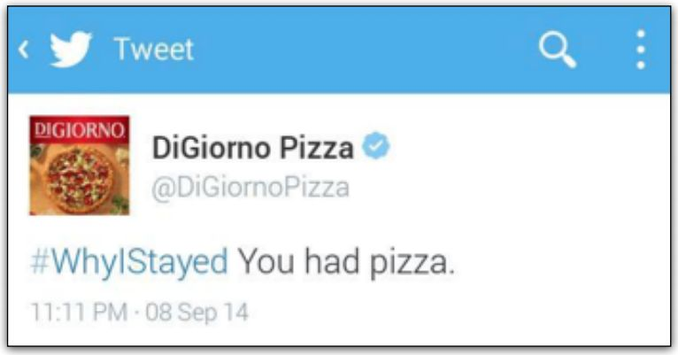
Research Trending Hashtags
What better way to promote your pizza..

Slide 19
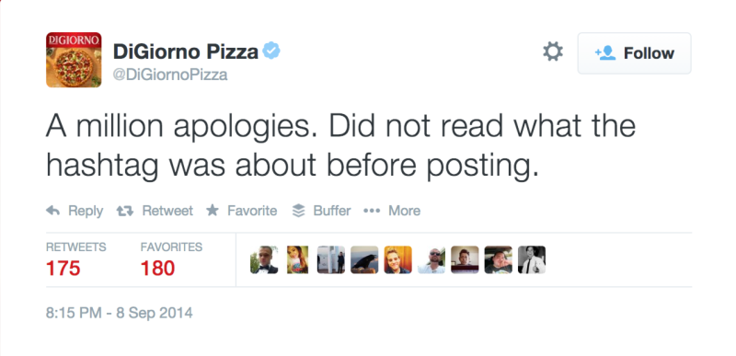
…than to associate your product with domestic violence
#oops

Slide 20

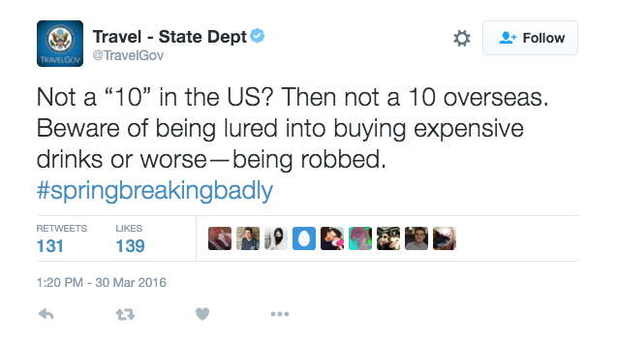
Best Practices
Use a consistent voice

Slide 21
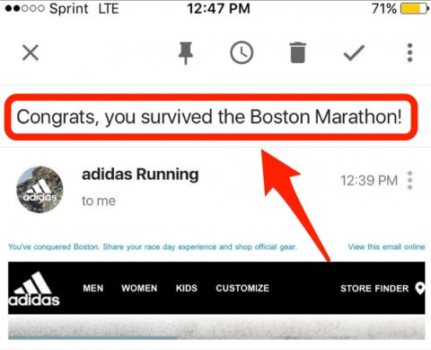
Think Before You Post
#toosoon
#oops

Slide 22
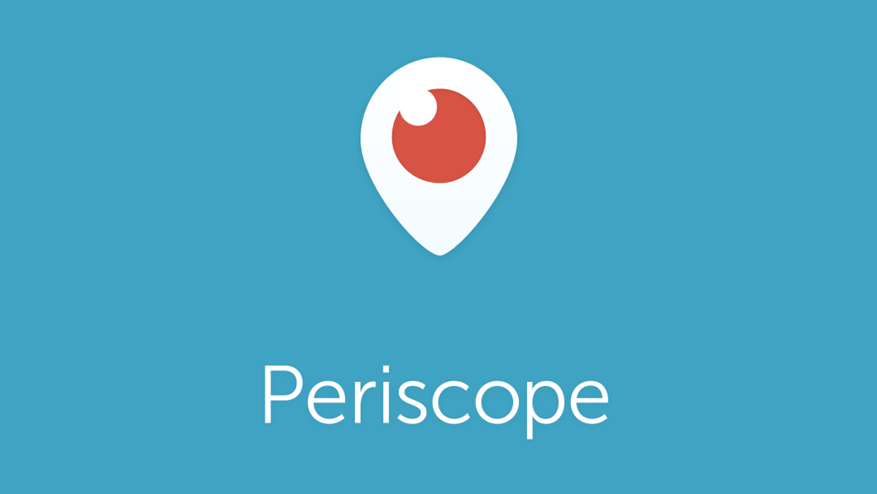
Live Stream Video

Slide 23
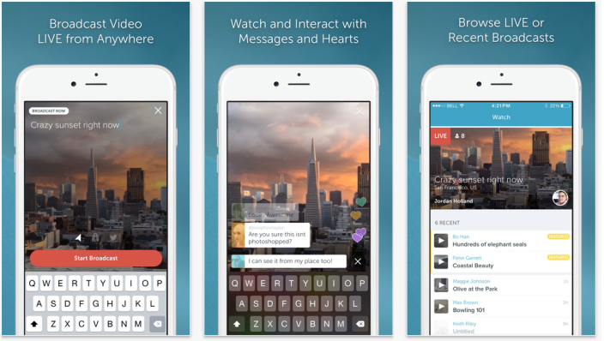
Periscope Overview
Owned by Twitter
Available on IOS and Android
2 million daily active users

Slide 24

Facebook
Facebook remains the most popular Social Media Platform, used by 79% of adults who use the internet
Most Facebook users use the site daily

Slide 25
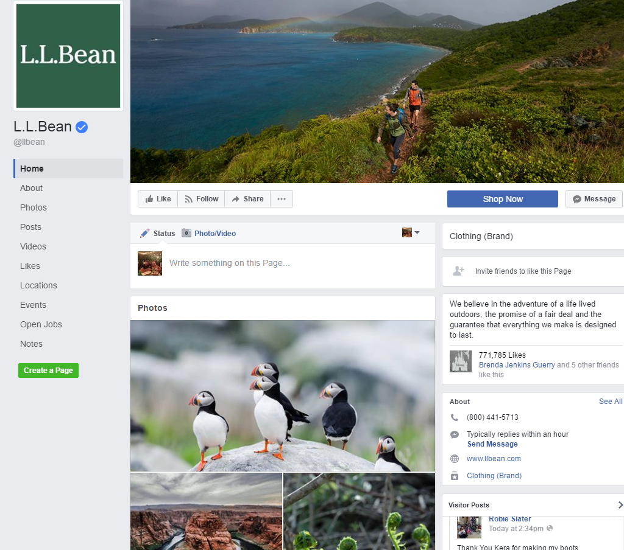
Best Practices
Create a business page
Verify your page
Invite friends to Like your page
Enable Reviews
Use the correct size cover photo (851px by 315px)
Use the correct size for profile picture (180px x 180px)
Look at your settings
  Publishing options, messaging options, Page roles, etc.

Slide 26

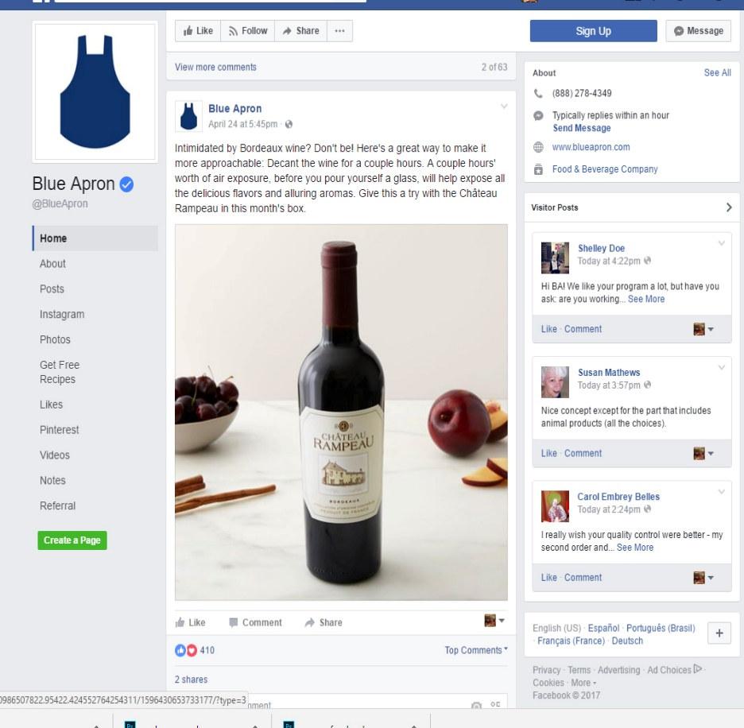
Don’t oversell. Promote.
Your audience doesn’t want to hear about your product. They want to know how your product can solve a problem for them.
Buy my product now!!!
Promote your product

Slide 27
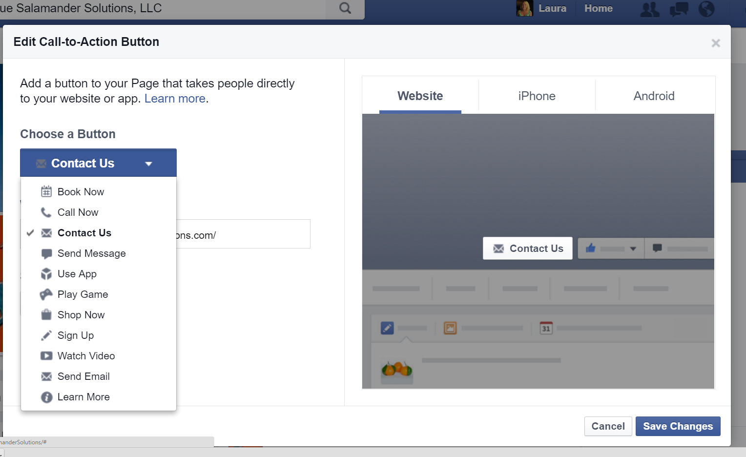
Add a Call to Action

Slide 28
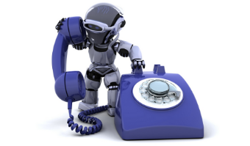
Automated Customer Service
Always be available

Slide 29

Real Time Customer Service
Enable Instant Replies
“Thank you for sending us a message! Our average response time on Facebook is 6 hours or less. If you would like to speak to a customer service representative, please call 800-whatever or click here to submit a service request

Slide 30
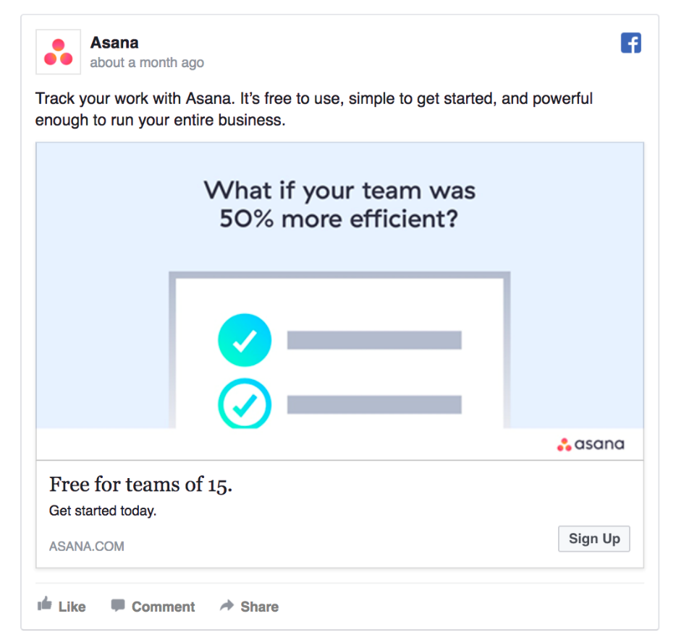
Tips for Effective Posts
Write magnetic headlines
Ask fascinating questions
Keep your headlines at the right length
Give tips
Link to your blog or other platforms
Use emojis to catch attention
Engage your fans
Use videos
Promote events
Schedule your posts

Slide 31

Add Events to Facebook
Add Events
Advantages
Easy to invite
RSVP
Allows for purchasing tickets online
Increase customer engagement
Attendance Metrics

Slide 32
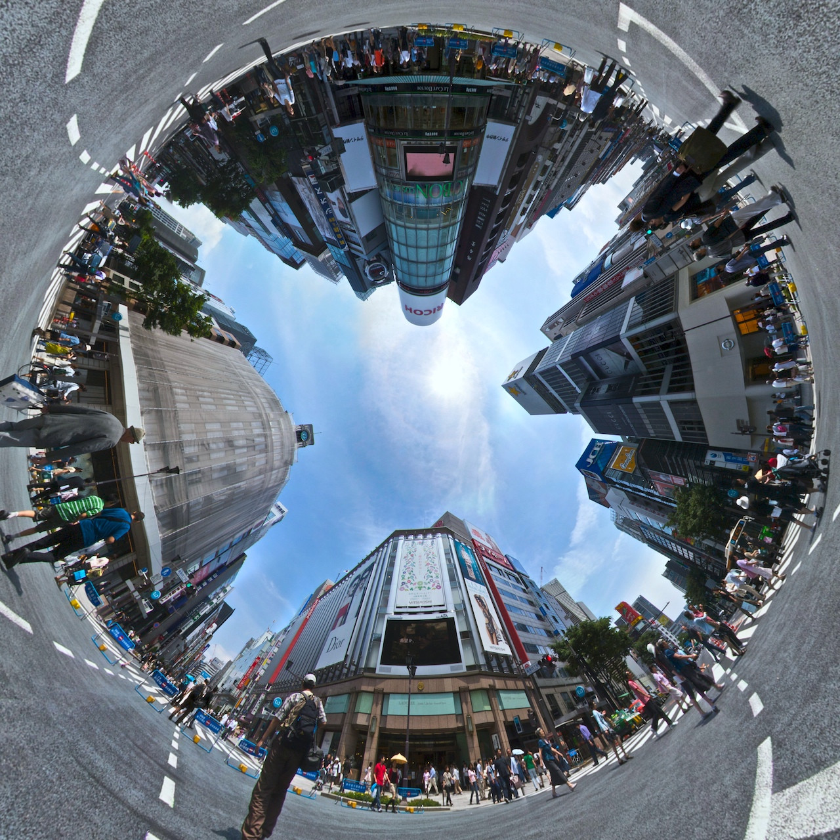
Use 360 Video

Slide 33
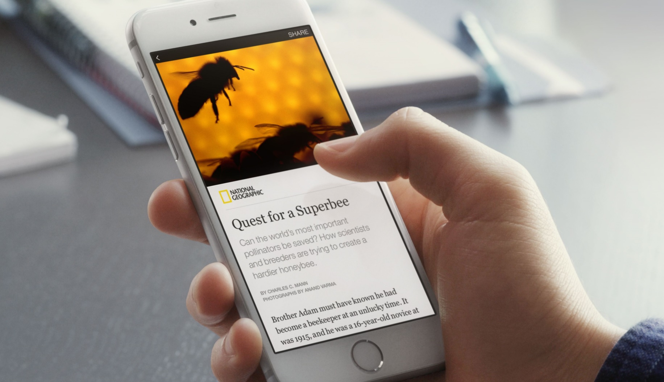
Inform your Audience
Add Instant Articles

Slide 34

Facebook Live

Slide 35
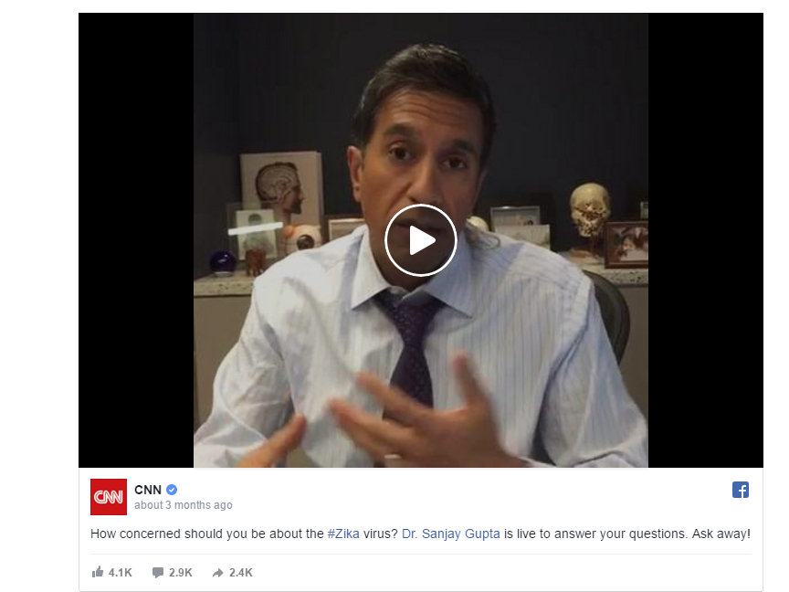
Livestream Your Content
Livestreaming
Best Practices
Promote before you broadcast
Prepare
Decide whether to use a mount or hold the phone yourself
Enlist a colleague
Use a spot with a strong internet connection
Enable Do Not Disturb
Encourage Feedback
Show something interesting

Slide 36

Artificial intelligence

Slide 37

Facebook chatbot

Slide 38
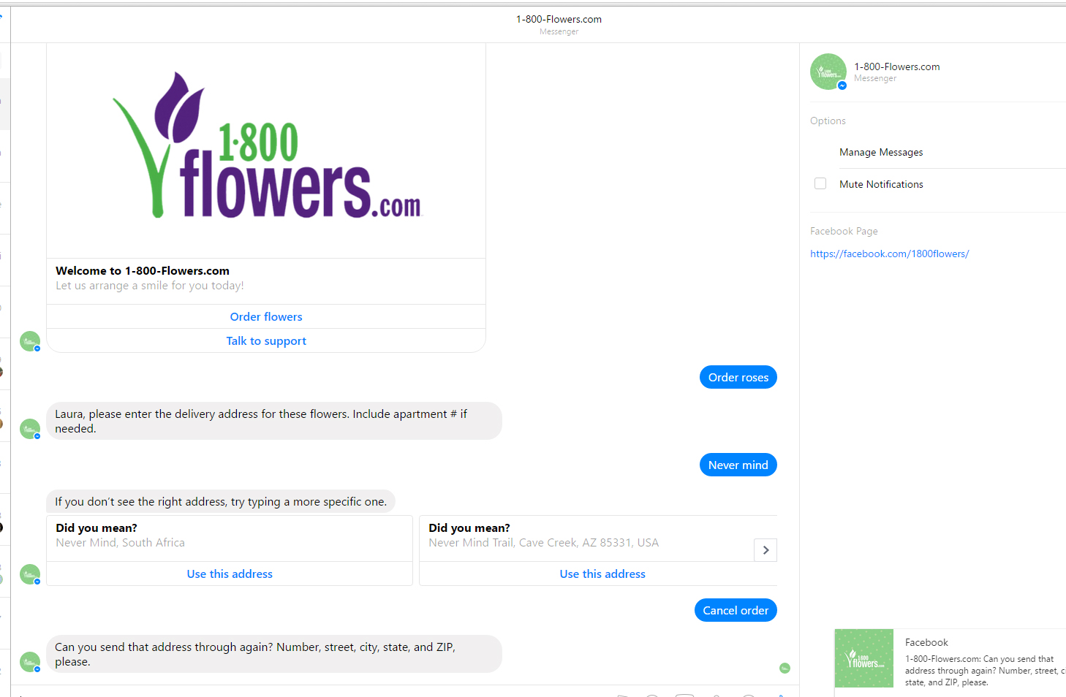
Facebook chatbot example

Slide 39

Measure your results
Available in Settings
How will you know if it’s working?
Insights (Page views, likes, engagements, etc.)
Reach
Page Views
Actions on page
Data about posts
Video views
Demographics on people who like your page

Slide 40

Analyze reactions using Insights

Slide 41

Facebook Ads
Facts
Organic reach is at an all time low (2 – 6%)
Reach more customers
Choose your demographics

Slide 42
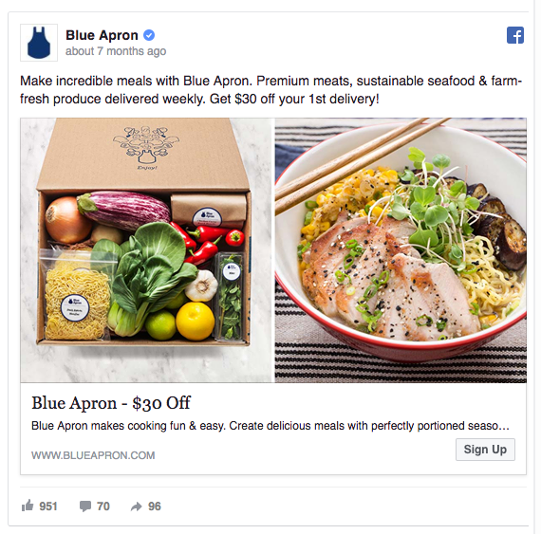
Facebook Ads Best Practices
Organic reach is at an all time low (2 – 6%)
Keep your headlines at the right length
  Headlines with 60-100 characters earn the highest CTR
  Ads decrease with headlines with fewer than 60 characters and more than 100 character
Use action verbs
  Examples are get, try subscribe, start
Include numbers
Use photos, videos, or slideshow
Include numbers in headlines
Check your analytics for CTR and conversion rate
Target your audience
Select the right advertising goal

Slide 43
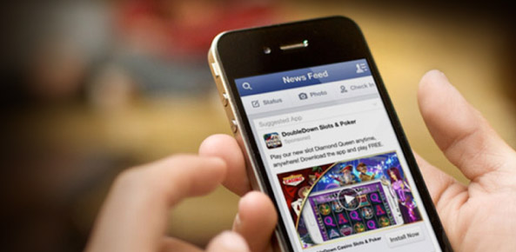
Facebook Ad Features
Slideshow ads
Video ads
Canvas
Connection targeting

Slide 44

Repurpose Your Content

Slide 45

Putting It All Together
Use a calendar (preferably one with reminders)
Make a schedule
Devise your campaign to achieve your goals
Measure your goals, and revise if necessary

Slide 46
Thank You!
www.BlueSalamanderSolutions.com
803-270-3762
laura@bluesalamandersolutions.com

