Slide 1

Building your Website
www.BlueSalamanderSolutions.com

Slide 2

What are you trying to accomplish?

Slide 3

Website Checklist

Slide 4
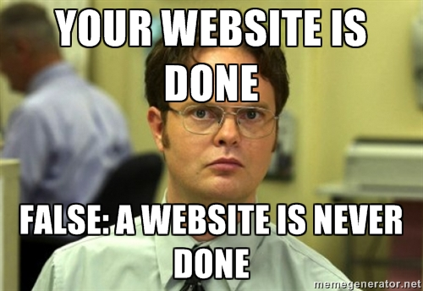
Update your website

Slide 5

Is your website responsive?

Slide 6
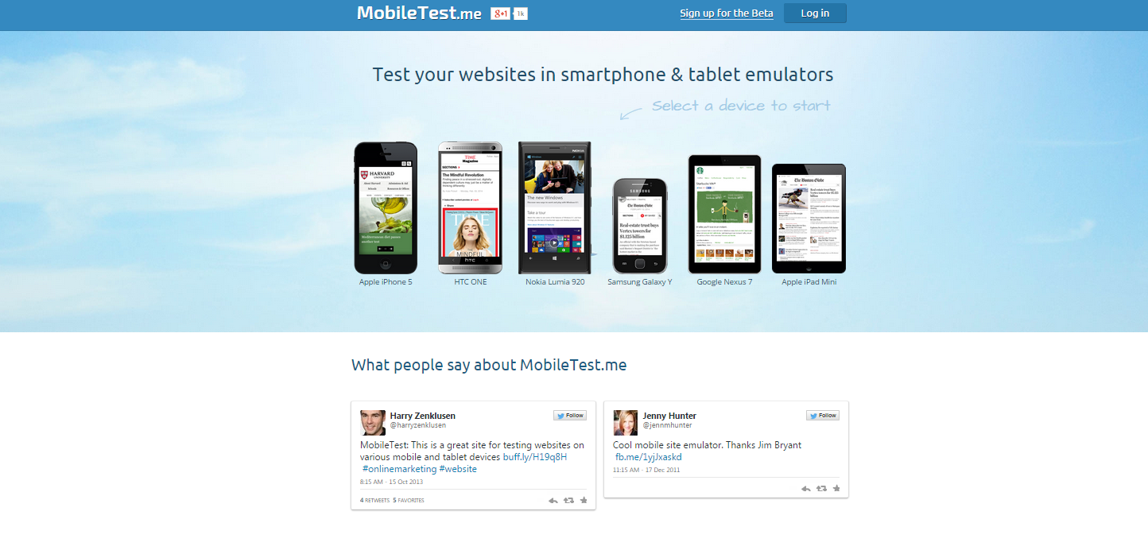
Test your site in all devices

Slide 7

Mobile-friendly links

Slide 8

Check for Broken Links

Slide 9

Call to Action

Slide 10
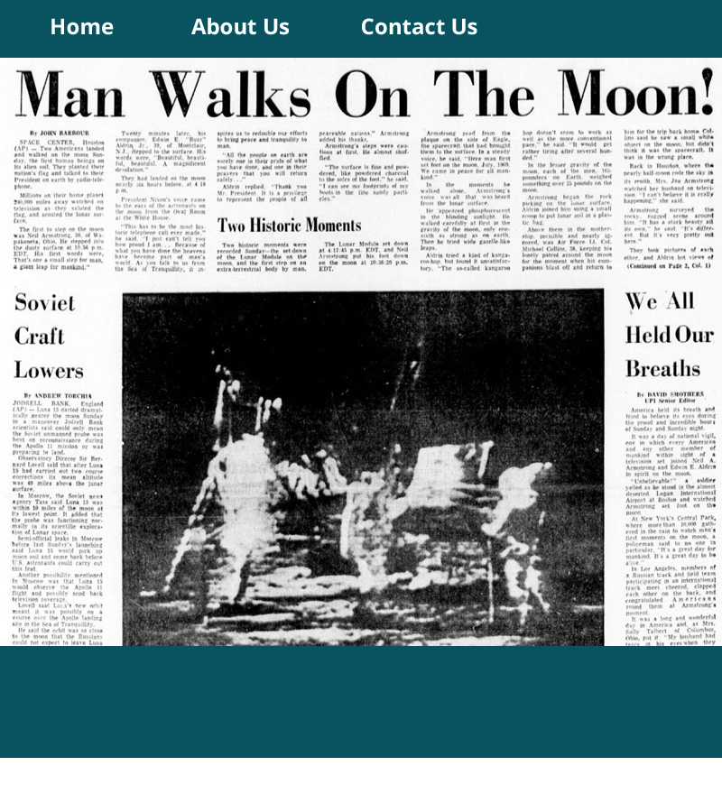
Is your content fresh?

Slide 11

Add Social Media Icons

Slide 12
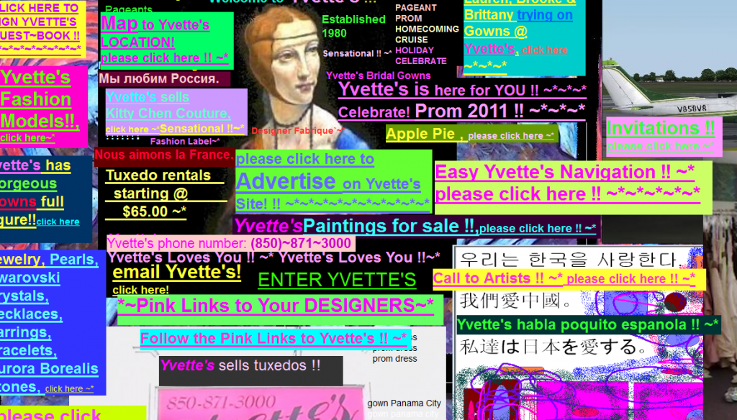
Not easy to Navigate

Slide 13

Intuitive navigation

Slide 14
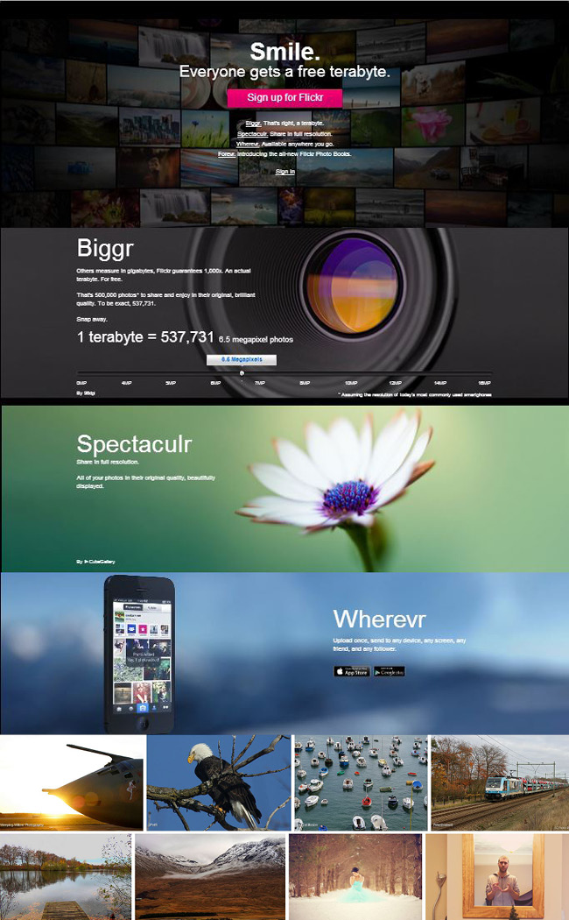
Long scroll

Slide 15

Use Professional Photos

Slide 16
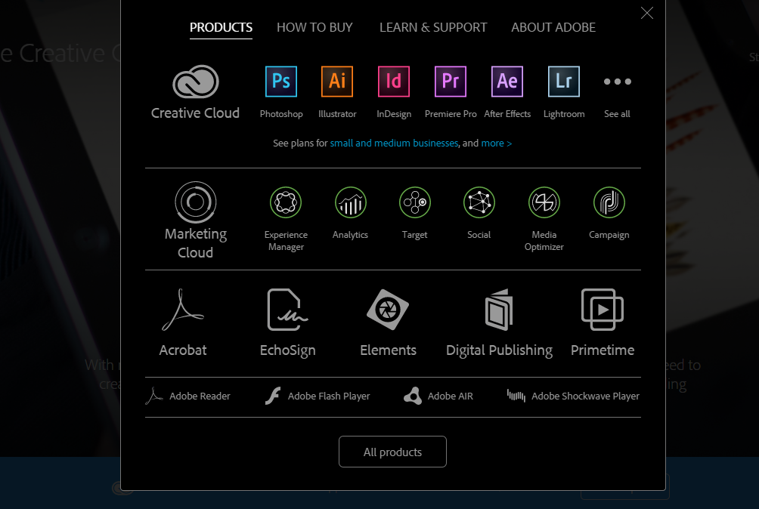
Photo Editing Resources

Slide 17

Web Friendly Logo

Slide 18

2017 Trends

Slide 19
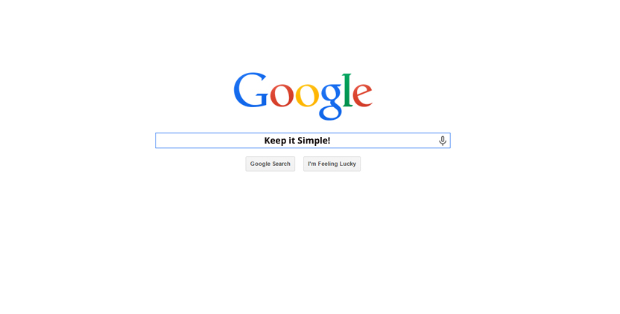
Keep it Simple

Slide 20

AI

Slide 21

Parallax Scrolling

Slide 22
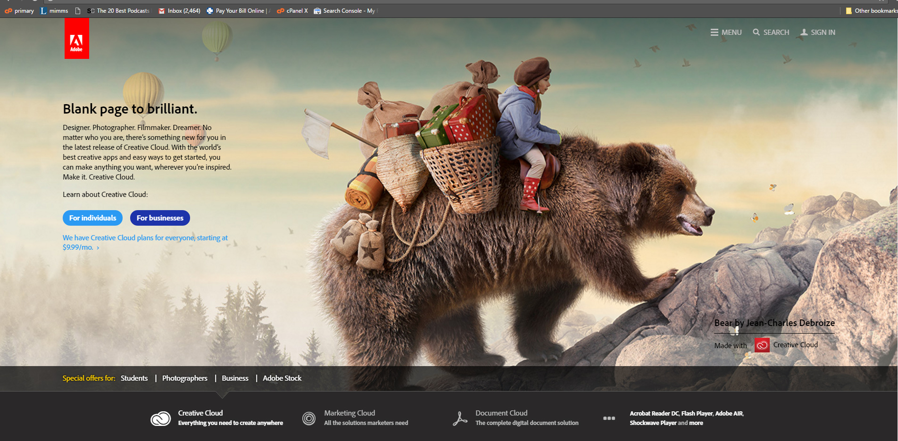
Customized Art

Slide 23

Full Screen Videos

Slide 24

Google updates

Slide 25

https//
Hypertext Transfer Protocol Secure

Slide 26

Popup Ads

Slide 27

Website Don’ts

Slide 28

Don’t use graphics for text

Slide 29
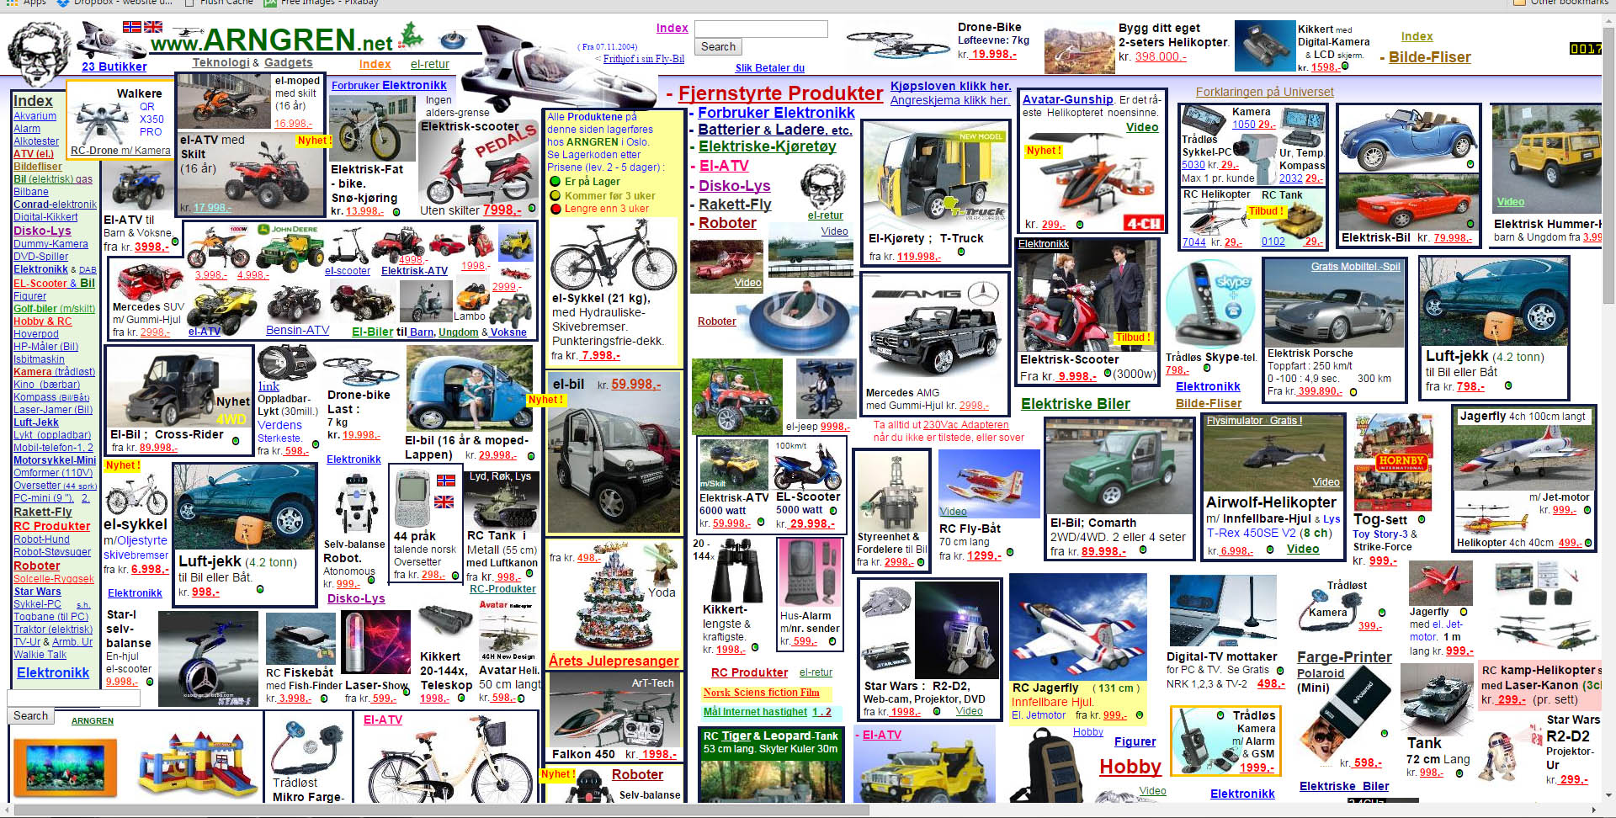
Less is More

Slide 30

Stay away from Monetized Ads

Slide 31

Website Security

Slide 32
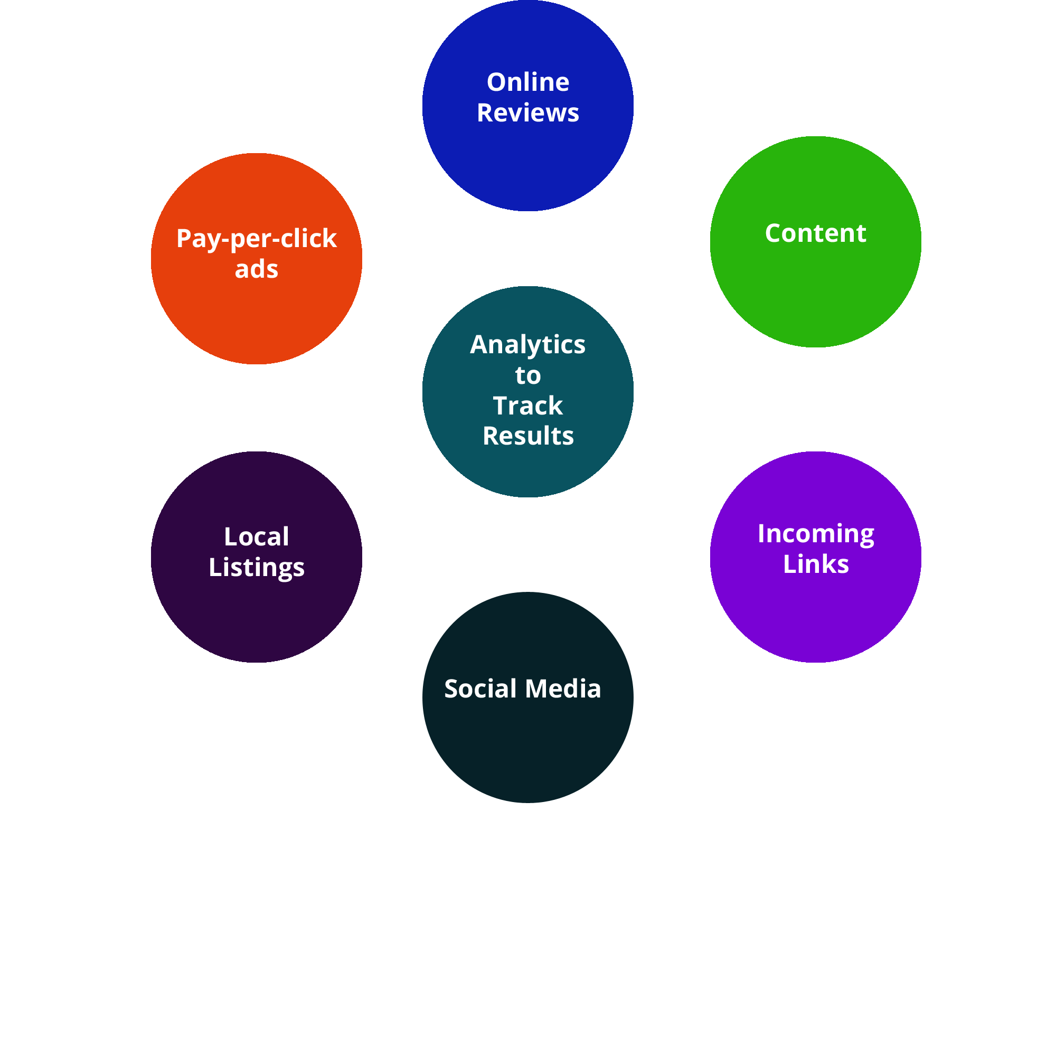
SEO

Slide 33
Thank you!
www.BlueSalamanderSolutions.com
803-270-3762
sales@bluesalamandersolutions.com

