Slide 1

Product Positioning and the Management of Brand Identity
Richard Heiens, Ph.D.
Professor of Marketing
Walter F. O’Connell Palmetto Professorship

Slide 2
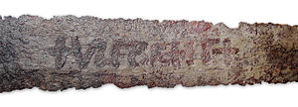
The Ulfberht Swords _________________________________________
About 170 medieval swords found in Europe by archeologists studying the Viking age
Dated from the 9th to the 11th centuries

Slide 3
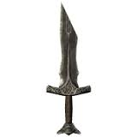
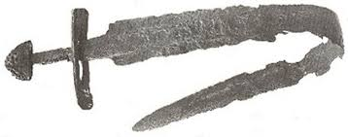
Traditional Swords of the Day _________________________________________
Made from low quality bog iron
These swords were either too brittle or bent easily

Slide 4
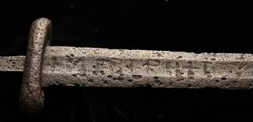
Ulfberht Technology _________________________________________
Made of premium materials
Often made from high-quality crucible steel
Contains low levels of impurities
Requires precise control over temperature
The temperature of the forge must be over 3000 degrees Fahrenheit
Steel of this level of quality was not found again in Europe for another 1000 years

Slide 5
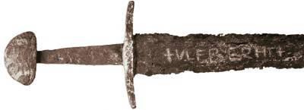
The Ulfberht Knockoffs _________________________________________
Many of the Ulfberht swords were found to have a slight shift in spelling
+ULFBEHR+T (the genuine spelling)
+ULFBEHT+ or +ULFBEHRT+ (examples of alternative spelling)
All of the misspelled Ulfberht swords were found to be made of inferior quality steel

Slide 6
Differentiation and Positioning _________________________________________
Differentiation
Creating differences in the firm’s product offering that set it apart from competing offerings
Positioning
Creating a mental image of the product offering and its differentiating features in the minds of the target market
Relative Position
A product’s position vis-à-vis the competition
Addressed through two tools
Perceptual mapping- A visual, spatial display of customer perceptions that allows monitoring of product positioning relative to other products
Strategy canvas

Slide 7
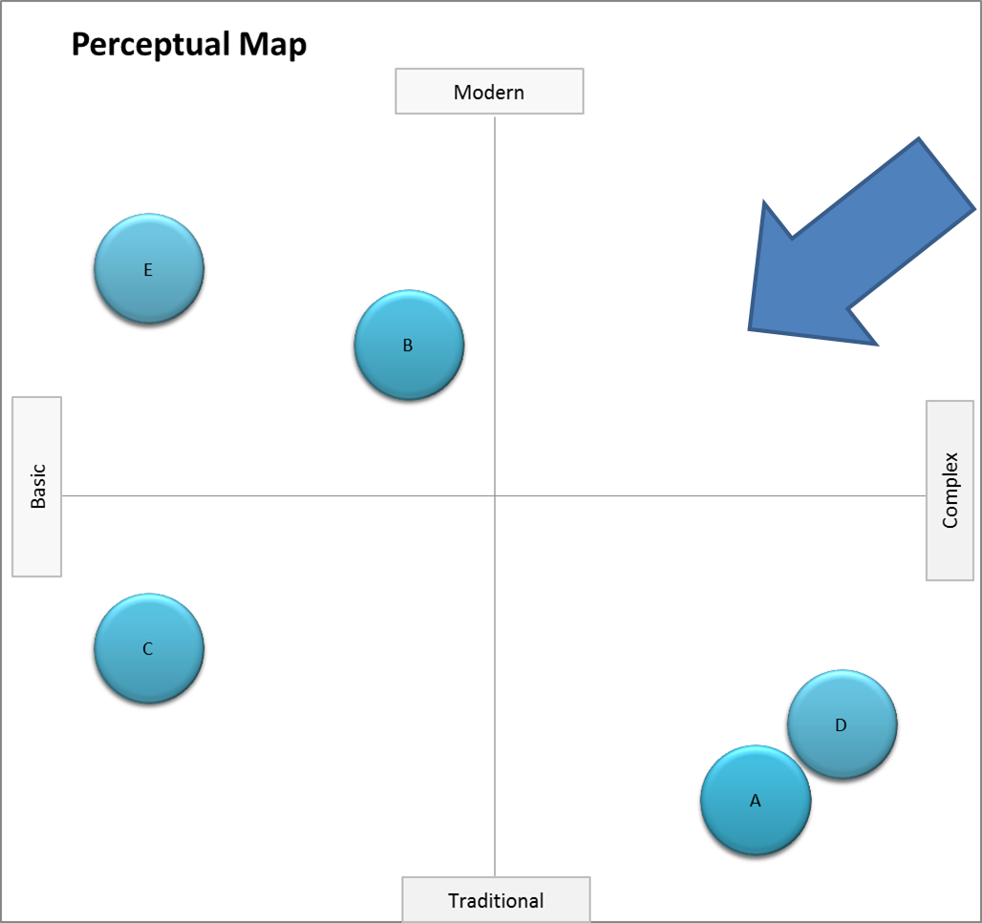
Perceptual Map _________________________________________

Slide 8
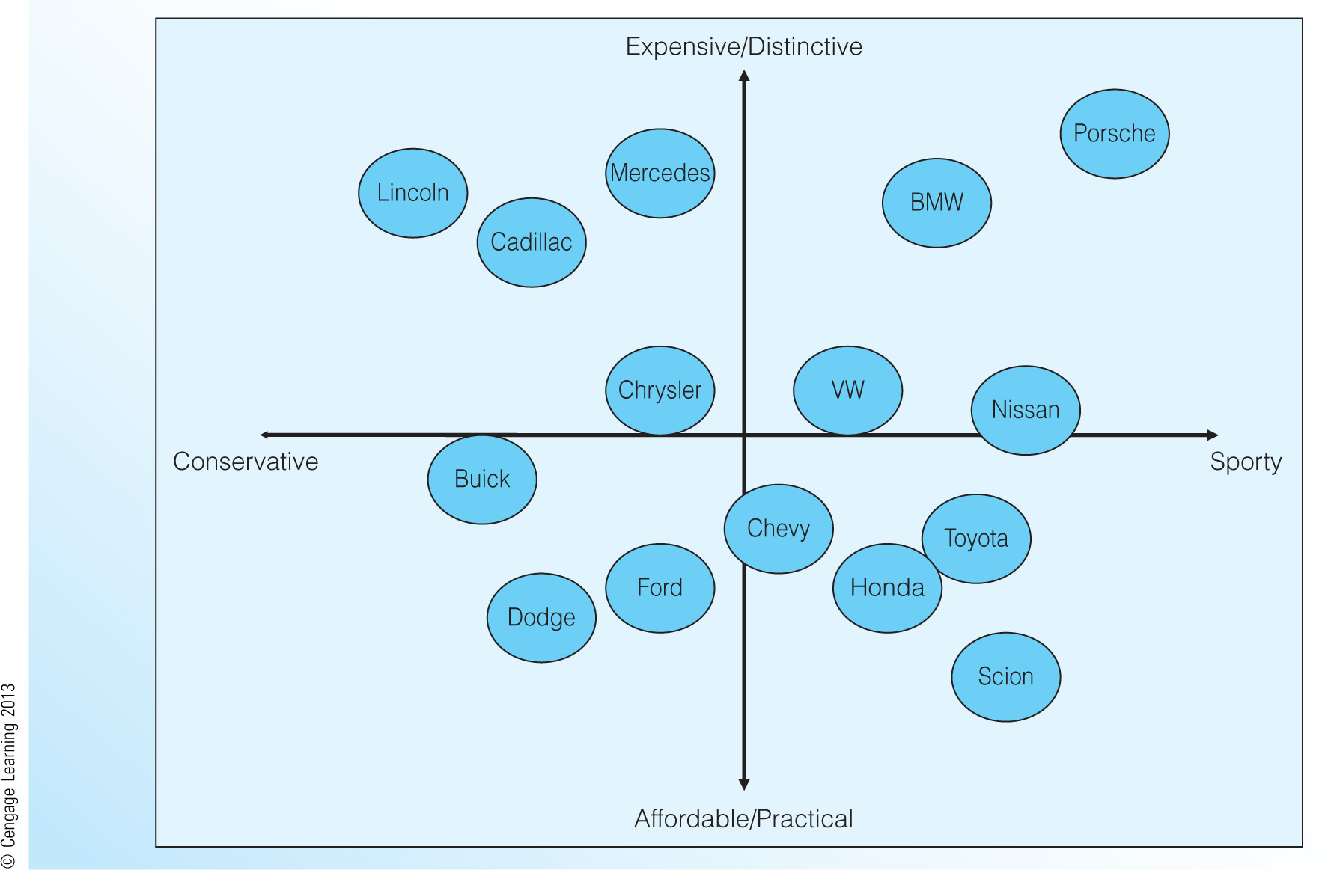
Hypothetical Perceptual Map of the Automotive Market _________________________________________

Slide 9
Blue Ocean Strategy _____________________________________
Firms develop strategic focus by developing a strategy that stands apart from the competition.
Firms can visually identify their strategic focus through the use of the strategy canvas.
Firms can use the Four Actions Framework to reorient their strategic focus away from the competition.
“Blue Ocean Strategy” by W. Chan Kim and Renee Mauborgne (2005)

Slide 10
Strategy Canvas _____________________________________
Identifies factors that the industry currently competes on and what customers receive from existing product offerings (captured by the horizontal axis)
Identifies the offering level received by buyers for each factor (captured by the vertical axis)
High levels mean that a company invests more and offers buyers more of that factor.
Identifies a company’s relative performance across its industry’s factors of competition (captured by the value curve)

Slide 11
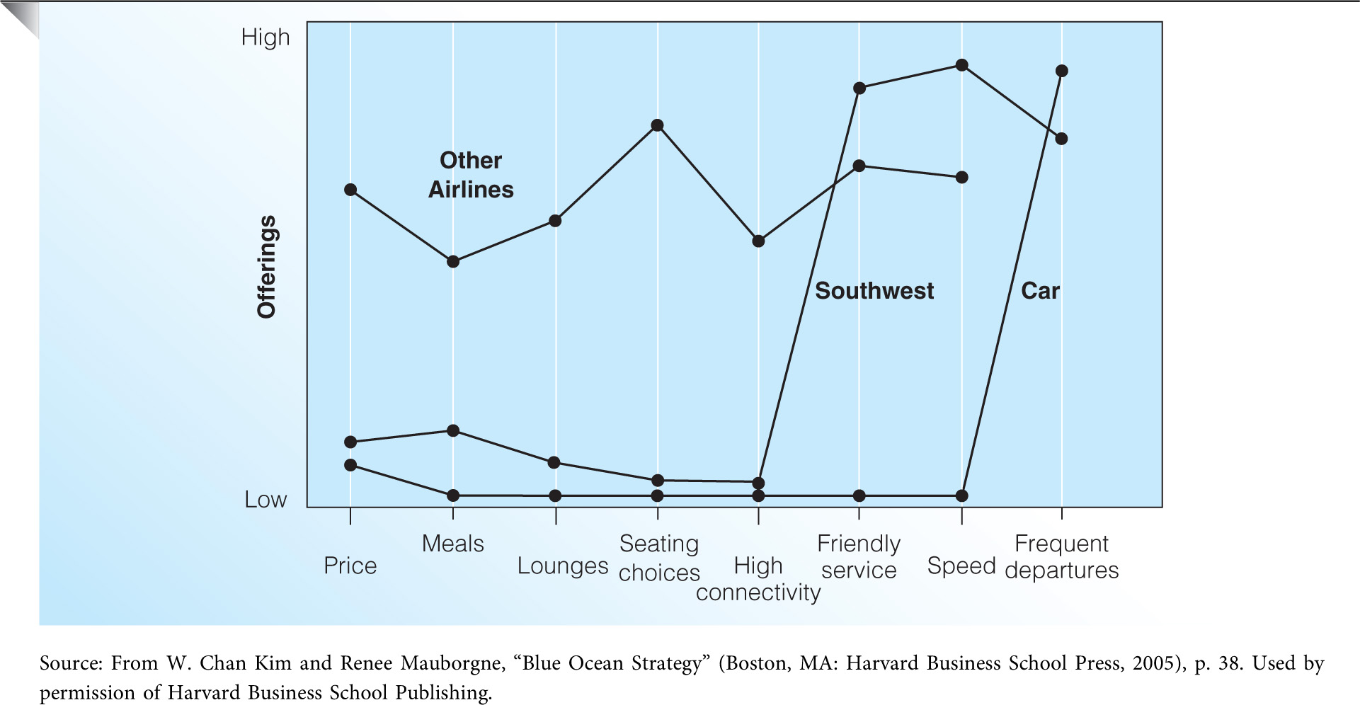
Strategy Canvas for the Southwest Airlines _________________________________________

Slide 12
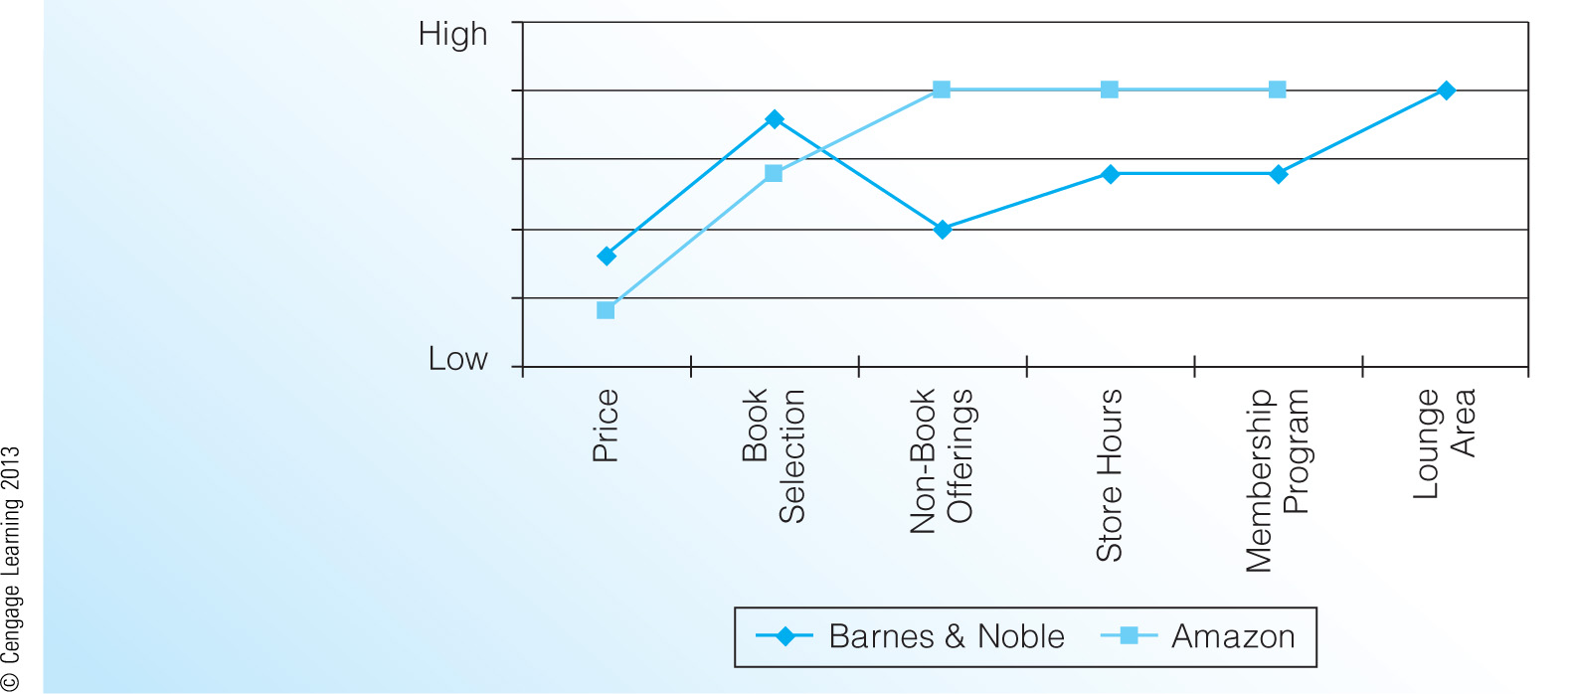
Hypothetical Strategy Canvas for the Book Retailing Market _________________________________________

Slide 13
The Four Actions Framework: Used to develop a Blue Ocean Strategy _________________________________________
Which factors that the industry takes for granted should be eliminated?
These factors may no longer have value for buyers.
(2) Which factors should be reduced well below the industry’s
standard?
Have products been over designed in a race to beat competition?
(3) Which factors should be raised well above the industry’s standard?
Has the industry forced customers to make compromises?
(4) Which factors should be created that the industry has never
offered?
What are the potential new sources of value for buyers?

Slide 14
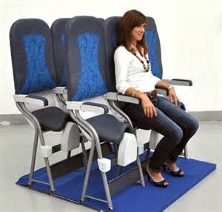
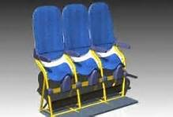
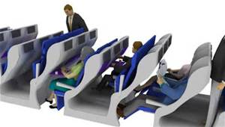
Could This be the Future for Airline Seats? _________________________________________

Slide 15
Picking a Good Brand Name _________________________________________
Should Suggest Product Benefits
Should Be Memorable, Distinctive, and Positive
Should Fit the Company or Product Image
Should Have No Legal or Regulatory Restrictions
Should Be Simple and Emotional
The Name Should Have Favorable Phonetic and Semantic Associations in Other Languages

Slide 16
Color Psychology _________________________________________
Prevalent in marketing and branding
Much of the influence of color is culture-dependent
Blue is the top choice for 35% of Americans, followed by green (16%), purple (10%) and red (9%).
There is evidence that color preference may depend on ambient temperature. People who are cold prefer warm colors like red and yellow while people who are hot prefer cool colors like blue and green.

Slide 17
Color Psychology _________________________________________
Functional (F): fulfills a need or solves a problem
Sensory-Social (S): conveys attitudes, status, or social approval
Red | Yellow | Green | Blue | Pink | Violet/Purple | Brown | Black | White
Lust (S) | Jealousy (S) | Good Taste (F) | Masculine (S) | Sophistication (S) | Authority (S) | Ruggedness (S) | Grief (S) | Happiness (S)
Power (S) | Competence (S) | Envy (S) | Competence (S) | Sincerity (S) | Sophistication (S) |  | Sophistication (S) | Sincerity (S)
Excitement (S) | Happiness (S) |  | High quality (F) | Feminine (S) | Power (S) |  | Expensive (F) | Purity (S)
Love (S) |  |  | Corporate (F) |  |  |  | Fear (S)
Bottomley, P.A.; Doyle, J.R. (2006). "The interactive effects of colors and products on perceptions of brand logo appropriateness". Marketing Theory. 6 (1): 63–83.

Slide 18
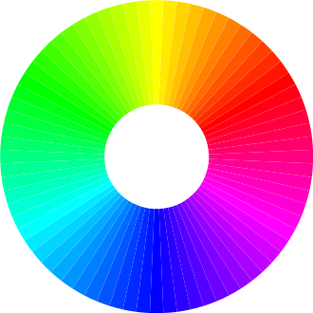
Color Psychology _________________________________________
Although some companies use a single color to represent their brand, many other companies use a combination of colors in their logo.
When asked to rate color pair preference of preselected pairs, people generally prefer color pairs with similar hues when the two colors are both in the foreground, however, greater contrast between the figure and the background is preferred.

Slide 19
AMA New Brand Identity _________________________________________
The American Marketing Association (AMA) has announced a new brand identity:
“The new AMA branding reflects our position as the essential community for marketers. The new logo is simple and versatile but embodies the trend of forwardness and bias toward action of the AMA community. The primary color palette of bone white, French navy blue and black evokes intellectual gravitas.”

Slide 20
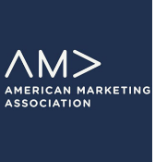
AMA New Brand Identity _________________________________________

Slide 21
Branding Project: Center for Hydrogen Research _________________________________________
The Aiken County Center for Hydrogen Research
A facility administered by Economic Development Partnership (EDP), a non-profit organization that serves Aiken and Edgefield Counties
Opened in October 2005, it has a total area of 60,000 square feet, with 30,000 square feet of leasable space.
It was decided that the facility needed a new name, slogan, and logo.
Although a decision had already been made to rebrand the facility as the Applied Research Center for Hydrogen (ARC: Hydrogen), EDP wanted to consider other approaches.

Slide 22

Sustainable Power Applied Research Center (SPARC) _________________________________________

Slide 23
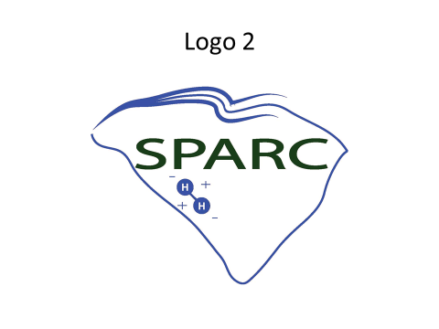
Sustainable Power Applied Research Center (SPARC) _________________________________________

Slide 24
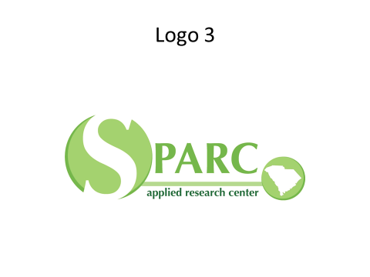
Sustainable Power Applied Research Center (SPARC) _________________________________________

Slide 25
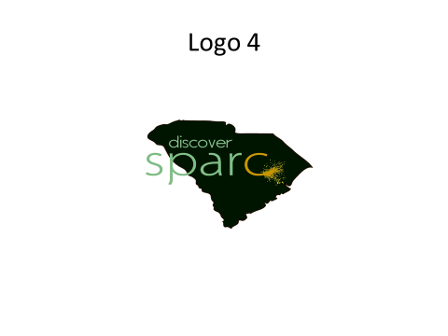
Sustainable Power Applied Research Center (SPARC) _________________________________________

Slide 26

Logos with Hidden Messages _________________________________________
An arrow is hidden between the letters E and X. More than 200 logos were designed before arriving at this solution.

Slide 27
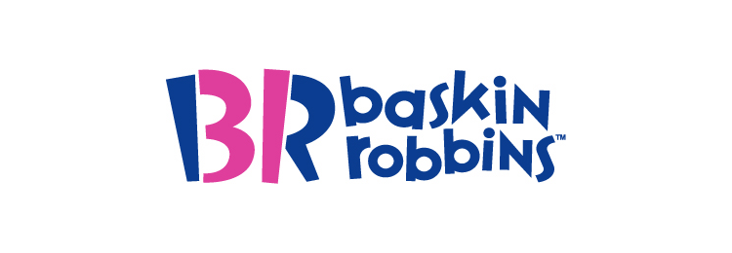
Logos with hidden messages _________________________________________
Baskin Robbins offers 31 flavors of ice-cream. The number 31 is hidden in the logo within the letters B and R.

Slide 28

Logos with hidden messages _________________________________________
The Bronx Zoo logo shows the animals within a city skyline.

Slide 29

Logos with hidden messages _________________________________________
This logo shows a golfer taking a swing and the head of a Spartan warrior in helmet at the same time.

Slide 30

Logos with hidden messages _________________________________________
The Hartford Whalers logo shows three concepts at the same time. A whale’s tail, the letter “W” in green, and the white space forming an “H” for Hartford.

Slide 31

Logos with hidden messages _________________________________________
The letters N and W can be seen in positive and negative spaces. Also, the red triangle points to the north-west compass point within the circle.

Slide 32

Logos with hidden messages _________________________________________
The yellow arrow is not just a smiley. It also suggests that you can buy everything A to Z on Amazon.

Slide 33
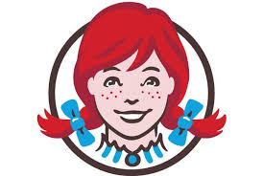
Logos with hidden messages _________________________________________
Wendy’s collar spells the word “mom”.

Slide 34

Logos with hidden messages _________________________________________
M for Milwaukee and B for Brewers are hidden within the baseball glove.

