Slide 1
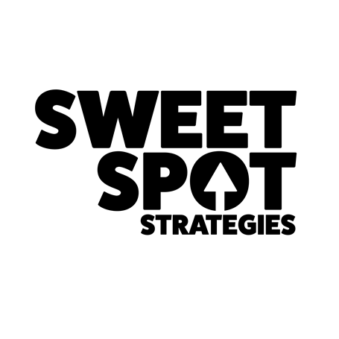

Build a Brand and
You Build a Business

Slide 2
Expectations
Establish branding as the first step in creating marketing and sales content that brings more customers and more sales to your business
Identify the critical elements that go into the branding process so you can be effective with your time and your budget
Better understand the process of branding, and the role of your Brand for your business

Slide 3
3 Things I Know to be True
Building a business takes work
Every successful business owner understands that branding, marketing, and sales are critical
And, every successful business owner incorporates all three of these processes

Slide 4
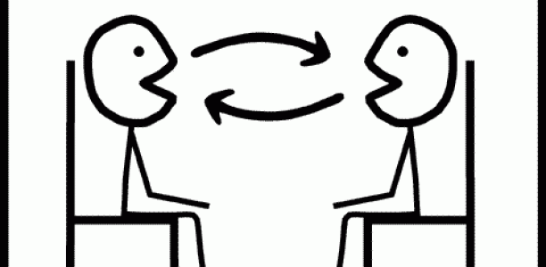
Sales
2-way conversations focused on qualifying, overcoming objections, and closing customers to bring new clients into your business which translates to income, and success.

Slide 5

Marketing
1-way conversations designed to make your brand visible and credible so that prospects are compelled to self-qualify that they want to know more about what you do, and how you do it.

Slide 6
MARKETING brings people to your sales table
SALES closes the deal

Slide 7
Branding
The American Marketing Association (AMA) defines a brand as a, “Name, term, sign, symbol or design, or a combination, intended to identify the goods and services of one seller or group of sellers and to differentiate them from those of other sellers.”

Slide 8

Key Takeaway
To differentiate from other sellers

Slide 9
Differentiation makes you a leader
Prospects will watch what you do
How would it feel to be considered an authority in your industry?

Slide 10
Differentiation makes you an expert
Prospects seek out experts because their opinions matter
How great does it sound that people want to seek you out?

Slide 11
Differentiation takes price out of decision making
Now you can focus on easier and more natural sales conversations
What would that do to your confidence?

Slide 12
Differentiation lets you charge more
Now you’re free to design your life
What would more money let you have?

Slide 13
Your BRAND has to be compelling
Your MARKETING has to get your brand noticed
Your SALES has to close the deal

Slide 14
A
The Customer Continuum
PEOPLE
PROSPECTS
QUALIFIED PROSPECTS
CUSTOMERS
FANS

Slide 15
Things your ideal clients are saying
“I need X.”
“I need something, but don’t what it is.”
“My problem is X.”
“I have a problem, but don’t know how to fix it.”

Slide 16
Your Ideal Clients
Are looking for you right now
Have a challenge and need options
Are shopping to solve a problem
Are not aware that the problem they have even has a solution

Slide 17
#1
Your BRAND says
who you are

Slide 18
Your BRAND is your:
Voice
Platform
Positioning

Slide 19
Your voice gives you confidence to share what you know in a way that is authentic
Your Brand platform tells your prospects what you do, why you do it, and for whom you do it
Your Brand positioning lets you show up unique and different in your marketplace

Slide 20
  Karen started a home health services company
Before branding she was:
The 143rd home health provider in her market
Positioned like every other HHS
  There to help your loved one with quality care

Slide 21
Her branding process:
Segment her market
Target her “best” ideal customer
Position her in a space where no one else was talking

Slide 22
After branding she is the only provider:
Focused on the caregiver
Focused on memory care vs. general HHS
Starting conversations about the memory care caregiver experience

Slide 23
Her positioning:
We come in so you can go out
Her tagline:
“Nurturers by Nature”

Slide 24
By being focused on the caregiver Karen:
Gets to relevant conversations faster
Talks about their specific journey
Emotionally connects with their pain points

Slide 25
So, if you’re looking for speed:
Relating to client’s needs
Bringing income into your business
Having a Big Bold Brand allows you to focus on key messages your prospects need to hear NOW

Slide 26
Branding is not about getting your target market to choose you over the competition, but about getting your prospects to see you as the only one who provides a solution to their specific problem in the way they want their problem solved

Slide 27
#2
Your BRAND is your foundation for successful marketing and sales conversations

Slide 28
Your BRAND gets you closer to knowing which conversations your prospects want to have
Your BRAND messaging is specific to the problems you solve

Slide 29
Stuart runs an IT company
Before branding he:
Targeted any type of business
Traded hours of IT services for dollars
Was a hunter convincing business owners they needed professional IT support

Slide 30
  His branding process:
  Set up all foundational marketing elements
  Refocused his target audience profile
  Created messaging that is consistent and unique to his “best” ideal client
  Created a marketing plan and follows it frequently and with intention

Slide 31
After branding he:
Prioritizes his marketing allocations
Focuses on one industry where he has proven success
Has built visibility and credibility in his market, simply by showing up consistently, frequently and with intention

Slide 32
So, if you’re looking to get into the zone more quickly:
To have relevant conversations
Position yourself as an expert
Your Big Bold Brand allows you to start marketing and sales conversations more easily

Slide 33
His positioning:
Your IT health affects your financial health
His tagline:
“Your Trusted IT Advisor”

Slide 34
Your Big Bold Brand
Delivers the message clearly
Confirms your ability to solve a problem uniquely
Starts the relationship-building process
Connects with your ideal client emotionally
Motivates your ideal client to action

Slide 35
#3
Helps you show up consistently so you can decide:
  Who really matters
  What really matters
  What problems really matter

Slide 36
Visibility, Credibility, and Authority happen with:
Consistency
Frequency
Intention

Slide 37
If you’re looking for visibility:
Where your ideal clients will see you
To get to the discovery phase faster
Your Big Bold Brand allows you to create a marketing plan that builds credibility, visibility and authority

Slide 38
Your Brand is built
Your Brand is fluid and designed to evolve as your business evolves
Your Brand permeates everything you do
Your Brand must be nurtured

Slide 39
Own your Brand
Control your Brand

Slide 40
Recap
  Your Big Bold Brand:
  Confirms who you are to more quickly show up connected to your ideal client
  Supports your marketing and sales activities for better conversations
  Has your business showing up consistently to build that know, like, trust factor quicker

Slide 41
On a scale of 1 to 10 does your Brand
Confirm who you are?
Support your marketing and sales conversations?
Show up consistently?

Slide 42
What goes into creating a brand?
  The branding process:
  Determine goals
  Confirm your Why
  Select your target audience
  Identify your target’s Why
  Decide on strategy
  Determine how you want to show up
  Research marketplace
  Create a unique positioning
  Prepare marketing plan

Slide 43
“Branding is about everything” (Tom Peters)
What are you doing to build Your Big Bold Brand?
And, Your Big Bold Brand Experience?

