Slide 1
Everything is updated except the Soapy Rides financials.
The loan payment on the Monthly Expenses slide is $250, but on the Income Statement and Cash Flow it’s $600. We are in the process of revising Soapy Rides to resolve this.

Slide 2

Understanding
Basic Business Financials

Slide 3

Workshop Goals
Explain terms, costs, calculations
Determine what you need
Discuss how to determine $$
Understand fixed vs. variable expenses
let’s take a step-by-step approach

Slide 4

Steps
Start Up Costs
Pricing Your Service or Product
Hiring Help
Variable Costs
Fixed Costs
Use of Vehicle
Business Loan
Depreciation
Reality Check
Financial Statements

Slide 5

Start Up Costs
START-UP COSTS
Business Summary
Start Up Costs
Start Up Costs
One time costs
Associated with launching business
Generally funded by cash in hand
Depends on type and location of business

Slide 6
Typical Start Up Costs
START-UP COSTS
Business Summary
Start Up Costs
Start Up Costs
Note: These are just examples, and all $ values are purely estimates. YOU must determine what YOU need and what YOUR costs will be. HOW WILL YOU DO THAT?

Slide 7
Store/Office Start Up Costs
START-UP COSTS
Business Summary
Start Up Costs
Start Up Costs

Slide 8
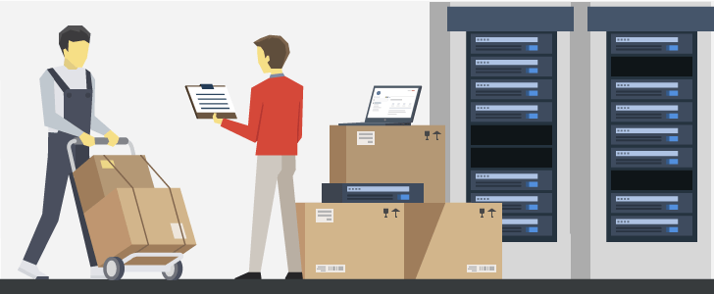
Product Sales Start Up Costs
START-UP COSTS
Business Summary
Start Up Costs
Start Up Costs

Slide 9
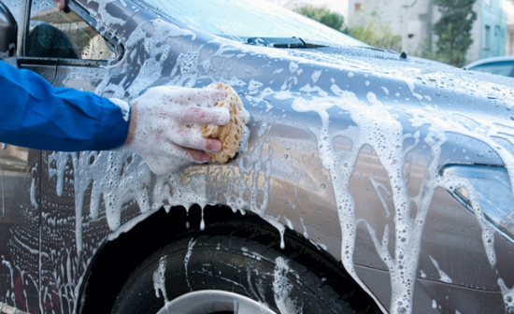

Soapy Rides Start Up Costs
START-UP COSTS
Business Summary
Start Up Costs
Start Up Costs

Slide 10
Pricing Your Product/Service
PRICING
Business Summary
Pricing
First determine your COSTS
Service business
  mostly labor
Buy wholesale sell retail
  mostly cost of product plus overhead
Build/create product
  cost of materials plus labor
Then plan your PRICING
How much do you need to break even?
What does the competition charge?
Does your competitive advantage allow you to charge more?
If COSTS are greater than SALES, you will lose $$.

Slide 11
Service Pricing
PRICING
Business Summary
Pricing
Ways to charge
  by the hour
    mow lawn and do yard work for $25/hour
    customer will want to know how many hours it will take
  by the service
    mow lawn for $100
    specify exactly what is included
  long-term contract
    bi-weekly yard care $300/month
    includes trimming, raking, mowing, edging, pruning
Research competition to determine your rate.

Slide 12

Clara’s Cleaning Service
PRICING
Business Summary
Pricing
Goal: $35,000/year
$100 to clean a home
Average 2 homes a day for 15 days/month
  30 homes/month =
  360 homes/year =
  $36,000
$1000 covers cost of fuel, cleaning supplies, business cards

Slide 13
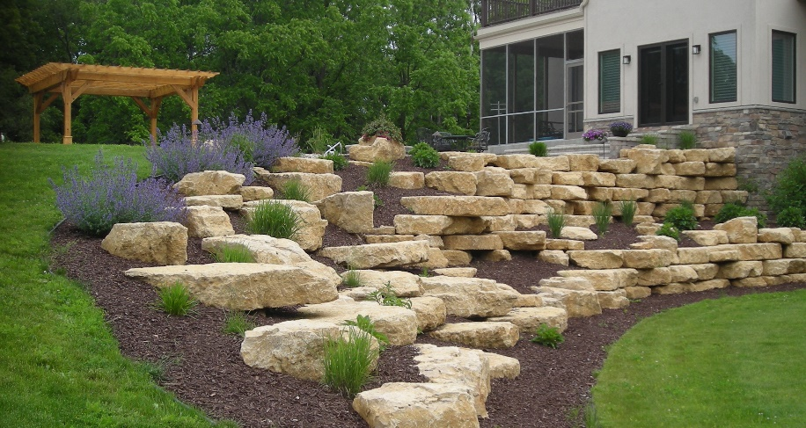
Larry’s Big Landscaping Project
HIRING HELP
Hiring Help
One of Larry’s customers wants a quote for a major landscaping project.
Larry needs 3 people for 4 days to help him complete the job.
Should he hire employees, or contract extra temporary help?

Slide 14
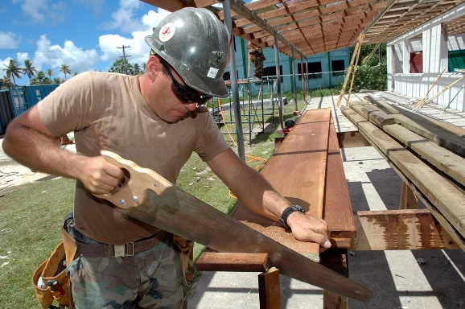
Hiring Help
HIRING HELP
Hiring Help
Hiring Help
Your business reputation depends on the quality of work performed by anyone working for you.
Consider the costs of background checks and bonding.
It is ILLEGAL to pay someone as a “contractor”
if he/she is really an employee!!!

Slide 15
Employees vs. Contractors
HIRING HELP
Hiring Help
Hiring Help
Employees
hourly or salary
need training/supervision
record keeping
  SS, medicare withholding
  SS, medicare deposits
benefits
  Worker’s Comp
  Unemployment Insurance
  vacation
  medical, dental, retirement
Contractors
higher hourly rate
already trained/skilled
simple recordkeeping
  no withholding or deposits
  payments reported on 1099-MISC
no benefits
no commitment

Slide 16
Larry’s Landscaping Project
HIRING HELP
Hiring Help
Hiring Help
Larry hires 3 people for 4 days to complete the job.
Add cost for use of Larry’s equipment
Add fixed costs (insurance, accounting)
Add $$ for Larry
What happens if the project ends up taking 5 days?!

Slide 17
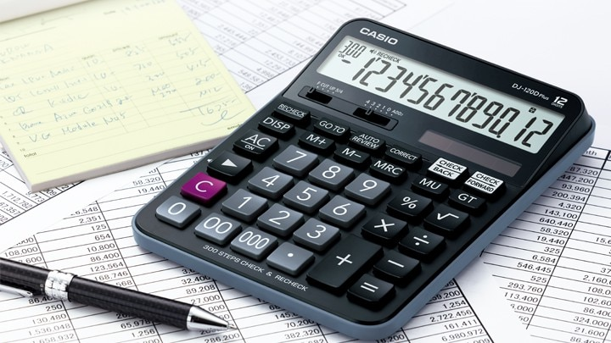
Product Sales Business
VARIABLE COSTS
Business Summary
Start Up Costs
Start Up Costs
Variable Costs
Your income is the difference between your sales income and your costs/expenses.
First figure your
  variable costs (cost per unit)
  fixed costs (things you have to pay no matter how much you sell)
How much do you want to make?
What is your competition charging?

Slide 18

Buy Wholesale / Sell Retail
VARIABLE COSTS
Business Summary
Start Up Costs
Start Up Costs
Variable Costs
Variable Costs
Define specific product list
  start with the products you’ll sell the most
Identify wholesalers and costs
  do they give a bigger discount at higher volume?
Cost of supplies for each product

Slide 19
Kayla’s Hair Salon
Wholesale Suppliers of Sleek & Shiny Brand Products
VARIABLE COSTS
Business Summary
Start Up Costs
Start Up Costs
Variable Costs
Variable Costs

Slide 20
Create/Build Product
VARIABLE COSTS
Business Summary
Start Up Costs
Start Up Costs
Variable Costs
Variable Costs
What supplies do you need?
  Find wholesalers, sources
  Determine the cost of materials
  (Costs will go down as volume grows)
How long does it take you to make?
  What is a fair hourly rate to pay yourself?
What can you charge?
What is the competition charging?

Slide 21

Cooper’s Copper Cleaner
VARIABLE COSTS
Business Summary
Start Up Costs
Start Up Costs
Variable Costs
Variable Costs
Cooper will mix up batches of 100 at a time.
If he sells them online, what added costs might he have?

Slide 22
Fixed Costs = Overhead
FIXED COSTS
Business Summary
Fixed Costs
Insurance
  liability, property, bonding, disability, malpractice
  discuss needs and get quotes from multiple agents
Accounting/Bookkeeping
  accounting software or
  paid professional
Payroll
  if you have paid staff
Loan payments
...

Slide 23

Rental/Lease Fixed Expenses
FIXED COSTS
Business Summary
Fixed Costs
Fixed Costs
Monthly payment
Utilities – heat, lights, security, telephone
Insurance
Cleaning service
...
A lease is a long term $$ obligation
even if your business fails!

Slide 24
Use of Vehicle
VEHICLE COSTS
Business Summary
Vehicle Costs
Clara is going to drive a lot to provide her cleaning service, but she can use a vehicle she already owns.

Slide 25
Bobby’s Handyman Services
VEHICLE COSTS
Business Summary
Vehicle Costs
Vehicle Costs
Bobby needs to buy a pick-up truck that he will use exclusively for his handyman business.
The first $1030 Bobby makes in a month goes directly to his vehicle.
Let’s talk about that loan.

Slide 26
Loan Payment Calculation
BUSINESS LOAN
Business Loan
Hiring Help
Hiring Help
Excel has a function that calculates loan payments for you:
=PMT(int/12,months,loanamount)
There are many loan calculators online.
A loan is a long term $$ obligation even if your business fails!

Slide 27
Loan Payoff Keeps Decreasing
BUSINESS LOAN
Business Loan
Business Loan
Hiring Help
Hiring Help
Bobby borrows $11,000.
One month’s interest on $11,000 is $36.67.
The rest of the payment, $211.70, goes to reduce the loan value (also called principal).
After the 1st payment, Bobby owes only $10,788.30.

Slide 28
amortization
BUSINESS LOAN
Business Loan
Business Loan
Hiring Help
Hiring Help
the loan payoff amount decreases with each payment you make

Slide 29
BUSINESS LOAN
Business Loan
Business Loan
Hiring Help
Hiring Help
Amortization
Table
Bobby borrowed $11,000.
At the end of a year, Bobby owed just $8412.
But the equipment isn’t worth $11,000 after one year either.
Because it has depreciated.

Slide 30
depreciation
DEPRECIATION
Business Summary
Start Up Costs
Start Up Costs
Variable Costs
Variable Costs
Depreciation
some things lose value over time
depreciation is the loss in value

Slide 31
asset
DEPRECIATION
Business Summary
Start Up Costs
Start Up Costs
Variable Costs
Variable Costs
Depreciation
something the company owns that has value:
vehicles, inventory, balance in bank accounts,
buildings, furniture, fixtures
asset value may not = market value

Slide 32
Straight Line Depreciation
DEPRECIATION
Business Summary
Start Up Costs
Start Up Costs
Variable Costs
Variable Costs
Depreciation
Depreciation
By year 5, Bobby needs to replace his truck with a newer
one that is going to cost much more.
TIP: Set aside $$ every year for equipment replacement.

Slide 33
Soapy Rides Business
REALITY CHECK
Business Summary
Reality Check
Fixed Costs
Fixed Costs
Mobile car wash and detailing business operating in Aiken and North Augusta.
Owner takes all materials and cleaning supplies in a trailer to the customer’s residence or place of business.
Startup costs are $14,600.
Owner owns a 2 year old truck and has $6000 in cash but needs an $11,000 loan to purchase a trailer.

Slide 34
Soapy Rides Business Model
REALITY CHECK
Business Summary
Reality Check
Reality Check
Fixed Costs
Fixed Costs
Basic car wash, wax and interior cleaning takes 2 hours
Assume 3 customer sales/day 4 days/week
Competition is brick and mortar car wash services and other mobile services
Initial pricing of $50 per car is based on researching competitors’ pricing

Slide 35
Soap Rides Monthly Expenses
REALITY CHECK
Business Summary
Reality Check
Reality Check
Fixed Costs
Fixed Costs

Slide 36

Soapy Rides Monthly Sales
REALITY CHECK
Business Summary
Reality Check
Reality Check
Fixed Costs
Fixed Costs
Can you rely on 3 sales/day as soon
as you start your business?

Slide 37

gross revenue gross income gross sales
REALITY CHECK
Business Summary
Reality Check
Reality Check
Fixed Costs
Fixed Costs
$$ collected before any expenses are subtracted

Slide 38
Soapy Rides Reality Check
REALITY CHECK
Business Summary
Reality Check
Reality Check
Fixed Costs
Fixed Costs
Can you live on $1,880/month?
What if you can’t work for a week?
What if you have an unexpected emergency repair?
Can you save $250/month to cover unforeseen expenses?
Working a 5th day per week increases monthly revenue by $645 ...

Slide 39
income statement
FINANCIAL STATEMENTS
Financial Statements
Business Summary
Vehicle Costs
shows the revenue (income), expenses, and net profit
for a given time period
usually several time periods are shown side by side to identify trends

Slide 40
FINANCIAL STATEMENTS
Financial Statements
Financial Statements
Business Summary
Vehicle Costs
Cooper’s Copper Cleaner
Income
Statement
October 2018

Slide 41
balance sheet
FINANCIAL STATEMENTS
Financial Statements
Financial Statements
Business Summary
Vehicle Costs
snapshot of the assets (value of things the business owns)
and liabilities (loans and debts)
on a specific date

Slide 42
asset
FINANCIAL STATEMENTS
Financial Statements
Financial Statements
Business Summary
Vehicle Costs
something the company owns that has value:
vehicles, inventory, balance in bank accounts,
buildings, furniture, fixtures
current asset
an asset that can be converted to cash
within one year:
inventory, supplies, cash on hand

Slide 43
Cooper’s Copper Cleaner
Balance Sheet
October 31, 2018
FINANCIAL STATEMENTS
Financial Statements
Financial Statements
Business Summary
Vehicle Costs

Slide 44
cash flow statement
FINANCIAL STATEMENTS
Financial Statements
Financial Statements
Business Summary
Vehicle Costs
summary of
cash in and out of a business
during a specific period of time

Slide 45
Cooper’s Copper Cleaner
Cash Flow Statement
October 2018
FINANCIAL STATEMENTS
Financial Statements
Financial Statements
Business Summary
Vehicle Costs

Slide 46
Cooper’s Copper Cleaner
Cash Flow Statement
November 2018
FINANCIAL STATEMENTS
Financial Statements
Financial Statements
Business Summary
Vehicle Costs

Slide 47
Cooper’s Copper Cleaner
Cash Flow Statement
December 2018
FINANCIAL STATEMENTS
Financial Statements
Financial Statements
Business Summary
Vehicle Costs

Slide 48
FINANCIAL STATEMENTS
Financial Statements
Financial Statements
Business Summary
Vehicle Costs

Slide 49
Soapy Rides
Income
Statement
July 2018
FINANCIAL STATEMENTS
Financial Statements
Financial Statements
Business Summary
Vehicle Costs

Slide 50
FINANCIAL STATEMENTS
Financial Statements
Financial Statements
Business Summary
Vehicle Costs
Soapy Rides
Balance
Sheet
July 31, 2018

Slide 51
FINANCIAL STATEMENTS
Financial Statements
Financial Statements
Business Summary
Vehicle Costs
Soapy Rides
Cash Flow
Report
October 2018

Slide 52
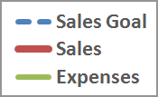
FINANCIAL STATEMENTS
Financial Statements
Financial Statements
Business Summary
Vehicle Costs
Soapy Rides Sales vs. Expenses

Slide 53

Where Do You Go From Here?
Websites
  SCORE.org
    articles, webinars, checklists
    use the search tool
  bizplans.com
    templates for business models
Workshops
Mentoring sessions
Business Brochures

Slide 54

Thank You ... and Good Luck!

