Slide 1
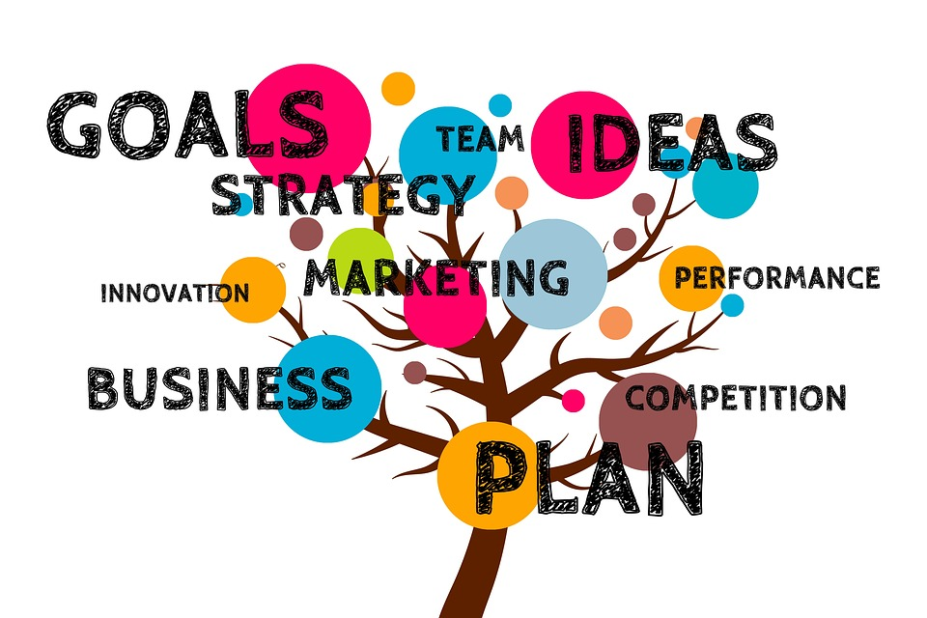

Plan Your Business
A business cannot succeed without a plan!

Slide 2

workshop purpose
understand and develop the
key elements of
your business strategy
determine whether your
business model is viable

Slide 3

workshop purpose
it is not our purpose today to teach the “formal business plan” required for obtaining a bank loan
but every business needs a plan of some kind
ours will fit on one page

Slide 4
The New Business Journey
Your successful business
Climbing the Mountain
What key partners do you depend on?
How will you know you are a success?
11
12
Will your pricing generate a profit?
10
9
What are your costs?
Elevator speech!
6
How will you build customer loyalty?
8
7
How will you reach your customers?
You and your idea
5
Who will buy your product or service?
4
What risks and challenges do you anticipate?
What Problem to Solve?
3
Your competitive advantage?
1
2
What alternatives are there?
Notes:
Phased format
Think of building your business as a journey, perhaps Climbing a mountain. The Lean Canvas will serve as your map. Don’t just start climbing, get a good plan and map out the route.
All steps are important and all are in order. Skipping steps leaves your plan vulnerable to failure

Slide 5

YOUR IDEA
YOUR CUSTOMER
HOW THE $$s WORK
Your Product or Service What customer problem/need/want does it address?
1
Ideal Customer/Business Type What characteristics do your customers share?
5
Costs What are your major start-up, fixed, and variable costs?
9
Customer Alternatives How else can the customer meet this problem/need/want? What competition do you have?
2
Pricing and Income Projection What is your pricing plan? What sales do you project?
10
Your Elevator Speech!
6
Marketing Plan
How will you reach your customers? How will you test the market?
7
Competitive Advantage Why would customer buy yours instead?
3
Important Relationships What key business partners does your business depend on?
11
Risks & Challenges What obstacles or hurdles do you anticipate?
4
Customer Retention How will you collect customer info and build loyalty?
8
Measurements How will you quantify whether the business is viable?
12
Key Activities What are the next tasks that need to be carried out?
One Page Plan Template
GreaterAiken.SCORE.org

Slide 6

YOUR IDEA
1
Your business idea may be wonderful
But a business needs customers
Your business has to do one of these things:
solve a problem
fulfill a need
fulfill a want
Notes:
In a business, you are only one side of the equation.
It’s not a business unless it, at least eventually, makes a profit.
And for that to happen, you need customers.
You need to understand how your product or service fits into the marketplace.
Are you solving a problem for your customer?
Filling a need, a requirement?
Filling a desire, a want?

Slide 7

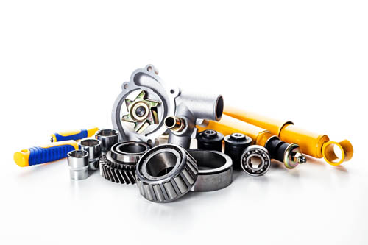
YOUR IDEA
1
Service Business
mostly labor
e.g. web design, landscaping, hair dresser, consultant
Product Business
buy wholesale sell retail
OR
build/create/manufacture product
e.g. crafts, pond pumps, widgets, greeting cards
Notes:
There are 2 basic kinds of businesses.
A service business sells primarily LABOR, the time it takes for its workers to complete a job.
Whereas a product business sells THINGS.
The seller can either 1) buy wholesale and sell retail OR 2) buy materials to make a product and use labor to manufacture or complete the product.

Slide 8
Service Business
YOUR IDEA
1
What services do you provide?
mowing, photography, social media marketing
(and e.g. if social media marketing, what specific aspects)
What equipment do you need?
computers, specialized tools, vehicles, uniforms
Do you buy materials as part of your service?
paint, fencing, cleaning products, paper
What people skills are required for your service?
Notes:
When planning a service business, these are the types of questions the owner needs to consider.
[go through the questions one by one]

Slide 9
Product Business
YOUR IDEA
1
What are your products?
e.g. chocolate candy, clothing, framed photographs
How do you acquire them?
making them, purchasing wholesale, combination
What do they cost?
best supply sources, volume discounts
Notes:
A product business would answer questions like these.
[go through the questions one by one]

Slide 10
YOUR IDEA
1
Combination
Your business may have elements of both types of businesses.
Hair Salon
cut & color services, also sells high-end shampoo etc. products
Photographer
custom photo shoot, offers additional enlargements and albums
Hardware Store
sells hardware products, also does installations
Note: in South Carolina, products incur sales tax whereas services generally do not. (Consult your accountant!)

Slide 11

YOUR IDEA
1
Want vs. Need
needs (required items)
food, lodging, clothing
utilities, insurance, vehicle
wants (discretionary)
entertainment, recreation, fun, travel, sports
luxury items
Notes:
It’s a good idea to understand whether your product or service fills a want or a need.
[go through the examples eone by one]

Slide 12
What Competes for Your Customer’s Attention?
2
ALTERNATIVES
Note that your “competition” may not do exactly what you do.
For example, if you provide activities for kids using computers, your competition may include craft activities, sports, entertainment, etc.

Slide 13

Who is Your Competition?
2
ALTERNATIVES
What companies offer what you offer?
search online, ask friends, look for the product/service yourself
What is their special appeal?
how do they distinguish themselves from their competition?
How are you different?

Slide 14

Your Competitive Advantage
3
COMPETITIVE ADVANTAGE
Is your product or service
Less expensive
Faster
Better
More attractive
More available
Longer warranty?
What makes your business unique?

Slide 15

What barriers might keep you from success?
4
RISKS & CHALLENGES

Slide 16

Common Barriers to Success
4
RISKS & CHALLENGES
insufficient knowledge
too much competition
finding the right customer
not enough $$ to start
quality suppliers
poor location
regulations
labor shortage

Slide 17
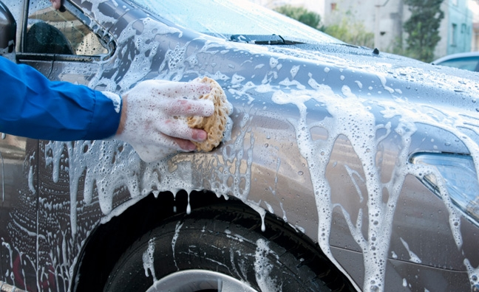

Soapy Rides
mobile auto
detailing business
service or product?
customer problem/need/want?
alternatives?
competitive advantage?
risks/challenges?
EXAMPLE

Slide 18
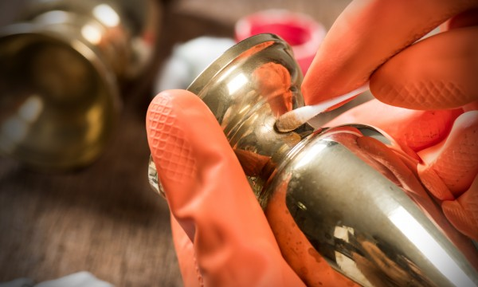
Cooper’s Copper Cleaner
metal cleaner
proprietary formula
service or product?
customer problem/need/want?
alternatives?
competitive advantage?
risks/challenges?
EXAMPLE

Slide 19


Who Will Buy Your Product or Service?
5
YOUR CUSTOMER
End Users
working moms
auto mechanics
jewelry crafters
Businesses
convenience stores
HR departments
government agencies
these are “market segments”

Slide 20

How Do You Define Each Market Segment?
5
YOUR CUSTOMER
By Demographics
age, gender, income level
By Where You Find Them
where they live/work/shop
urban or rural
online (where and when?)
how do you find that out?
By Special Interest
model railroads, special needs children, online gaming

Slide 21

Local Customer Research
5
YOUR CUSTOMER
Drive around town
Ask at the Chambers of Commerce
Ask town/city/state government offices
Visit local (or online) clubs, groups, blogs
Visit your competitors’ stores, offices, websites, social media

Slide 22

Deepen Your Customer Knowledge
5
YOUR CUSTOMER
Industry/Trade data
Industry/Trade mentor
Census & Government data
SCORE.org
Library

Slide 23

Industry Help
5
YOUR CUSTOMER
National Trade and Professional Associations Directory (NTPAD)
lists over 8,000 trade and professional organizations
look for this in your library
Find a Mentor
experienced business person in same industry
willing to share knowledge because you do not compete

Slide 24
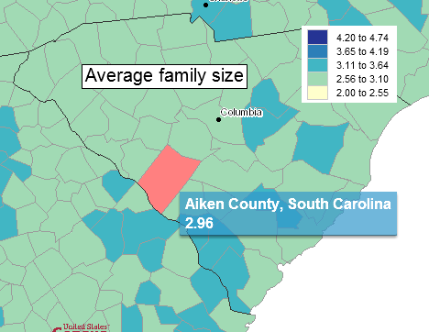
Census Data
5
YOUR CUSTOMER
www.census.gov
source of demographic information about age, race, income, veteran status, computer use, education level, # of teachers, labor force, commuting, businesses, medical expenses, fertility, new construction, ...

Slide 25
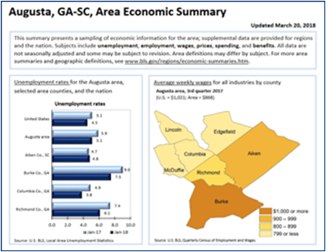
Bureau of Labor Statistics
5
YOUR CUSTOMER
www.bls.gov
source of information about employment, unemployment, pay, benefits, inflation
There is a multi-page PDF of information about the greater Augusta area.
https://www.bls.gov/regions/southeast/summary/blssummary_augusta.pdf

Slide 26
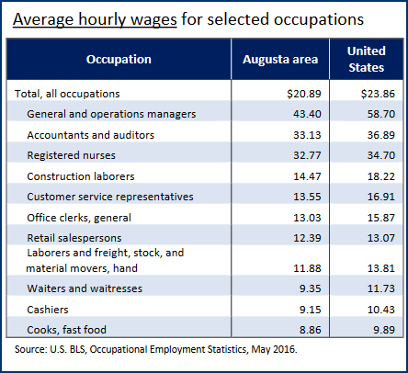
5
YOUR CUSTOMER
Bureau of Labor Statistics
www.bls.gov

Slide 27
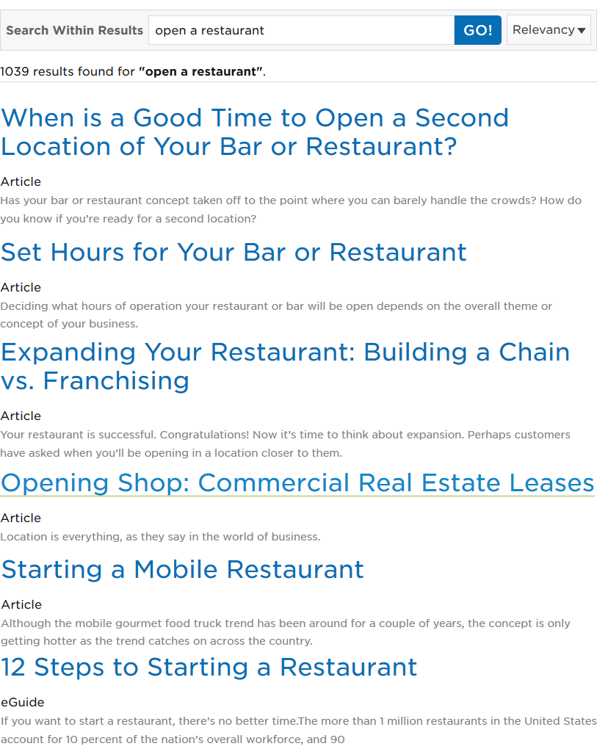
Search SCORE.org
5
YOUR CUSTOMER
articles, eGuides, webinars, blogs, infographics, podcasts
open a restaurant
1039 results
seo (search engine optimization)
181 results
selling wholesale 1105 results

Slide 28

Library Resources
5
YOUR CUSTOMER
Reference Librarian
knowledgeable and there to help!!!
Publications
industry analysis, competition, trends
Dun & Bradstreet
Reference USA
Risk Management Association (RMA) Annual Statement Studies

Slide 29

6
ELEVATOR SPEECH
Now that you understand
the value of your product or service to your customer
the customer’s alternatives
your competitive advantage
your market segments
You will love
my product because ...
You Will Love My Product Because ...
You are ready to create
your elevator speech!

Slide 30
6
ELEVATOR SPEECH
My widgets
will save you $$
More Important:
your customer
the value you provide to your customer
Less Important
you
why you are terrific
You Will Love My Product Because ...
Me Me Me
I’m great!!!
Me Me Me! I’m Great!

Slide 31
Soapy Rides
6
ELEVATOR SPEECH
Soapy Rides brings auto detailing to your car, whether it’s in your driveway or at work. We wash and polish the exterior and detail the interior and you don’t even need to be there!

Slide 32
Cooper's Copper Cleaner
6
ELEVATOR SPEECH
Cooper's Copper Cleaner cleans and polishes antique copper doorknobs and all metal hardware in a flash. Easy to use, non-toxic, made of a proprietary formula Cooper developed for his own restoration business. $14.99/bottle, available online at www.CoopersCopperCleaner.com.

Slide 33

Bill’s English Instruction
6
ELEVATOR SPEECH
Bill’s English provides basic instruction for those who would like to understand, read, speak and write English better.
We place students with others at a similar level. All classes are small and individualized instruction is emphasized.
Our sole mission is to improve
your language skills in a positive
and non-judgmental setting.

Slide 34

Clara's Cleaning Service
6
ELEVATOR SPEECH
Clara's Cleaning Service will leave your home dust-free and spotless. My home cleaning service includes dusting every surface, washing kitchen counters and appliances, and washing and/or vacuuming all floors. Your home will look new and smell fresh. Insured, bonded, and licensed in North Augusta and Aiken.

Slide 35
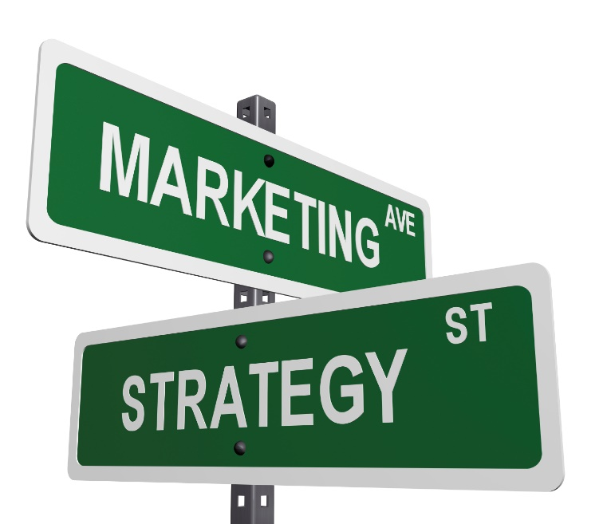
7
MARKETING PLAN
How will you market?
How does the competition market?
social media, online, website, email, blog
newspaper, fairs, storefront
word of mouth
mail campaign
trade shows
chamber, networking group
through distributors

Slide 36

Test Your Marketing Assumptions
7
MARKETING PLAN
Find places to test market
family, friends, church events, booth at markets, festivals
sell on Etsy, eBay, Amazon before developing your own website
ask local stores to carry your product
Track & document your results!

Slide 37
Test Your Pricing
7
MARKETING PLAN
Try different prices
If you charge twice as much, do your sales drop 50%?
Can what you tried be scaled?
Is the market there to sell 10x as much? 100x?
Can you sell enough to cover your costs?
Can you sell enough to support yourself?
Track and document your results!

Slide 38

satisfied repeat customers are the best customers!
8
BUILD CUSTOMER RETENTION
While you are test marketing, start building your customer base….
collect email addresses
offer coupons for repeat sales
frequent buyer card
referral bonus
BOGO

Slide 39
Soapy Rides
mobile auto
detailing business
who will use this service?
what are possible market segments?
what market research will help?
how would you market this service?
how would you build customer retention?
EXAMPLE

Slide 40
Cooper’s Copper Cleaner
metal cleaner
proprietary formula
who will use this product?
what are possible market segments?
what market research will help?
how would you market this product?
how would you build customer retention?
EXAMPLE

Slide 41
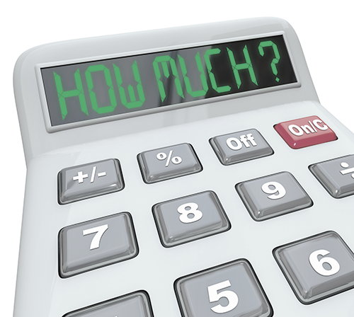
COSTS – Start-Up
9
Every business has them!
Name/LLC registration
Business cards
Business permits
Telephone, email address
Equipment
Office supplies

Slide 42
More Examples
COSTS – Start-Up
9
Professional license
Memberships, associations
Insurance
Accounting software or service
Initial inventory
Storage

Slide 43

Building Related Start Up Costs
COSTS – Start-Up
9
Lease/rent deposit
Utility deposits
Telephone system
Furniture/fixtures
Building inspections
Signage

Slide 44

COSTS – Variable
9
Variable Costs
costs associated with your product
“cost of goods sold” (COGS)
raw materials
parts
ingredients
pieces
supplies

Slide 45
COSTS – Fixed
9
Fixed Costs
costs you have to pay even if there are no sales
e.g. rent, phone, insurance, loan payment

Slide 46
Capital $$ Needed to Start
COSTS – Starting Capital
9
Start Up Costs
equipment, materials, supplies to get you started
Working Capital
cash flow until sales catch up with expenses
Safety Net
your living expenses until business supports you
keep your previous job for now if possible
If you don’t have enough cash on hand to cover these 3 things, you will need to borrow or raise $$.

Slide 47
Soapy Rides
mobile auto
detailing business
start-up costs?
variable costs?
fixed costs?
starting capital?
EXAMPLE

Slide 48
Cooper’s Copper Cleaner
metal cleaner
proprietary formula
start-up costs?
variable costs?
fixed costs?
starting capital?
EXAMPLE

Slide 49
Pricing – based on market price
$$ PROJECTION
Business Summary
10
research competitors’ prices
determine the market price, the average price charged by your competitors
if your product or service has a strong competitive advantage, you may be able to charge a premium price
a discount price, well below market price, is generally not recommended

Slide 50

Pricing – based on costs
$$ PROJECTION
Business Summary
10
determine your product-related cost
add % for overhead (fixed) costs
add % for profit
how does it compare with market price?

Slide 51
$$ PROJECTION
Business Summary
10
Pricing – sales channels
sell to consumers
full price
sell to businesses for resale
wholesale pricing
sell through distributors or marketing reps
pay commission on sales

Slide 52
Income Projections
$$ PROJECTION
Business Summary
10
What sales can you expect when you start?
When will you break even?
How much must you sell to make a profit?
How much must you sell to earn a living?

Slide 53
Key Business Partners
11
IMPORTANT RELATIONSHIPS
Insurance Agent
Banker
Accountant
Attorney
SCORE Mentor

Slide 54
Key Business Partners
11
IMPORTANT RELATIONSHIPS
Suppliers
Social Media Expert
Referral Sources
Patent Attorney
Key Customers

Slide 55
How will you measure growth & success?
MEASUREMENTS
Business Summary
12
# customers
# new customers
total sales
Facebook likes
# visitors
profits

Slide 56
Soapy Rides
mobile auto
detailing business
how would you determine pricing?
key relationships?
how would you measure growth & success?
EXAMPLE

Slide 57
Cooper’s Copper Cleaner
metal cleaner
proprietary formula
how would you determine pricing?
key relationships?
how would you measure growth & success?
EXAMPLE

Slide 58
Useful Links
RESOURCES
Business Summary
US Government
Small Business Administration www.sba.gov
SCORE www.score.org
Small Business Development Center www.sbdc.org
Bureau of Economic Analysis www.bea.gov
Securities and Exchange Commission www.sec.gov
Census Data, Statistics https://www.usa.gov/statistics
Department of Labor https://www.dol.gov/
Trade Associations
https://planningshop.com/associations
https://en.wikipedia.org/wiki/List_of_industry_trade_groups_in_the_United_States
https://www.marketing-mentor.com/pages/trade-list
South Carolina Government
Business One Stop https://scbos.sc.gov/
Department of Commerce https://www.sccommerce.com/
Georgia Government
First Stop Business Information Center http://sos.ga.gov/index.php/corporations/first_stop_business_guide
Department of Labor https://dol.georgia.gov/
Planning Tools
MPlans www.mplans.com
sample marketing plans ,template, tools
BPlans www.bplans.com
Complete Guide to Business Planning
500 sample business plans
BizPlans www.bizplans.com
business plan template, business financials, calculators

Slide 59

THANK YOU
and good luck!

