Slide 1



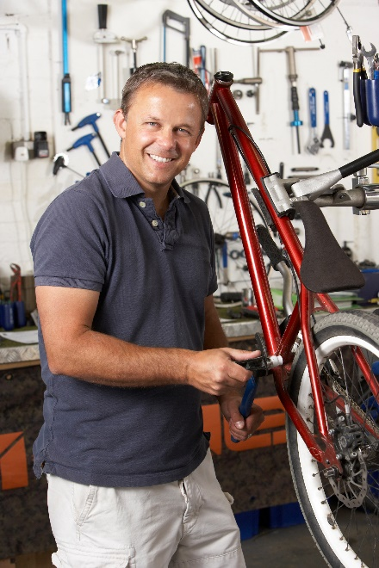

WELCOME TO
Thinking of Starting a Business?

Slide 2
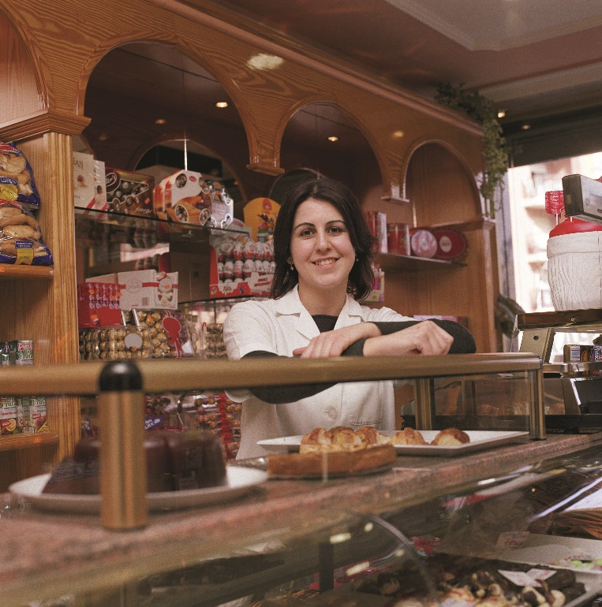
Your Own Business
Do something you love……by turning a passion or hobby into a business!
Why are you doing this?
  Be your own boss
  Make more money
  More time with family
  Personal satisfaction
  Helping others

Slide 3

Ultimately, a business needs to make a profit.
If it doesn’t make a profit, it’s probably a hobby.

Slide 4

Agenda
Small Business Environment
Important Skills
Ways to Go into Business
First Steps
Business Structure
Important Partners
Helpful Workshops
Resources

Slide 5
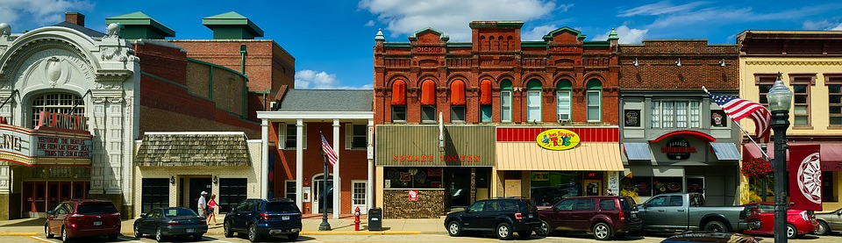
SMALL BUSINESS ENVIRONMENT
75% of US businesses, and 80% of South Carolina businesses, are 1 person operations
over 50% of US businesses are home-based

Slide 6
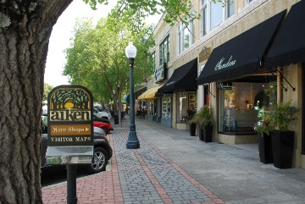
At 5 Years
Most Start-Ups Are Still in Business

Slide 7
How Many Fail, and Why?
Most Common Reasons for Business Failure:
Not understanding financials
2) Inadequate financing

Slide 8

IMPORTANT SKILLS

Slide 9

Industry experience/knowledge
Reliable, responsible
Self-starter, motivated
Creative
Persistent
Good communicator, articulate
Organized
Good credit
Computer capable
Basic understanding of financial statements

Slide 10

What Else Does It Take to Start a Small Business?
Tolerance for risk
Some money to invest
Commitment
Vision

Slide 11

How Do You Want to Go into Business?

Slide 12
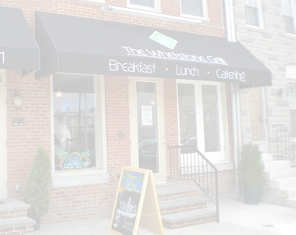
Buy an Existing Business
Advantages
Established customer base, location, suppliers
Build on name recognition and reputation
Review previous owner’s financials
Easier to obtain financing
Disadvantages
Hidden problems, especially
  financial
  reputation
  obsolescence
Employees may be loyal to previous owner
No guarantee of continued success

Slide 13

Buy a Franchise
Advantages
Proven system, image, and products
Marketing and sales assistance
Training and guidance
Built-in peer network
Opportunity to rise with entire network
Disadvantages
Must follow franchisor’s procedures, pricing, methods
Ongoing royalties and fees
Binding contract with franchisor
Opportunity to fall with entire network

Slide 14

Start a New Business
Advantages
You have complete control!
Your choice of location, name, image, logo, business relationships
Establish your own customer base
Disadvantages
Bigger risk
No track record, so financing is difficult
No existing customer base to build on

Slide 15

Start a Home-Based Business
Advantages
Convenience
Lower cost
Flexible schedule
Tax advantage of use of home for business
Disadvantages
Zoning restrictions
Isolating
Hard to find financing
More IRS scrutiny of tax returns

Slide 16

Start an Online Business
Advantages
Start-up costs lower than opening store or office
Not limited to local customers
Do business 24/7
Operate anywhere there is WiFi
Disadvantages
Lots of competition world-wide
Impersonal – harder to make the sale
Impersonal - harder to deliver exceptional customer service

Slide 17

Form a Non-Profit Organization
Advantages
Government and foundation grant opportunities
Some liability protection
Can pay salaries and contractor fees
Disadvantages
Mission must focus on education or charity
Cannot provide profit to the founders
Profits remain within organization (not distributed to “owners”)
Must receive 501(c)(3) IRS status

Slide 18

FIRST STEPS

Slide 19
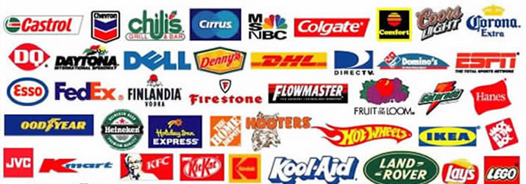

Naming
Your Business
Think long-range
  Will it work in 5, 25 years?
  Is it too specific?
  Is it too general?
Name availability?
  Check with the state
  Internet domain name
Register the name & domain name

Slide 20

Your Product/Service
What will you sell?
Who will buy it?
How often?
What will it cost?
How many do you need
to sell to be successful?

Slide 21

Learn to Describe Your
Business in 30 Seconds

Slide 22

What Is Your Competitive Advantage?
Test your idea
Is there competition?
  What do they charge?
  How do they market?
Is yours
  less expensive
  faster
  better quality
  better guarantee
  more available?
  what makes your business unique?

Slide 23

Know Your Customers
Where are they? Where do they
  live?
  work?
  shop?
Are they online?
  where?
  when?
How can you market to them?

Slide 24

Marketing
Word of mouth
Newspaper advertising
T-shirts, billboards
Website, social media
Coupons, free samples, BOGO
Open house
Networking, chamber of commerce
how will you get the word out?

Slide 25

Track Your Marketing Efforts
Ask
  “How did you hear about us?”
Track
  Where is most of your business
  coming from?
Adjust
  Spend $$ and effort where it counts.
  Try something new.

Slide 26

Business Structure
Sole Proprietorship LLC
Partnership LLC
S Corporation
C Corporation
LLC - Limited
Liability Company

Slide 27

Alternative Business Structures
B Corporation
  Corporate mission may put benefit
  to social or environmental
  problems ahead of profit motive
501(c)3 Non-Profit
  Board of Trustees, Incorporation documents, By-Laws
  IRS application & determination, annual state & tax filings
  Board meetings, minutes
  Board members cannot draw a salary (conflict of interest)

Slide 28

Get a DUNS Number
DUNS Number
  Unique identification # for businesses
  Builds business credibility
  Gathers data about your business
  Credit profile for suppliers and creditors
  Required for SBA loans & government contracts
www.dnb.com

Slide 29

Find Your NAICS Code
Replaced SIC code in 1997
Self-assigned
Reflects your primary business activity
Required for SBA loans and government contracts
www.naics.com

Slide 30

Get Expert Advice
Legal
Organization structure, registration, documents
Plan for dissolution of the business
Protect intellectual property (IP)
Accounting
Record keeping method, expenses, milage
Tax implications
Banking
Open account
Establish long-term relationship
Insurance
Cover risks and exposures
SCORE
Ensure solid plan
Minimize risk

Slide 31

Vision
Use Your Imagination
  How will you answer the telephone?
  How will you greet customers in person?
  What will your place of business look like?
  What problems might arise?
  How will you handle problems?

Slide 32

Watch for Problem Areas
Not meeting your financial goals?
  What area is trending downward?
  Is it your Pricing? Packaging? Marketing?
Consider other options.
  SCORE can help.
Adjust.
  Regroup based on your findings.
  Modify the Business Plan.

Slide 33

Financing Your Business
you must have some "skin in the game"
Bootstrap (Savings, Home Equity, Credit Cards, etc.)
Family & Friends
Crowd funding (Kickstarter, GoFundMe)
Bank Loans (some are SBA backed)
Government Loans or Grants
Outside Investors

Slide 34

Safety Net
Can you survive until your business is profitable?
  savings
  part-time job
Can you afford to fail?
How much financial risk are you willing to take?
What is your backup plan?

Slide 35

Don’t Give Up!
Learn from your mistakes.
Try again.
Find out what went wrong.
Work for someone else until the smoke clears.
Some people don’t
get it right until the
second or third try.

Slide 36

RESOURCES

Slide 37
Plan Your Business Workshop
Costs
Pricing
Income Goals
Measurements
Product or Service
Competition
Competitive Advantage
Risks & Challenges
SCORE WORKSHOP
Plan Your
New Business
Ideal Customer
Market Research
Marketing Plan
Market Testing
Notes:
steve

Slide 38
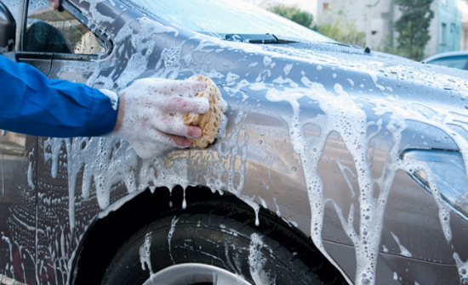

Soapy Rides
Income
Statement
July 2018
Understanding Basic Financials Workshop

Slide 39
Understanding Basic Financials Workshop
Soapy Rides
Balance
Sheet
July 31, 2018

Slide 40
Understanding Basic Financials Workshop
Soapy Rides
Cash Flow
Report
October 2018

Slide 41

Business/LLC Registration
South Carolina
  SC Business One Stop Guide to Starting Your Business
  https://www.scbos.sc.gov/Business-Resources
  Register a Business Name, LLC, or Non-Profit
  http://www.sos.sc.gov/Name
  Public Charities Information
  http://www.sos.sc.gov/Public_Charities
Georgia
  Reserve a Business Name
  https://georgia.gov/blog/2015-11-05/reserving-your-businesss-name
  Georgia Licenses, Permits, and Registration
  http://www.sba.com/georgia/licenses-permits/
  What is an LLC?
  https://georgia.gov/blog/2014-06-12/what-llc
  Starting a Non-Profit Organization in Georgia
  http://www.pbpatl.org/wp-content/uploads/2011/12/gcn_starting_a_nonprofit1.pdf
General Non-Profit
  Starting a Non-Profit Organization
  https://www.usa.gov/start-nonprofit
  https://www.councilofnonprofits.org/tools-resources/how-start-nonprofit
Other
DUNS
  http://www.dnb.com
NAICS
  http://www.naics.com

Slide 42


How We Can Help!
Websites
  GreaterAiken.SCORE.org
  BizPlans.com
Mentoring sessions
Local Workshops
  How to Write a Business Plan
  Creating a Website
SCORE Webinars
  GreaterAiken.SCORE.org
Business Brochures

Slide 43

Thank You ... and Good Luck!

