Slide 1

Portland Public Library
Business Data Resources
Business & Government Librarian – Team Leader:
Williams Bandoma
bandoma@portlib.org
Adapted from Portland Public Library presentations by librarian Sonya Durney

Slide 2
Why do you need business data?
Business data encompasses all information you have to gather in relation to your business, from legal research, to demographics, to industry trends.
Gathering this information is the one of the first steps to creating an effective business plan and discovering potential advantages or pitfalls about your idea that had not occurred to you.
This guide will help you navigate business data and the resources available to you at your local library!

Slide 3

What might I need to research when starting a business?
Trends in your industry
Demographics of your potential customers
Potential market size
Your competition
What rules and regulations govern your industry (licenses, insurance, etc.)
How to raise capital
Trade associations related to your industry

Slide 4

What are the resources available to me at Portland Public Library?
PPL has a Business page that compiles its resources on Census Data, Law, Financial Literacy, the GALE Small Business Resource Center and more: https://www.portlandlibrary.com/topics/business/
Remember that you will need a library card to access some of the materials like the Small Business Resource Center
PPL and SCORE offer a free monthly workshop on Business Data at PPL. Check out www.portlandme.score.org for the latest details.

Slide 5
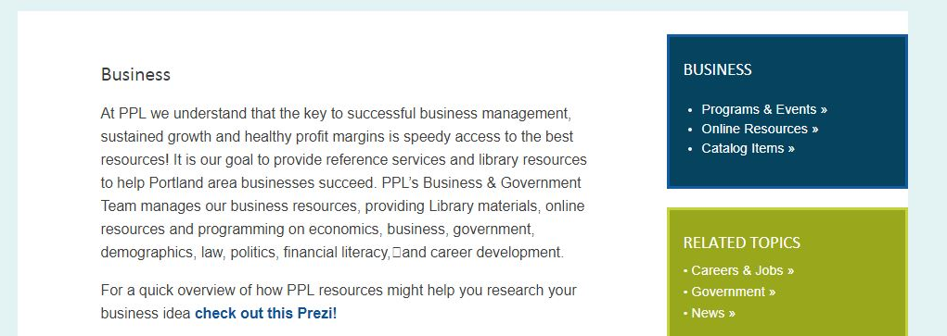
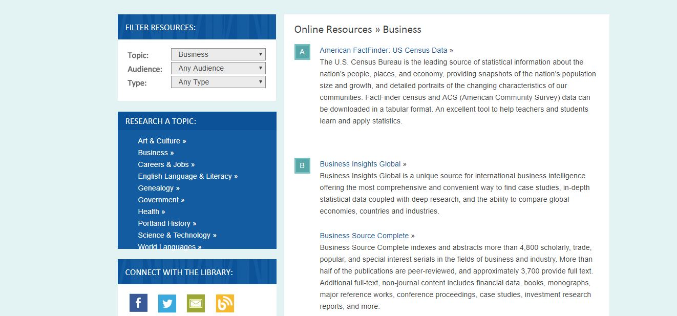
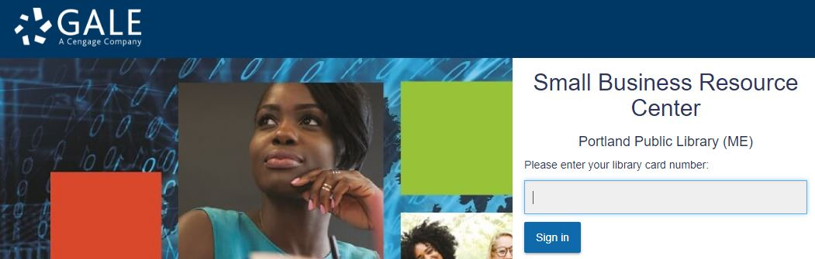
Start at PPL’s Business Gateway
Click Online Resources
You will find a list of links to the databases describe in this guide
These will ask for your library card bar code, so have it handy!

Slide 6
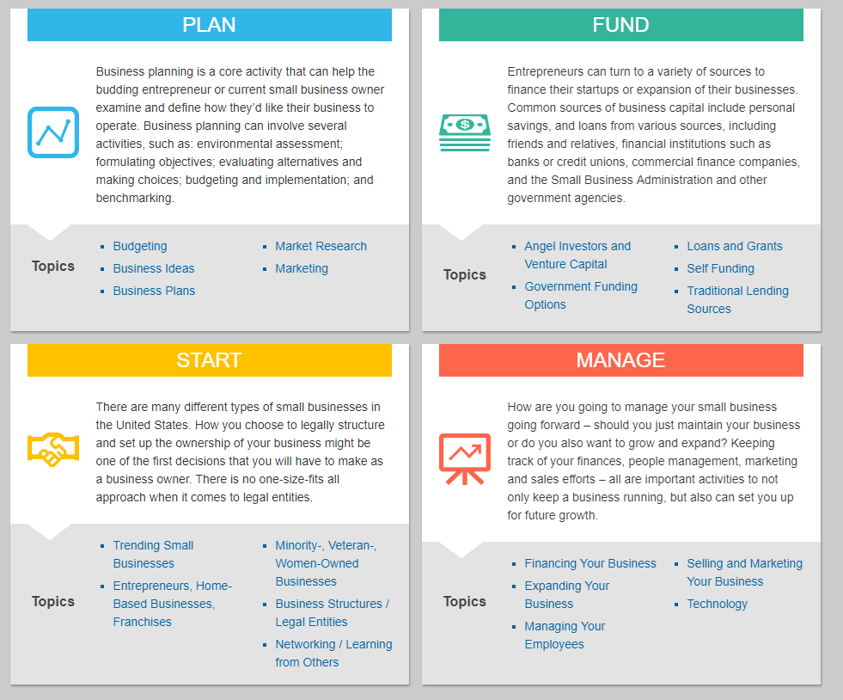

The Small Business Resource Center
Find and download sample business plans (and so much more)!
You can search for information based on business topic and business type.
You also have access to legal forms and templates.

Slide 7
Business Source Complete
It’s like Google for business!
Business Source Complete Indexes and abstracts of more than 4,800 scholarly, trade, and popular publications in the fields of business and industry.
Additional full-text, non-journal content includes: financial data, books, major reference works, conference proceedings, case studies, investment research reports, country reports, company profiles, SWOT analyses, faculty seminars, and more!
Updated daily.
Note: This resource is a robust search engine that finds information using a number of filters and fields. Don’t get overwhelmed and remember that you can search for something as broad or as specific as you would like!

Slide 8
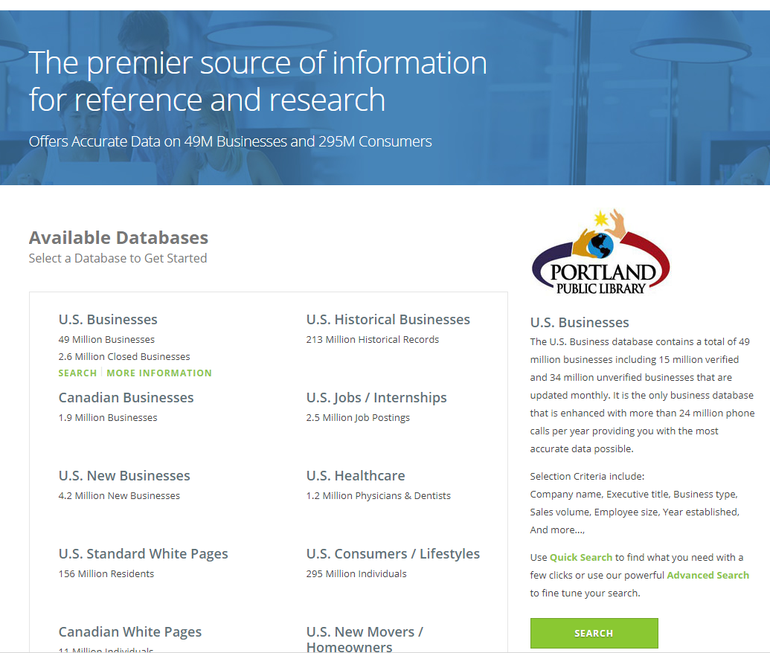

referenceUSA
Directory information for 14 million businesses or 89 million residents across the country. Narrow your search by criteria such as number of employees, location, NAICS/SIC (by keyword), and sales.

Slide 9

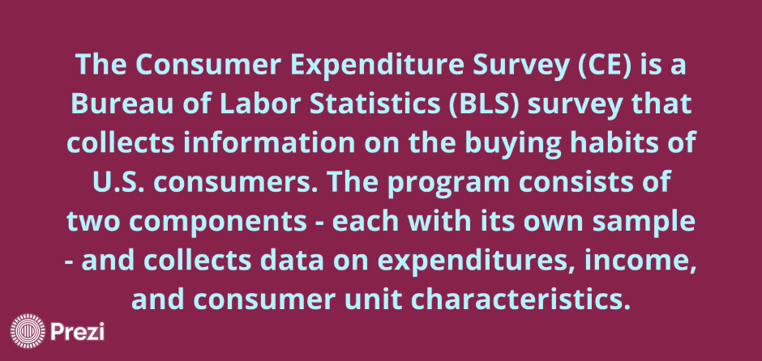
DemographicsNow
Access demographic reports on any geography and find useful numbers based on business type (when available) from the Customer Expenditure Survey.
Source: PPL Prezi

Slide 10
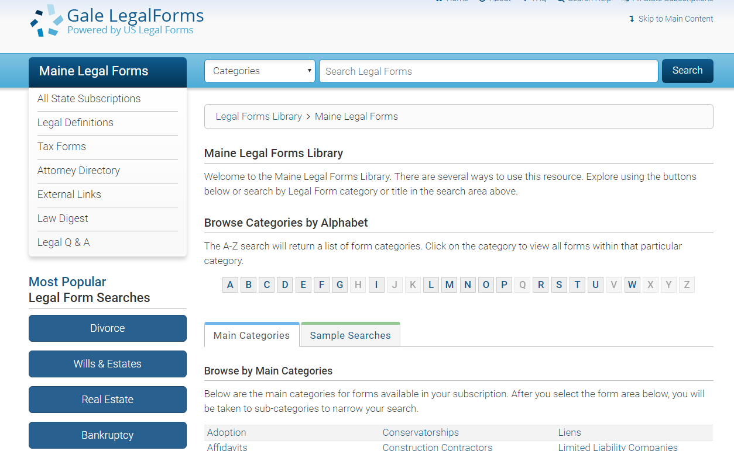
Gale LegalForms
Forms available on Gale Legal forms include forms drafted by an attorney for a particular legal matter, forms from public records and participating companies and attorneys. “Official” forms for many states are included.
Access these at the top of the Small Business Resource Center Page.

